Slide 1
Familiarisation and planning
240872
Australian Curriculum v9.0: Science — Years 7–10
Notes:
This presentation is designed to introduce curriculum leaders and teachers to the Australian Curriculum Version 9.0: Science — Years 7‒10.

Slide 2
Acknowledgment of Country
Notes:
Acknowledgment of Country
The QCAA acknowledges the Traditional Owners and Traditional Custodians of the lands on which we meet today.
We pay our respects to their Elders and their descendants, who continue cultural and spiritual connections to Country, and we extend that respect to Aboriginal people and Torres Strait Islander people here today.
We thank them for sharing their cultures and spiritualities and recognise the important contribution of this knowledge to our understanding of this place we call home.

Slide 3
Learning goal
Understand the implications of changes in the Years 7–10 Australian Curriculum from v8.4 to v9.0: Science for planning.
Success criteria
You will know you are successful if you:
have more knowledge about the intent and structure of the Years 7–10 Australian Curriculum v9.0: Science
can identify actions for planning in your school.

Slide 4
Outline
Introduction to Australian Curriculum v9.0: Science
Understand this learning area
Formulating next steps
Curriculum elements

Slide 5
Outline
Introduction to Australian Curriculum v9.0: Science
Understand this learning area
Formulating next steps
Curriculum elements

Slide 6
The three-dimensional Australian Curriculum
Source: ACARA, www.v9.australiancurriculum.edu.au/help/website-tour
Notes:
In the Australian Curriculum Version 9.0, the three-dimensional interrelated structure has not changed as part of the review. The diagram visually represents these three dimensions.
Source: Script and picture adapted (addition of labels) from video at www.v9.australiancurriculum.edu.au/help/website-tour (time stamp 50 seconds).

Slide 7
Science in the three-dimensional Australian Curriculum
Source: ACARA, www.v9.australiancurriculum.edu.au/help/website-tour
Notes:
The Australian Curriculum consists of eight learning areas. Science is indicated in light green.
Source: Script and picture adapted (addition of labels) from video at https://v9.australiancurriculum.edu.au/help/website-tour (time stamp 50 seconds).

Slide 8
The three-dimensional Australian Curriculum
Source: ACARA, www.v9.australiancurriculum.edu.au/help/website-tour
Notes:
There are seven general capabilities:
Literacy
Numeracy
Digital literacy
Critical and creative thinking
Personal and social capability
Intercultural understanding, and
Ethical understanding.
As part of the review, the general capabilities have been refined.
The Information, Communications and Technologies (ICT) general capability in v8.4 has been renamed Digital literacy in v9.0 to reflect current understandings in the field.
The Literacy and Numeracy general capabilities are no longer continua. In v9.0 they are progressions representing the fine-grained indicators of the typical trajectory of literacy and numeracy development.
The remaining general capabilities have had refinements to elements, sub-elements and continua.
Source: Script and picture adapted (addition of labels) from video at https://v9.australiancurriculum.edu.au/help/website-tour (time stamp 50 seconds).

Slide 9
The three-dimensional Australian Curriculum
Source: ACARA, www.v9.australiancurriculum.edu.au/help/website-tour
Notes:
There are three cross-curriculum priorities:
Aboriginal and Torres Strait Islander Histories and Cultures
Asia and Australia’s engagement with Asia, and
Sustainability.
Source: Script and picture adapted (addition of labels) from video at https://v9.australiancurriculum.edu.au/help/website-tour (time stamp 50 seconds).

Slide 10
Organisation of Science and changes
Version 8.4
Version 9.0
Understand how the learning area works
Rationale
Aims
Key ideas
Structure
Resources (learning area specific)
Understand this learning area
Introduction
Rationale
Aims
Structure
Key considerations
Key connections
Resources
Learning area curriculum
Year level description
Achievement standard
Strands and sub-strands
Content descriptions
Threads (learning area specific)
Content elaborations
Curriculum elements
Level description
Achievement standard
Strands and sub-strands
Content descriptions
Content elaborations
Notes:
This is an overview of the organisation of the Australian Curriculum Version 8.4: Science compared with Version 9.0, with the main changes noted.
Source: Image created in house using SmartArt. Adapted from https://v9.australiancurriculum.edu.au/teacher-resources/understand-this-learning-area/science.

Slide 11
Organisation of Science and changes
Version 8.4
Version 9.0
Understand how the learning area works
Rationale
Aims
Key ideas
Structure
Resources (learning area specific)
Understand this learning area
Introduction
Rationale
Aims
Structure
Key considerations
Key connections
Resources
Learning area curriculum
Year level description
Achievement standard
Strands and sub-strands
Content descriptions
Threads (learning area specific)
Content elaborations
Curriculum elements
Level description
Achievement standard
Strands and sub-strands
Content descriptions
Content elaborations
Notes:
The organisation of the Australian Curriculum in Version 8.4 (represented on the left) is in two parts:
Understand how the learning area works, which includes the rationale, aims, key ideas, structure and resources
Learning area curriculum including the year level description, the achievement standard, strands and sub-strands, content descriptions, threads and content elaborations.
Source: Image created in house using SmartArt. Adapted from https://v9.australiancurriculum.edu.au/teacher-resources/understand-this-learning-area/science.

Slide 12
Organisation of Science and changes
Version 8.4
Version 9.0
Understand how the learning area works
Rationale
Aims
Key ideas
Structure
Resources (learning area specific)
Understand this learning area
Introduction
Rationale
Aims
Structure
Key considerations
Key connections
Resources
Learning area curriculum
Year level description
Achievement standard
Strands and sub-strands
Content descriptions
Threads (learning area specific)
Content elaborations
Curriculum elements
Level description
Achievement standard
Strands and sub-strands
Content descriptions
Content elaborations
Notes:
The Version 9.0 learning area structure helps us organise the teaching and assessment for Science.
It is organised into two sections:
Understand this learning area and,
Curriculum elements.
The Understand this learning area section provides detail of the intent of the Australian Curriculum v9.0: Science and a snapshot of the structure. In green are two new sections: key considerations and key connections.
The Curriculum elements section shows the elements associated with Science.
Source: Image created in house using SmartArt. Adapted from https://v9.australiancurriculum.edu.au/teacher-resources/understand-this-learning-area/science.

Slide 13
Outline
Introduction to Australian Curriculum v9.0
Understand this learning area
Formulating next steps
Curriculum elements

Slide 14
Organisation of Science
Version 9.0
Understand this learning area
Introduction
Rationale
Aims
Structure
Key considerations
Key connections
Resources
Introduction
Rationale
Aims
Curriculum elements
Level description
Achievement standard
Strands and sub-strands
Content descriptions
Content elaborations
Notes:
In Science, the introduction in Version 9.0 is one sentence: ‘The Australian Curriculum: Science has been developed on the basis that all students will study Science from Foundation to Year 10.’ (ACARA, 2022, https://v9.australiancurriculum.edu.au/teacher-resources/understand-this-learning-area/science)
The rationale and aims capture the intent of teaching Science and inform teachers’ planning in a school context.
Source: Image created in house using SmartArt. Adapted from https://v9.australiancurriculum.edu.au/teacher-resources/understand-this-learning-area/science.

Slide 15
Organisation of Science
Version 9.0
Understand this learning area
Introduction
Rationale
Aims
Structure
Key considerations
Key connections
Resources
Structure
Curriculum elements
Level description
Achievement standard
Strands and sub-strands
Content descriptions
Content elaborations
Notes:
Exploring the structure provides a way for teachers to conceptualise the Australian Curriculum Science.
Source: Image created in house using SmartArt. Adapted from https://v9.australiancurriculum.edu.au/teacher-resources/understand-this-learning-area/science

Slide 16
Structure of Science: Strands and sub-strands
Version 9.0 |  | (Header row)
Science understanding | Science as a human endeavour | Science inquiry skills
Biological sciences Earth and space sciences Physical sciences Chemical sciences | Nature and development of science Use and influence of science | Questioning and predicting Planning and conducting Processing and analysing data and information Processing, modelling and analysing Evaluating Communicating
Notes:
The three strands have remained, but the third strand’s name has changed from Science inquiry skills to Science inquiry. This change is in response to the contemporary work of scientists whose practices include both skills and cognitive dimensions such as modelling and argumentation. Modifying the name also draws attention to the changes in the inquiry content that emphasises evaluation and communication. There is value in our students becoming critical communicators. The more sophisticated communicators of science our students become, the more likely they are to transfer those skills to critically consume science communication from others.
In Science, the sub-strand organisation has remained with one modification. Processing, modelling and analysing has been named to reflect the contemporary use of models to explore and explain phenomena. This new focus opens opportunities for students to use and create models but also to consider the strengths and limitations of using models to explain phenomena.
Source: Adapted from https://v9.australiancurriculum.edu.au/teacher-resources/understand-this-learning-area/science.

Slide 17
Example of strand integration in Year 7
Version 9.0 |  | (Header row)
Science understanding | Science as a human endeavour | Science inquiry
Students represent the flow of matter and energy in ecosystems and predict the effects of environmental changes. | Students consider the role of science in informing environmental policy and regulations. | Students refine their skills of data collection, representation and analysis.
Notes:
In addition, the Australian Curriculum continues to position the strands and sub-strands as being interrelated and the information about the sub-strands found in the Understand this learning area section supports integration of the strands. The Version 9 Science curriculum states that the strands should be taught in an integrated way, and, in each year level, integration is possible.
On screen is an example of integration of the strands in Year 7.
The table shows how a unit of work might incorporate content from each strand. When we consider the rationale, aims and global education goals, it is clear how important science is in developing creative and confident members of society who can make informed decisions. In this proposed unit, the Science as a human endeavour content description allows students to see the role of science in informing environmental policy. The new focus of Science as a human endeavour positions students as active participants in science and can strengthen their confidence to be active members of society.
Source: Adapted from https://v9.australiancurriculum.edu.au/teacher-resources/understand-this-learning-area/science.

Slide 18
Organisation of Science
Version 9.0
Understand this learning area
Introduction
Rationale
Aims
Structure
Key considerations
Key connections
Resources
Key considerations
Key connections
Resources
Curriculum elements
Level description
Achievement standard
Strands and sub-strands
Content descriptions
Content elaborations
Notes:
The final section of Understand this learning area includes the key considerations, key connections and resources that provide further support and advice for teachers when planning for Version 9.0 in Science.
Source: Image created in house using SmartArt. Adapted from https://v9.australiancurriculum.edu.au/teacher-resources/understand-this-learning-area/science.

Slide 19
Key considerations
Safety
Animal ethics and biosecurity
Protocols for engaging First Nations Australians
Meeting the needs of diverse learners
Notes:
The key considerations is a new section in v9.0 consistent across all learning areas and includes the refined key ideas from v8.4. It helps teachers to think about teaching and learning specific to Science.
In green are the two Science specific considerations. They remind teachers of the considerations to manage risk and contain references to state and federal regulations for safety, animal ethics and biosecurity.
There are two new considerations in all learning areas which are Protocols for engaging First Nations Australians and Meeting the needs of diverse learners.
Source: Image created in house using SmartArt based on https://v9.australiancurriculum.edu.au/teacher-resources/understand-this-learning-area/science.

Slide 20
Key connections
Learning areas
General capabilities
Cross-curriculum priorities
Source: ACARA, www.v9.australiancurriculum.edu.au/help/website-tour
Notes:
The key connections in the curriculum support teachers to integrate Science with other learning areas, embed relevant general capabilities and provide possible contexts for learning through the cross-curriculum priorities.
This integration can enrich and deepen student engagement with learning area content.
These connections should only be considered when they provide appropriate and authentic opportunities to strengthen learning area content.

Slide 21
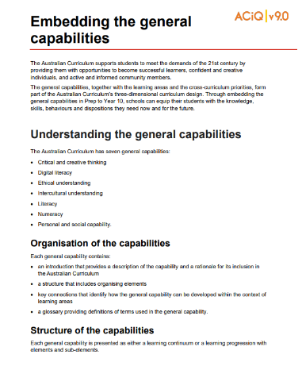
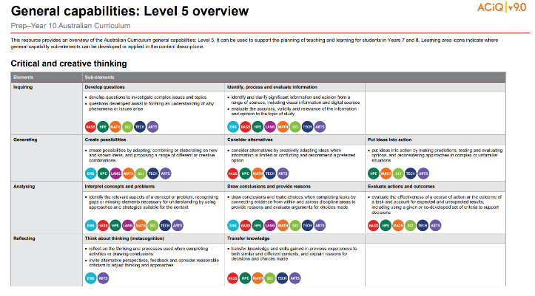
General capabilities advice and resources
www.qcaa.qld.edu.au/p-10/aciq/version-9/cross-curriculum-priorities
Notes:
The QCAA has resources that identify the connections the Australian Curriculum has made between learning areas and the general capabilities.
The general capability level overviews provide an overview of where each general capability can be developed or applied in the content descriptions of the learning areas. For example, the general capability Level 5 and Level 6 align with Years 7–10 learning areas.
The continua resources are available for the general capabilities:
critical and creative thinking
digital literacy
ethical understanding
intercultural understanding and,
personal and social capability.
There are resources available that provide a sequence of learning for the capability from Level 1 to Level 6. This can be helpful for teachers when catering for students with diverse needs.
The QCAA has advice documents to support teachers to use the Literacy and Numeracy progressions. These progressions provide observable indicators of increasing complexity in literacy and numeracy which can help teachers to develop targeted teaching and learning programs for students who are working at, above, and below year-level expectations.
These resources can support teaching teams to interrogate connections between the general capabilities and the learning area content in more detail.

Slide 22
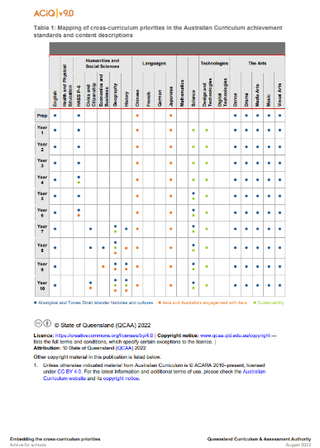
Cross-curriculum priorities advice and resources
www.qcaa.qld.edu.au/p-10/aciq/version-9/cross-curriculum-priorities
Notes:
The QCAA has resources to support schools with understanding how to connect the curriculum with cross-curriculum priorities.
Cross-curriculum priorities are incorporated through learning area content, in ways that are appropriate and authentic. The resources provide an overview of, as well as mapping across learning area and/or subject content descriptions and achievement standards to identify connections to each of the cross-curriculum priorities. ​

Slide 23
Outline
Introduction to Australian Curriculum v9.0
Understand this learning area
Formulating next steps
Curriculum elements

Slide 24
Organisation of Science
Version 9.0
Understand this learning area
Introduction
Rationale
Aims
Structure
Key considerations
Key connections
Resources
Curriculum elements
Level description
Achievement standard
Strands and sub-strands
Content descriptions
Content elaborations
Level description
Achievement standard
Notes:
The Science level description in the Curriculum elements section provides a high-level overview of the learning students should experience each year.
In Queensland, the achievement standard represents the C standard (or equivalent).
Source: Image created in house using SmartArt. Adapted from https://v9.australiancurriculum.edu.au/teacher-resources/understand-this-learning-area/science.

Slide 25
Science: Achievement standard structure
By the end of Year 9 students explain how body systems provide a coordinated response to stimuli. They describe how the processes of sexual and asexual reproduction enable survival of the species. They explain how interactions within and between Earth’s spheres affect the carbon cycle. They analyse energy conservation in simple systems and apply wave and particle models to describe energy transfer. They explain observable chemical processes in terms of changes in atomic structure, atomic rearrangement and mass. Students explain the role of publication and peer review in the development of scientific knowledge and explain the relationship between science, technologies and engineering. They analyse the different ways in which science and society are interconnected.
Students plan and conduct safe, reproducible investigations to test or identify relationships and models. They describe how they have addressed any ethical and intercultural considerations when generating or using primary and secondary data. They select and use equipment to generate and record replicable data with precision. They select and construct appropriate representations to organise, process and summarise data and information. They analyse and connect data and information to identify and explain patterns, trends, relationships and anomalies. They analyse the impact of assumptions and sources of error in methods and evaluate the validity of conclusions and claims. They construct logical arguments based on evidence to support conclusions and evaluate claims. They select and use content, language and text features effectively to achieve their purpose when communicating their ideas, findings and arguments to specific audiences.
Science Understanding (SU)
Science as a Human Endeavour (SHE)
Science Inquiry (SI)
Source: Quoted verbatim and unaltered from AC https://v9.australiancurriculum.edu.au/f-10-curriculum/learning-areas/science/year-9?view=quick&detailed-content-descriptions=0&hide-ccp=0&hide-gc=0&side-by-side=1&strands-start-index=0
Notes:
Organisation of the achievement standard in Version 9.0 has not changed, retaining the familiar two-paragraph structure:
a paragraph aligned with the strands Science understanding and Science as a human endeavour
and a second paragraph aligned with Science Inquiry.

Slide 26
Science: Achievement standard structure
By the end of Year 9 students explain how body systems provide a coordinated response to stimuli. They describe how the processes of sexual and asexual reproduction enable survival of the species. They explain how interactions within and between Earth’s spheres affect the carbon cycle. They analyse energy conservation in simple systems and apply wave and particle models to describe energy transfer. They explain observable chemical processes in terms of changes in atomic structure, atomic rearrangement and mass. Students explain the role of publication and peer review in the development of scientific knowledge and explain the relationship between science, technologies and engineering. They analyse the different ways in which science and society are interconnected.
Students plan and conduct safe, reproducible investigations to test or identify relationships and models. They describe how they have addressed any ethical and intercultural considerations when generating or using primary and secondary data. They select and use equipment to generate and record replicable data with precision. They select and construct appropriate representations to organise, process and summarise data and information. They analyse and connect data and information to identify and explain patterns, trends, relationships and anomalies. They analyse the impact of assumptions and sources of error in methods and evaluate the validity of conclusions and claims. They construct logical arguments based on evidence to support conclusions and evaluate claims. They select and use content, language and text features effectively to achieve their purpose when communicating their ideas, findings and arguments to specific audiences.
SU and SHE
SI
Source: Quoted verbatim and unaltered from AC https://v9.australiancurriculum.edu.au/f-10-curriculum/learning-areas/science/year-9?view=quick&detailed-content-descriptions=0&hide-ccp=0&hide-gc=0&side-by-side=1&strands-start-index=0
Notes:
In Version 9.0, the organisation of the achievement standard is also consistent across year levels. The first sentence of the achievement standard refers to biological science content, followed by Earth and space science content and so on through the sub-strands.
This consistency across year levels supports teachers who may be planning for students who are working at a different year level than their peers or for teachers planning for multi-age classes.

Slide 27
Science: Achievement standard structure
By the end of Year 9 students explain how body systems provide a coordinated response to stimuli. They describe how the processes of sexual and asexual reproduction enable survival of the species. They explain how interactions within and between Earth’s spheres affect the carbon cycle. They analyse energy conservation in simple systems and apply wave and particle models to describe energy transfer. They explain observable chemical processes in terms of changes in atomic structure, atomic rearrangement and mass. Students explain the role of publication and peer review in the development of scientific knowledge and explain the relationship between science, technologies and engineering. They analyse the different ways in which science and society are interconnected.
Students plan and conduct safe, reproducible investigations to test or identify relationships and models. They describe how they have addressed any ethical and intercultural considerations when generating or using primary and secondary data. They select and use equipment to generate and record replicable data with precision. They select and construct appropriate representations to organise, process and summarise data and information. They analyse and connect data and information to identify and explain patterns, trends, relationships and anomalies. They analyse the impact of assumptions and sources of error in methods and evaluate the validity of conclusions and claims. They construct logical arguments based on evidence to support conclusions and evaluate claims. They select and use content, language and text features effectively to achieve their purpose when communicating their ideas, findings and arguments to specific audiences.
compare the role of body systems in regulating and coordinating the body’s response to a stimulus, and describe the operation of a negative feedback mechanism AC9S9U01
Source: Quoted verbatim and unaltered from AC https://v9.australiancurriculum.edu.au/f-10-curriculum/learning-areas/science/year-9?view=quick&detailed-content-descriptions=0&hide-ccp=0&hide-gc=0&side-by-side=1&strands-start-index=0
Notes:
Additionally, the alignment of the achievement standard with content descriptions is clearer and more consistent in Version 9.0.
On screen in the callout box is the first Year 9 content description for biological sciences which aligns with the first sentence of the achievement standard.

Slide 28
Achievement standard comparison: Year 9
v8.4 | v9.0
Students design questions that can be investigated using a range of inquiry skills. They design methods that include the control and accurate measurement of variables and systematic collection of data and describe how they considered ethics and safety. They analyse trends in data, identify relationships between variables and reveal inconsistencies in results. They analyse their methods and the quality of their data, and explain specific actions to improve the quality of their evidence. They evaluate others' methods and explanations from a scientific perspective and use appropriate language and representations when communicating their findings and ideas to specific audiences. | Students plan and conduct safe, reproducible investigations to test or identify relationships and models. They describe how they have addressed any ethical and intercultural considerations when generating or using primary and secondary data. They select and use equipment to generate and record replicable data with precision. They select and construct appropriate representations to organise, process and summarise data and information. They analyse and connect data and information to identify and explain patterns, trends, relationships and anomalies. They analyse the impact of assumptions and sources of error in methods and evaluate the validity of conclusions and claims. They construct logical arguments based on evidence to support conclusions and evaluate claims. They select and use content, language and text features effectively to achieve their purpose when communicating their ideas, findings and arguments to specific audiences.
They evaluate others' methods and explanations from a scientific perspective and use appropriate language and representations when communicating their findings and ideas to specific audiences.
They select and use content, language and text features effectively to achieve their purpose when communicating their ideas, findings and arguments to specific audiences.
Notes:
In Version 9.0, in the Science inquiry paragraph of the achievement standard, extra detail is provided about expectations of students when providing evidence of communicating.
Inclusion of this content aligns with the Science achievement standard, which includes language such as ‘use content, language and text features’.

Slide 29
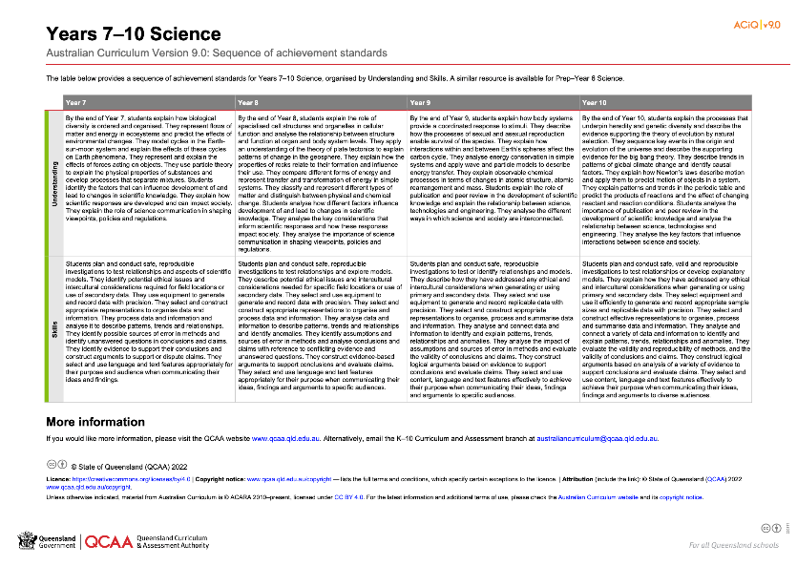
Science: Achievement standard structure
www.qcaa.qld.edu.au/downloads/aciqv9/science/curriculum/ac9_science_yr7-10_as_sequence.pdf
Notes:
On the QCAA website, there is a resource illustrating the sequence of achievement standards from Years 7–10. There is a similar resource for Prep–Year 6.

Slide 30
Organisation of Science
Version 9.0
Understand this learning area
Introduction
Rationale
Aims
Structure
Key considerations
Key connections
Resources
Curriculum elements
Level description
Achievement standard
Strands and sub-strands
Content descriptions
Content elaborations
Strands and sub-strands
Content descriptions
Content elaborations
Notes:
The final section of Curriculum elements provides further information regarding the content descriptions in the strands and sub-strands, which inform teaching and learning and assessment.
Content descriptions specify the knowledge, understanding and skills that students learn and that teachers are expected to teach. The content elaborations provide optional examples of how to teach the content descriptions.
Source: Image created in house using SmartArt. Adapted from https://v9.australiancurriculum.edu.au/teacher-resources/understand-this-learning-area/science.

Slide 31
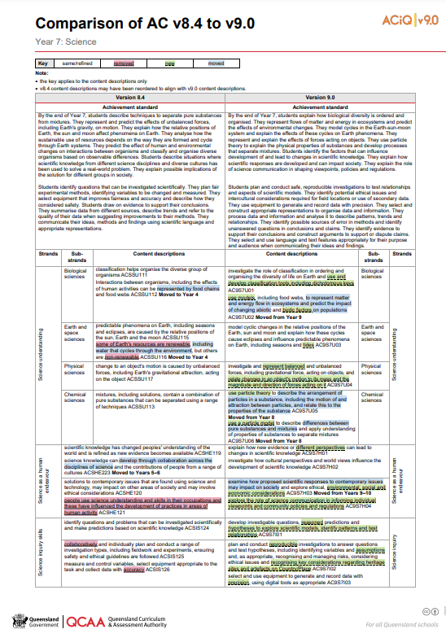
Comparison of AC v8.4 to v9.0 documents
One document for each year level is available on the QCAA website.
https://www.qcaa.qld.edu.au/downloads/aciqv9/science/curriculum/ac9_science_yr7_comp.pdf
Notes:
The comparison documents show the changes to the content descriptions for Science.

Slide 32
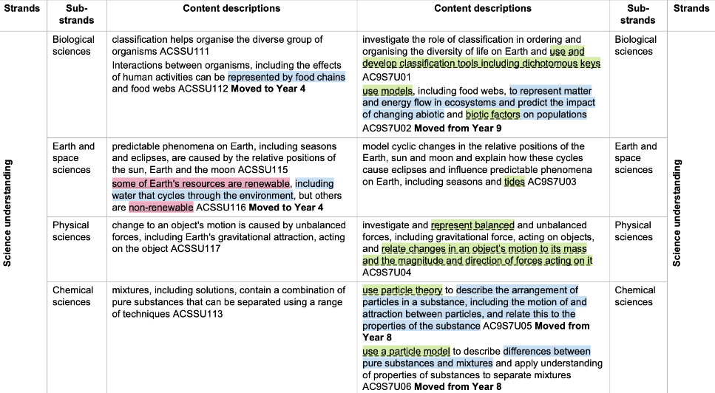
Changes in content descriptions
Notes:
A key is used to show the changes from Version 8.4 to Version 9.0.
Examples from the Years 7–10 Science curriculum will be used to show the changes.

Slide 33
Same/refined content
Notes:
If something has been refined from Version 8.4, it does not appear in colour.
In this example from Year 8, the wording has changed; however, the essence of the content which informs your planning has remained.

Slide 34
Same/refined content
Notes:
Notice that verbs are now included in Science understanding and Science as a human endeavour content descriptions. For example, in version 8.4 there is a statement of fact about energy whereas in Version 9.0 students will engage in classifying and investigating different types of energy. This invites active participation from students in their learning and informs planning, teaching and learning.

Slide 35
Removed content
Notes:
If a content description or part of a content description has been removed from Version 8.4 and no longer appears in Version 9.0, it has been highlighted in red.
For example, content referring to science careers in Year 8 has been removed.
This reflects the change in focus in Science as a human endeavour to students perceiving themselves as active participants in science inquiry, active users of science knowledge and as being impacted by science knowledge every day.

Slide 36
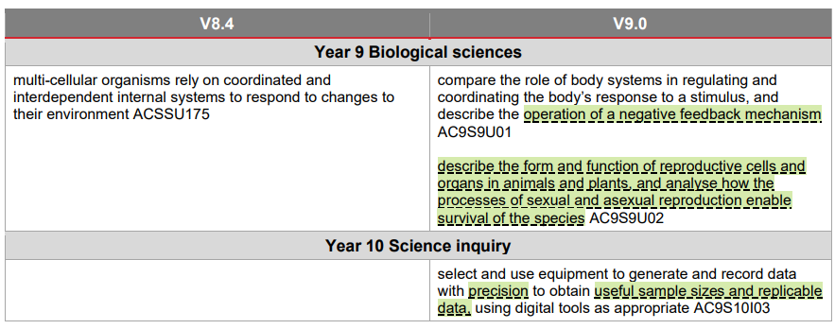
New content
Notes:
If a new content description has been added to Version 9.0, it has been highlighted in green.
For example, in Year 9, detail about the negative feedback mechanism has been added.
In addition, while most science teachers would have focussed on reproductive biology when looking at adaptations in Year 8 in version 8.4, the addition of this explicit content description is new and now in Year 9.
In Year 10, new language around generating and recording data will require planning for the development of these skills.
These additions help reinforce the link between the Australian Curriculum and the senior syllabuses.

Slide 37
Moved content
Notes:
If a content description has moved year levels from Version 8.4 to Version 9.0, it has been highlighted in blue. There is also a bold note to indicate the year level to which it has moved.
For example, content about water cycles has moved from Year 7 to Year 4, and the expectation of what students need to know is clarified.

Slide 38
Considerations for implementation
Notes:
In the first year of implementation, content movement will mean that some students will be impacted by where the content has moved to.
Think of this as the gaps caused by content being moved to a lower year level or the overlaps caused by content being moved to the next year level.
Gaps and overlaps will appear during the transition from v8.4 to v9.0.
The snip on screen shows the final section of the resource comparing v8.4 and v9.0. This section will help you plan for possible gaps in student learning during the first year of implementation.

Slide 39
Outline
Introduction to Australian Curriculum v9.0
Understand this learning area
Formulating next steps
Curriculum elements

Slide 40
Australian Curriculum in Queensland (ACiQ) v9.0 webpages
QCAA website www.qcaa.qld.edu.au/p-10/aciq
Notes:
Resources to support the Australian Curriculum Version 9.0 can be found within the Australian Curriculum in Queensland Version 9.0 webpages.
These webpages only include resources that have been created or updated to align with Version 9.0.
Source: Screenshot from QCAA website www.qcaa.qld.edu.au/p-10/aciq.

Slide 41
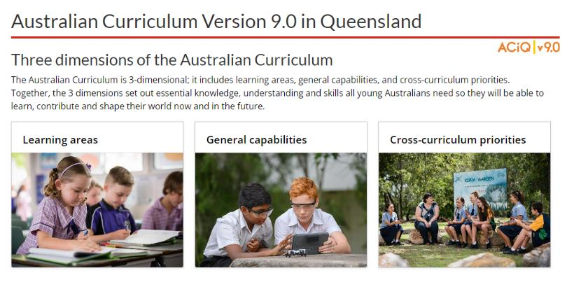
The ACiQ v9.0 webpages
These webpages house advice and resources to support the three dimensions of the Australian Curriculum:
Learning areas
General capabilities
Cross-curriculum priorities.
Notes:
The Version 9.0 webpages support familiarisation with all three dimensions of the curriculum.
Teachers can access advice and resources for their learning area and/or subject, or the general capabilities, and the cross-curriculum priorities.
Source: Screenshot from QCAA website www.qcaa.qld.edu.au/p-10/aciq/version-9.

Slide 42
Examples of QCAA Resources
Comparison of AC v8.4 to v9.0 (P–10)
Sequence of achievement standards
Sequence of content descriptions
Achievement standard aligned to content descriptions (P–10)
Prepopulated curriculum and assessment plans
Assessment techniques and conditions (P–10)
Standards elaborations
QCAA P–10 Planning app
Notes:
On screen is a snapshot of some of the Science resources. These resources have been hyperlinked in the slide.

Slide 43
Learning goal
Understand the implications of changes in the Years 7–10 Australian Curriculum from v8.4 to v9.0: Science for planning.
Success criteria
You will know you are successful if you:
have more knowledge about the intent and structure of the Years 7–10 Australian Curriculum v9.0: Science
can identify actions for planning in your school.

Slide 44
Contact
K–10 Curriculum and Assessment Branch​ ​
T +61 7 3120 6102
E australiancurriculum@qcaa.qld.edu.au
W www.qcaa.qld.edu.au
Notes:
If you have any queries regarding Australian Curriculum v9.0: Science, please contact the K–10 Curriculum and Assessment Branch.
​

Slide 45
References
Australian Curriculum, Assessment and reporting Authority 2013, The Shape of the Australian Curriculum Version 4.0, www.docs.acara.edu.au/resources/The_Shape_of_the_Australian_Curriculum_v4.pdf.

Slide 46
Acknowledgments
Third-party copyright material, and QCAA material not covered by the CC BY licence is listed below:
Queensland Government coat of arms, and the QCAA and QSA trademarks may not be reproduced without permission.
Unless otherwise indicated, material from Australian Curriculum is © ACARA 2010–present, licensed CC BY 4.0. For the latest information and additional terms of use, see the Australian Curriculum website and its copyright notice.
Acknowledgment of Country artwork (2023) ‘Growth through Learning’ by Chern’ee, Brooke and Jesse Sutton, Kalkadoon. www.cherneesutton.com.au
Student and staff images have been used with permission.
The three-dimensional curriculum diagram and glossary are 'Excluded Material' used under the terms of the Australian Curriculum and its copyright notice and not modified. © Australian Curriculum, Assessment and Reporting Authority (ACARA) 2009 to present, unless otherwise indicated. You may view, download, display, print, reproduce (such as by making photocopies) and distribute these Excluded Materials in unaltered form only for your personal, non-commercial educational purposes or for the non-commercial educational purposes of your organisation, provided that you make others aware it can only be used for these purposes and attribute ACARA as the source of the Excluded Material. For the avoidance of doubt, this means that you cannot edit, modify or adapt any of these materials, and you cannot sub-licence any of these materials to others. Apart from any uses permitted under the Copyright Act 1968 (Cth), and those explicitly granted above, all other rights are reserved by ACARA. If you want to use such material in a manner

Slide 47
Copyright notice
© State of Queensland (QCAA) 2024
Licence: https://creativecommons.org/licenses/by/4.0 | Copyright notice: www.qcaa.qld.edu.au/copyright — lists the full terms and conditions, which specify certain exceptions to the licence. | Attribution: © State of Queensland (QCAA) 2024 www.qcaa.qld.edu.au/copyright.
Other copyright material in this presentation is listed on the previous slide/s.

Slide 48
QCAA social media
Notes:
If you don’t do so already, we recommend you follow QCAA on one or more social media platforms to stay in touch with us, and to find out about upcoming resources and professional learning.

