Slide 1
Familiarisation and planning
240872
Australian Curriculum v9.0: Mathematics — Years 7–10
Notes:
This presentation is designed to introduce curriculum leaders and teachers to the Australian Curriculum Version 9.0: Mathematics — Years 7‒10.

Slide 2
Acknowledgment of Country
Notes:
Acknowledgment of Country
The QCAA acknowledges the Traditional Owners and Traditional Custodians of the lands on which we meet today.
We pay our respects to their Elders and their descendants, who continue cultural and spiritual connections to Country, and we extend that respect to Aboriginal people and Torres Strait Islander people here today.
We thank them for sharing their cultures and spiritualities and recognise the important contribution of this knowledge to our understanding of this place we call home.

Slide 3
Learning goal
Understand the implications of changes in the Years 7–10 Australian Curriculum from v8.4 to v9.0: Mathematics for planning.
Success criteria
You will know you are successful if you:
have more knowledge about the intent and structure of the Years 7–10 Australian Curriculum v9.0: Mathematics
can identify actions for planning in your school.

Slide 4
Outline
Introduction to Australian Curriculum v9.0: Mathematics
Understand this learning area
Formulating next steps
Curriculum elements

Slide 5
Outline
Introduction to Australian Curriculum v9.0: Mathematics
Understand this learning area
Formulating next steps
Curriculum elements

Slide 6
Mathematics in the three-dimensional Australian Curriculum
Source: ACARA, www.v9.australiancurriculum.edu.au/help/website-tour
Notes:
In the Australian Curriculum Version 9.0, the three-dimensional interrelated structure has not changed as part of the review. The diagram visually represents these three dimensions.
Source: Script and picture adapted (addition of labels) from video at www.v9.australiancurriculum.edu.au/help/website-tour (time stamp 50 seconds).

Slide 7
Mathematics in the three-dimensional Australian Curriculum
Source: ACARA, www.v9.australiancurriculum.edu.au/help/website-tour
Notes:
The Australian Curriculum consists of eight learning areas. Mathematics is indicated in orange.
Source: Script and picture adapted (addition of labels) from video at www.//v9.australiancurriculum.edu.au/help/website-tour (time stamp 50 seconds).

Slide 8
Mathematics in the three-dimensional Australian Curriculum
Source: ACARA, www.//v9.australiancurriculum.edu.au/help/website-tour
Notes:
There are seven general capabilities:
Literacy
Numeracy
Digital literacy
Critical and creative thinking
Personal and social capability
Intercultural understanding, and
Ethical understanding.
As part of the review, the general capabilities have been refined.
The Information, Communications and Technologies (ICT) general capability in v8.4 has been renamed Digital literacy in v9.0 to reflect current understandings in the field.
The Literacy and Numeracy general capabilities are no longer continua. In v9.0 they are progressions representing the fine-grained indicators of the typical trajectory of literacy and numeracy development.
The remaining general capabilities have had refinements to elements, sub-elements and continua.
Source: Script and picture adapted (addition of labels) from video at www.v9.australiancurriculum.edu.au/help/website-tour (time stamp 50 seconds).

Slide 9
Mathematics in the three-dimensional Australian Curriculum
Source: ACARA, www.v9.australiancurriculum.edu.au/help/website-tour
Notes:
There are three cross-curriculum priorities:
Aboriginal and Torres Strait Islander Histories and Cultures
Asia and Australia’s engagement with Asia, and
Sustainability.
Source: Script and picture adapted (addition of labels) from video at www.//v9.australiancurriculum.edu.au/help/website-tour (time stamp 50 seconds).

Slide 10
Organisation of Mathematics and changes
Version 8.4
Version 9.0
Understand how the learning area works
Rationale
Aims
Key ideas
Structure
Resources (learning area specific)
Understand this learning area
Introduction
Rationale
Aims
Structure
Key considerations
Key connections
Resources
Learning area curriculum
Year level description
Achievement standard
Strands and sub-strands
Content descriptions
Threads (learning area specific)
Content elaborations
Curriculum elements
Level description
Achievement standard
Strands and sub-strands
Content descriptions
Content elaborations
Notes:
This is an overview of the organisation of the Australian Curriculum Version 8.4: Mathematics compared with Version 9.0, with the main changes noted.
Source: Image created in house using SmartArt. Adapted from https://v9.australiancurriculum.edu.au/teacher-resources/understand-this-learning-area/mathematics.

Slide 11
Organisation of Mathematics and changes
Version 8.4
Version 9.0
Understand how the learning area works
Rationale
Aims
Key ideas
Structure
Resources (learning area specific)
Understand this learning area
Introduction
Rationale
Aims
Structure
Key considerations
Key connections
Resources
Learning area curriculum
Year level description
Achievement standard
Strands and sub-strands
Content descriptions
Threads (learning area specific)
Content elaborations
Curriculum elements
Level description
Achievement standard
Strands and sub-strands
Content descriptions
Content elaborations
Notes:
The organisation of the Australian Curriculum in Version 8.4 (represented on the left) is in two parts:
Understand how the learning area works which includes the rationale, aims, key ideas, structure and resources
Learning area curriculum including the year level description, the achievement standard, strands and sub-strands, content descriptions, threads and content elaborations.
Source: Image created in house using SmartArt. Adapted from https://v9.australiancurriculum.edu.au/teacher-resources/understand-this-learning-area/mathematics.

Slide 12
Organisation of Mathematics and changes
Version 8.4
Version 9.0
Understand how the learning area works
Rationale
Aims
Key ideas
Structure
Resources (learning area specific)
Understand this learning area
Introduction
Rationale
Aims
Structure
Key considerations
Key connections
Resources
Learning area curriculum
Year level description
Achievement standard
Strands and sub-strands
Content descriptions
Threads (learning area specific)
Content elaborations
Curriculum elements
Level description
Achievement standard
Strands and sub-strands
Content descriptions
Content elaborations
Notes:
The Version 9.0 learning area structure helps teachers organise the teaching and assessment for Mathematics.
It is organised into two sections:
Understand this learning area and,
Curriculum elements.
The Understand this learning area section provides detail of the intent of the Australian Curriculum v9.0: Mathematics and a snapshot of the structure. In orange are two new sections: key considerations and key connections.
The Curriculum elements section shows the elements associated with Mathematics.
Source: Image created in house using SmartArt. Adapted from https://v9.australiancurriculum.edu.au/teacher-resources/understand-this-learning-area/mathematics.

Slide 13
Outline
Introduction to Australian Curriculum v9.0: Mathematics
Understand this learning area
Formulating next steps
Curriculum elements

Slide 14
Organisation of Mathematics
Version 9.0
Understand this learning area
Introduction
Rationale
Aims
Structure
Key considerations
Key connections
Resources
Introduction
Rationale
Aims
Curriculum elements
Level description
Achievement standard
Strands and sub-strands
Content descriptions
Content elaborations
Notes:
In Mathematics, the introduction in Version 9.0 is one sentence: ‘The Australian Curriculum: Mathematics has been developed on the basis that all students will study Mathematics in each year of schooling from Foundation to Year 10.’ (ACARA, 2022, https://v9.australiancurriculum.edu.au/teacher-resources/understand-this-learning-area/mathematics).
The rationale and aims capture the intent of teaching Mathematics and inform teachers’ planning in a school context.
Source: Image created in house using SmartArt. Adapted from https://v9.australiancurriculum.edu.au/teacher-resources/understand-this-learning-area/mathematics.

Slide 15
Organisation of Mathematics
Version 9.0
Understand this learning area
Introduction
Rationale
Aims
Structure
Key considerations
Key connections
Resources
Structure
Curriculum elements
Level description
Achievement standard
Strands and sub-strands
Content descriptions
Content elaborations
Notes:
Exploring the structure provides a way for teachers to conceptualise the Australian Curriculum: Mathematics.
Source: Image created in house using SmartArt. Adapted from https://v9.australiancurriculum.edu.au/teacher-resources/understand-this-learning-area/mathematics

Slide 16
Structure of Mathematics: Strands and sub-strands
Version 8.4 | Version 8.4
Proficiency strands: Understanding, fluency, problem-solving, reasoning
Number and algebra | Measurement and geometry | Statistics and probability
Number and place value | Using units of measurement | Chance
Fractions and decimals | Shape | Data representation and interpretation
Real numbers | Geometric reasoning
Money and financial mathematics | Location and transformation
Patterns and algebra | Trigonometry and Pythagoras
Linear and non-linear relationships
Notes:
On screen is the structure of Version 8.4.
Source: Adapted from https://v9.australiancurriculum.edu.au/teacher-resources/understand-this-learning-area/mathematics

Slide 17
Structure of Mathematics: Strands and sub-strands
Version 8.4 | Version 8.4
Proficiency strands: Understanding, fluency, problem-solving, reasoning
Number and algebra | Measurement and geometry | Statistics and probability
Number and place value | Using units of measurement | Chance
Fractions and decimals | Shape | Data representation and interpretation
Real numbers | Geometric reasoning
Money and financial mathematics | Location and transformation
Patterns and algebra | Trigonometry and Pythagoras
Linear and non-linear relationships
Notes:
In Version 8.4 of the Mathematics curriculum, the four proficiency strands of understanding, fluency, problem-solving and reasoning were used as the main organising structure. The proficiencies were signified by the verbs used throughout the curriculum and described the actions students engage in when learning and using the content. The proficiencies were the breadth and depth of mathematical action and were detailed in the year level descriptions.
Source: Adapted from https://v9.australiancurriculum.edu.au/teacher-resources/understand-this-learning-area/mathematics

Slide 18
Structure of Mathematics: Strands and sub-strands
Version 8.4 | Version 8.4
Proficiency strands: Understanding, fluency, problem-solving, reasoning
Number and algebra | Measurement and geometry | Statistics and probability
Number and place value | Using units of measurement | Chance
Fractions and decimals | Shape | Data representation and interpretation
Real numbers | Geometric reasoning
Money and financial mathematics | Location and transformation
Patterns and algebra | Trigonometry and Pythagoras
Linear and non-linear relationships
Notes:
Underneath the proficiency strands, were the content strands. The content was organised under three paired strands — Number and algebra; Measurement and geometry; Statistics and probability — and thirteen sub-strands.

Slide 19
Structure of Mathematics: Strands and sub-strands
Version 9.0 |  | Version 8.4
Proficiency strands: Understanding, fluency, problem-solving, reasoning
Number and algebra |  | Measurement and geometry |  | Statistics and probability
Number | Algebra | Measurement | Space | Statistics | Probability
Number and place value |  | Using units of measurement |  | Chance
Fractions and decimals |  | Shape |  | Data representation and interpretation
Real numbers |  | Geometric reasoning
Money and financial mathematics |  | Location and transformation
Patterns and algebra |  | Trigonometry and Pythagoras
Linear and non-linear relationships
Notes:
In Version 9.0, there have been several structural changes specifically to the Mathematical proficiencies and content strand organisation. The changes are indicated in grey with a strikethrough.
Source: Adapted from https://v9.australiancurriculum.edu.au/teacher-resources/understand-this-learning-area/mathematics.

Slide 20
Structure of Mathematics: Strands and sub-strands
Version 9.0 |  | Version 8.4
Proficiency strands: Understanding, fluency, problem-solving, reasoning
Number and algebra |  | Measurement and geometry |  | Statistics and probability
Number | Algebra | Measurement | Space | Statistics | Probability
Number and place value |  | Using units of measurement |  | Chance
Fractions and decimals |  | Shape |  | Data representation and interpretation
Real numbers |  | Geometric reasoning
Money and financial mathematics |  | Location and transformation
Patterns and algebra |  | Trigonometry and Pythagoras
Linear and non-linear relationships
Notes:
In Version 9.0, the proficiency strands of understanding, fluency, problem-solving and reasoning are now ‘key considerations’, which is a new addition to the curriculum (elaborated on later in the presentation).
However, the proficiencies are still signified by the verbs used throughout the curriculum and embedded within the content descriptions and achievement standards.
Source: Adapted from https://v9.australiancurriculum.edu.au/teacher-resources/understand-this-learning-area/mathematics.

Slide 21
Structure of Mathematics: Strands and sub-strands
Version 9.0 |  | Version 8.4
Proficiency strands: Understanding, fluency, problem-solving, reasoning
Number and algebra |  | Measurement and geometry |  | Statistics and probability
Number | Algebra | Measurement | Space | Statistics | Probability
Number and place value |  | Using units of measurement |  | Chance
Fractions and decimals |  | Shape |  | Data representation and interpretation
Real numbers |  | Geometric reasoning
Money and financial mathematics |  | Location and transformation
Patterns and algebra |  | Trigonometry and Pythagoras
Linear and non-linear relationships
Notes:
The content strands have all been separated so there are now six strands rather than three. These six strands are Number, Algebra, Measurement, Space, Statistics, and Probability.
Source: Adapted from https://v9.australiancurriculum.edu.au/teacher-resources/understand-this-learning-area/mathematics.

Slide 22
Structure of Mathematics: Strands and sub-strands
Version 9.0 |  | Version 8.4
Proficiency strands: Understanding, fluency, problem-solving, reasoning
Number and algebra |  | Measurement and geometry |  | Statistics and probability
Number | Algebra | Measurement | Space | Statistics | Probability
Number and place value |  | Using units of measurement |  | Chance
Fractions and decimals |  | Shape |  | Data representation and interpretation
Real numbers |  | Geometric reasoning
Money and financial mathematics |  | Location and transformation
Patterns and algebra |  | Trigonometry and Pythagoras
Linear and non-linear relationships
Notes:
The strand of Measurement and Geometry in Version 8.4 has been split into Measurement and Space. Geometry has been replaced by Space.
Source: Adapted from https://v9.australiancurriculum.edu.au/teacher-resources/understand-this-learning-area/mathematics.

Slide 23
Structure of Mathematics: Strands and sub-strands
Version 9.0 |  | Version 8.4
Proficiency strands: Understanding, fluency, problem-solving, reasoning
Number and algebra |  | Measurement and geometry |  | Statistics and probability
Number | Algebra | Measurement | Space | Statistics | Probability
Number and place value |  | Using units of measurement |  | Chance
Fractions and decimals |  | Shape |  | Data representation and interpretation
Real numbers |  | Geometric reasoning
Money and financial mathematics |  | Location and transformation
Patterns and algebra |  | Trigonometry and Pythagoras
Linear and non-linear relationships
Notes:
In Version 9.0, the sub-strands have been removed. The content descriptions now sit under each of the six strands.
Source: Adapted from https://v9.australiancurriculum.edu.au/teacher-resources/understand-this-learning-area/mathematics.

Slide 24
Organisation of Mathematics
Version 9.0
Understand this learning area
Introduction
Rationale
Aims
Structure
Key considerations
Key connections
Resources
Key considerations
Key connections
Resources
Curriculum elements
Level description
Achievement standard
Strands and sub-strands
Content descriptions
Content elaborations
Notes:
The final section of Understand this learning area includes the key considerations, key connections and resources that provide further support and advice for teachers when planning for Version 9.0 in Mathematics.
Source: Image created in house using SmartArt. Adapted from https://v9.australiancurriculum.edu.au/teacher-resources/understand-this-learning-area/mathematics.

Slide 25
Key considerations
Proficiency in mathematics
Mathematical processes
Computation, algorithms and the use of digital tools in mathematics
Protocols for engaging First Nations Australians
Meeting the needs of diverse learners
Notes:
The key considerations is a new section in v9.0 consistent across all learning areas and includes the refined key ideas from v8.4. It helps teachers think about teaching and learning specific to Mathematics.
The two key considerations in grey: Protocols for engaging First Nations Australians and Meeting the needs of diverse learners are in all learning areas.
The three key considerations in orange are specific to Mathematics.
Source: Adapted from https://v9.australiancurriculum.edu.au/teacher-resources/understand-this-learning-area/mathematics. Image created in house using SmartArt.

Slide 26
Key considerations
Proficiency in mathematics
Mathematical processes
Computation, algorithms and the use of digital tools in mathematics
Protocols for engaging First Nations Australians
Meeting the needs of diverse learners
Notes:
Proficiency in mathematics is the first key consideration.
Source: Adapted from https://v9.australiancurriculum.edu.au/teacher-resources/understand-this-learning-area/mathematics. Image created in house using SmartArt.

Slide 27
Proficiency in mathematics
Proficiency in mathematics
The proficiencies describe the actions that students can engage in when learning and using the content. The proficiencies are:
Understanding
Fluency
Problem-solving
Reasoning.
Notes:
The mathematical proficiencies describe how content is explored and developed; that is, the thinking and doing of mathematics and how they are enacted within the teaching and learning, and assessment.
The proficiencies describe the actions of students when learning and using the content of the Mathematics learning area and are signified by the verbs used in the achievement standard and content descriptions.
The Mathematics curriculum is cumulative and recursive. Just as mathematical concepts build in sophistication across the years of schooling, so do the mathematical proficiencies.
Photo source: created by Kirsty Morrison (QCAA).

Slide 28
Key considerations
Proficiency in mathematics
Mathematical processes
Computation, algorithms and the use of digital tools in mathematics
Protocols for engaging First Nations Australians
Meeting the needs of diverse learners
Notes:
Mathematical processes is another new key consideration in Version 9.0.
Source: Adapted from https://v9.australiancurriculum.edu.au/teacher-resources/understand-this-learning-area/mathematics. Image created in house using SmartArt.

Slide 29
Mathematical processes
Mathematical processes
Mathematical processes refer to the thinking, reasoning, communicating, problem-solving and investigation process skills involved in working mathematically.
https://v9.australiancurriculum.edu.au/teacher-resources/understand-this-learning-area/mathematics
Notes:
Mathematical processes refer to the thinking, reasoning, communicating, problem-solving and investigation process skills involved in working mathematically.
Source: https://v9.australiancurriculum.edu.au/teacher-resources/understand-this-learning-area/mathematics.

Slide 30
Mathematical processes
Mathematical processes
The processes describe different ways students can work mathematically to solve problems. The mathematical processes are:
mathematical modelling (Year 1 onwards)
computational thinking (Year 3 onwards)
statistical investigation (Year 3 onwards)
probability experiments and simulations (Year 3 onwards).
Notes:
Version 9.0 of the Mathematics curriculum outlines four mathematical processes that students use to find solutions to problems.
The mathematical processes of mathematical modelling, computational thinking, statistical investigation, probability experiments and simulations are mathematical problem-solving and investigation processes that students learn to use in mathematics and build in sophistication across the years of schooling.
Mathematical modelling is introduced in Year 1. Reference to these processes are included in the achievement standards and content descriptions from Year 1 through to Year 10.
The other three processes are introduced in Year 3. Reference to these processes are included in the achievement standards and content descriptions from Year 3 through to Year 10.
Source: https://v9.australiancurriculum.edu.au/f-10-curriculum/learning-areas/mathematics/year-8_foundation-year_year-1_year-2_year-3_year-4_year-5_year-6_year-7_year-9_year-10?view=quick&detailed-content-descriptions=0&hide-ccp=0&hide-gc=0&side-by-side=1&strands-start-index=0

Slide 31
Key considerations
Proficiency in mathematics
Mathematical processes
Computation, algorithms and the use of digital tools in mathematics
Protocols for engaging First Nations Australians
Meeting the needs of diverse learners
Notes:
The third key consideration is Computation, algorithms and the use of digital tools in mathematics.
Source: Adapted from https://v9.australiancurriculum.edu.au/teacher-resources/understand-this-learning-area/mathematics. Image created in house using SmartArt.

Slide 32
Computation, algorithms and the use of digital tools in mathematics
Computation, algorithms and the use of digital tools in mathematics
The capacity to purposefully select and effectively use the functionality of a digital device, platform, software or digital resource is a key aspect of computational thinking in the Mathematics curriculum.
Digital tools can be used effectively to learn and apply mathematics in and across all of the strands.
https://v9.australiancurriculum.edu.au/teacher-resources/understand-this-learning-area/mathematics
Notes:
This consideration has been included as the Mathematics rationale states that the modern world is influenced by ever expanding computational power, digital systems, automation, artificial intelligence, economics and data.
In Version 9.0 of the Mathematics curriculum, therefore, digital tools have been included in some content descriptions and mentioned in the achievement standards from Year 3 onwards to support students in developing this capacity.
Additionally, the use of digital tools relates to and addresses elements of the Digital Literacy general capability and includes digital hardware, software, platforms and resources to develop and communicate learning, ideas and information. ​

Slide 33
Key connections
Learning areas
General capabilities
Cross-curriculum priorities
Source: ACARA, www.v9.australiancurriculum.edu.au/help/website-tour
Notes:
The key connections in the curriculum support teachers to integrate Mathematics with other learning areas, embed relevant general capabilities and provide possible contexts for learning through the cross-curriculum priorities.
This integration can enrich and deepen student engagement with learning area content.
These connections should only be considered when they provide appropriate and authentic opportunities to strengthen learning area content.

Slide 34
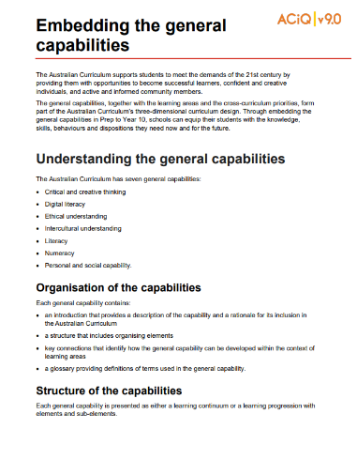
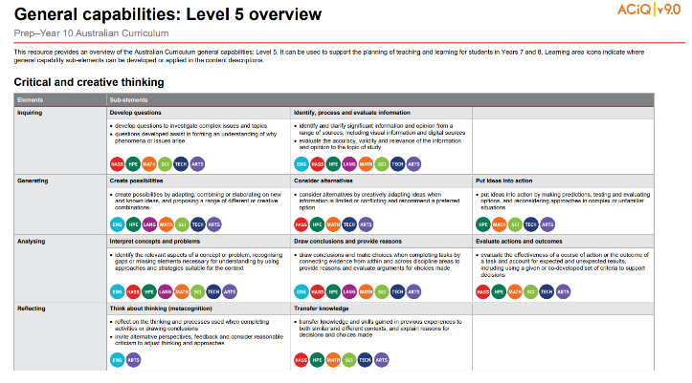
General capabilities advice and resources
www.qcaa.qld.edu.au/p-10/aciq/version-9/cross-curriculum-priorities
Notes:
The QCAA has resources that identify the connections the Australian Curriculum has made between learning areas and the general capabilities.
The general capability level overviews provide an overview of where each general capability can be developed or applied in the content descriptions of the learning areas. For example, the general capability Level 5 and Level 6 align with Years 7–10 learning areas.
The continua resources are available for the general capabilities:
critical and creative thinking
digital literacy
ethical understanding
intercultural understanding and,
personal and social capability.
There are resources available that provide a sequence of learning for the capability from Level 1 to Level 6. This can be helpful for teachers when catering for students with diverse needs.
The QCAA has advice documents to support teachers to use the Literacy and Numeracy progressions. These progressions provide observable indicators of increasing complexity in literacy and numeracy, which can help teachers to develop targeted teaching and learning programs for students who are working at, above, and below year-level expectations.
These resources can support teaching teams to interrogate connections between the general capabilities and the learning area content in more detail.

Slide 35
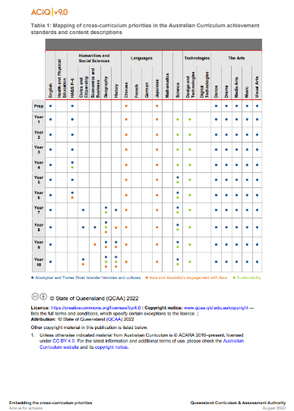
Cross-curriculum priorities advice and resources
www.qcaa.qld.edu.au/p-10/aciq/version-9/cross-curriculum-priorities
Notes:
The QCAA has resources to support schools with understanding how to connect the curriculum with cross-curriculum priorities.
Cross-curriculum priorities are incorporated through learning area content, in ways that are appropriate and authentic. The resources provide an overview of, as well as mapping across learning area and/or subject content descriptions and achievement standards to identify connections to each of the cross-curriculum priorities. ​

Slide 36
Outline
Introduction to Australian Curriculum v9.0: Mathematics
Understand this learning area
Formulating next steps
Curriculum elements

Slide 37
Organisation of Mathematics
Version 9.0
Understand this learning area
Introduction
Rationale
Aims
Structure
Key considerations
Key connections
Resources
Curriculum elements
Level description
Achievement standard
Strands and sub-strands
Content descriptions
Content elaborations
Level description
Achievement standard
Notes:
The Mathematics level description in the Curriculum elements section provides a high-level overview of the learning students should experience each year.
In Queensland, the achievement standard represents the C standard (or equivalent).
Source: Image created in house using SmartArt. Adapted from https://v9.australiancurriculum.edu.au/teacher-resources/understand-this-learning-area/mathematics.

Slide 38
Mathematics: Level descriptions
In Year ____, learning in Mathematics builds on each student’s prior learning and experiences. Students engage in a range of approaches to learning and doing mathematics that develop their understanding of and fluency with concepts, procedures and processes by making connections, reasoning, problem-solving and practice. Proficiency in mathematics enables students to respond to familiar and unfamiliar situations by employing mathematical strategies to make informed decisions and solve problems efficiently.
https://v9.australiancurriculum.edu.au/teacher-resources/understand-this-learning-area/mathematics
Notes:
The level description provides an overview of the learning that students should experience in each year and echoes the rationale and aims of the Mathematics curriculum.
On the screen is the opening level description paragraph that is consistent from Prep to Year 10.
The level description includes a sentence relating to the key consideration of proficiency in mathematics.
Each level description from Prep to Year 10 identifies the importance of proficiency in mathematics and the need for students to respond to familiar and unfamiliar situations. This language has been included in the QCAA standards elaborations. Refer to the QCAA website for more information about the use of the standards elaborations in Mathematics.
Source: https://v9.australiancurriculum.edu.au/teacher-resources/understand-this-learning-area/mathematics.

Slide 39
Mathematics: Achievement standard structure
Version 8.4 | Version 9.0
Understanding | Number and algebra
Skills | Measurement and space
 | Statistics and probability
Three paragraphs
Notes:
The organisation of the achievement standard in Version 9.0 has been revised.
The achievement standard is structured in a three-paragraph structure, sequenced in the order of how the content strands appear in the curriculum:
one for Number and algebra
one for Measurement and space, and
one for Statistics and probability.

Slide 40
Mathematics: Achievement standard structure
By the end of Year 8, students recognise irrational numbers and terminating or recurring decimals. They apply the exponent laws to calculations with numbers involving positive integer exponents. Students solve problems involving the 4 operations with integers and positive rational numbers. They use mathematical modelling to solve practical problems involving ratios, percentages and rates in measurement and financial contexts. Students apply algebraic properties to rearrange, expand and factorise linear expressions. They graph linear relations and solve linear equations with rational solutions and one-variable inequalities, graphically and algebraically. Students use mathematical modelling to solve problems using linear relations, interpreting and reviewing the model in context. They make and test conjectures involving linear relations using digital tools.
Students use appropriate metric units when solving measurement problems involving the perimeter and area of composite shapes, and volume of right prisms. They use Pythagoras’ theorem to solve measurement problems involving unknown lengths of right-angle triangles. Students use formulas to solve problems involving the area and circumference of circles. They solve problems of duration involving 12- and 24-hour cycles across multiple time zones. Students use 3 dimensions to locate and describe position. They identify conditions for congruency and similarity in shapes and create and test algorithms designed to test for congruency and similarity. Students apply the properties of quadrilaterals to solve problems.
They conduct statistical investigations and explain the implications of obtaining data through sampling. Students analyse and describe the distribution of data. They compare the variation in distributions of random samples of the same and different size from a given population with respect to shape, measures of central tendency and range. Students represent the possible combinations of 2 events with tables and diagrams, and determine related probabilities to solve practical problems. They conduct experiments and simulations using digital tools to determine related probabilities of compound events.
Number
Algebra
Measurement
Space
Statistics
Probability
Notes:
On the screen is the Year 8 achievement standard. The Version 9.0 achievement standard is sequenced in the same order that content strands appear in the curriculum.
In the first paragraph Number content is first, then Algebra content.
In the second paragraph Measurement content is at the top of the paragraph, followed by Space content.
And finally, in the third paragraph, Statistics content is first, then Probability content.

Slide 41
Organisation of Mathematics
Version 9.0
Understand this learning area
Introduction
Rationale
Aims
Structure
Key considerations
Key connections
Resources
Curriculum elements
Level description
Achievement standard
Strands and sub-strands
Content descriptions
Content elaborations
Strands and sub-strands
Content descriptions
Content elaborations
Notes:
The final section of Curriculum elements provides further information regarding the content descriptions in the strands and sub-strands which inform teaching and learning and assessment.
Content descriptions specify the knowledge, understanding and skills that students learn and that teachers are expected to teach. The content elaborations provide optional examples of how to teach the content descriptions.
Source: Image created in house using SmartArt. Adapted from https://v9.australiancurriculum.edu.au/teacher-resources/understand-this-learning-area/mathematics.

Slide 42
Prep | Year 1 | Year 2 | Year 3 | Year 4 | Year 5 | Year 6 | Year 7 | Year 8 | Year 9 | Year 10
3D coordinates
Logarithmic scales
Networks
Error & approximation
Error & approximation
Computational thinking
Statistical investigation
Probability experimentation and simulation
Mathematical modelling
Financial mathematics
Financial mathematics
Seasons
Probability
Time
(½ hr)
Symmetry
Enlargement
Pythagoras in 3D (formerly 10A)
Pythagoras
Percentages
Fractions
Numerical probability
Additive patterns
Circles
Volume
Similarity
Solving linear inequalities
Features of 3D objects
Line graphs
Notes:
This slide represents content in Version 9.0 of Mathematics.
The mustard-yellow section shows the notable inclusions to the Version 9.0 Mathematics curriculum including new specific concepts like 3D coordinates in Year 8, logarithmic scales and networks in Year 10, as well as the new mathematical processes.
The red section shows the removal of seasons and probability in the early years, and the orange section shows the content from Version 8.4 that has been redefined.
All content descriptions that were in the sub-strand of Money and financial mathematics except one in Year 3, can be found as a context to solve practical problems relating to the process of mathematical modelling.
The grey section shows some of the main content that has been moved and re-sequenced across the curriculum.

Slide 43
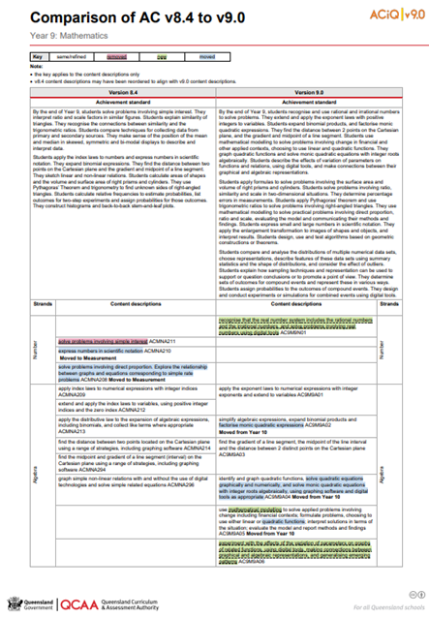
Comparison of AC v8.4 to v9.0 documents
One document for each year level is available on the QCAA website.
www.qcaa.qld.edu.au/downloads/aciqv9/mathematics/curriculum/ac9_maths_yr9_comp.pdf
Notes:
The comparison documents show in detail the changes to the content descriptions for Mathematics.

Slide 44
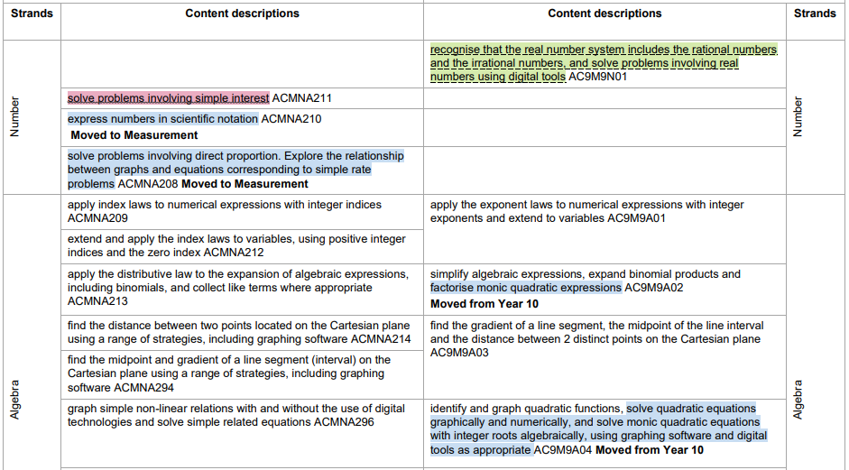
Comparison of AC v8.4 to v9.0 documents
Notes:
A key is used to show the changes from Version 8.4 to Version 9.0.
Examples from the Year 9 Mathematics curriculum will be used to show the changes.

Slide 45
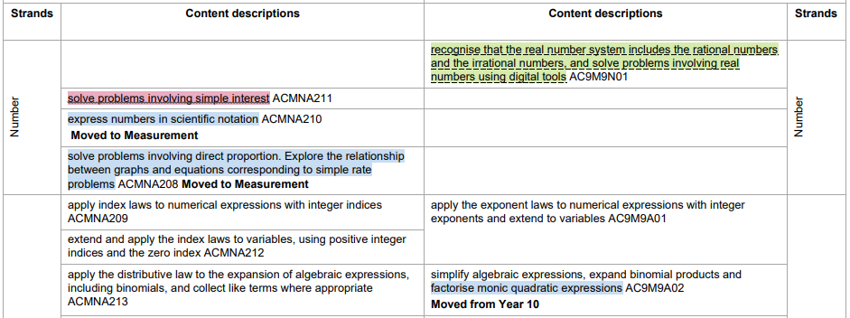
Comparison of AC v8.4 to v9.0 documents
Notes:
If a content description or part of a content description has been removed from Version 8.4 and no longer appears in Version 9.0, it has been highlighted in red.
For example, in v9.0 there is no specific mention of ‘simple interest’ in any content description or achievement standard. All content descriptions that were in the sub-strand of Money and financial mathematics in v8.4, can be found as a context to solve practical problems relating to the process of mathematical modelling.

Slide 46
Comparison of AC v8.4 to v9.0 documents
Notes:
If a new content description has been added to Version 9.0, it has been highlighted in green.

Slide 47
Comparison of AC v8.4 to v9.0 documents
Notes:
If a content description has moved year levels from Version 8.4 to Version 9.0, it has been highlighted in blue. There is also a bold note to indicate the year level from which it has moved. Similarly, if a content description has moved to another strand, there is a bold note to indicate the strand to which it has moved.

Slide 48
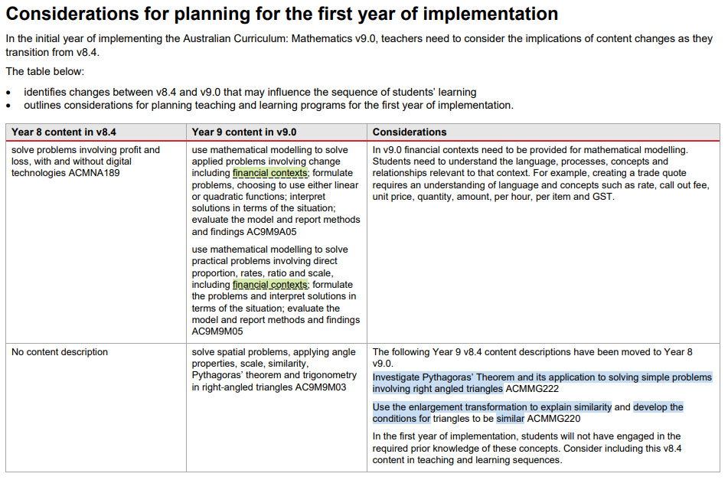
Considerations for planning
Each of the Mathematics Comparison documents include consideration for planning for the first year of implementation.
Notes:
The mathematics comparison documents also include an advice section — Consideration for planning for the first year of implementation — highlighting the content changes between Version 8.4 and Version 9.0 that may influence the sequence of students’ learning. In the first year of implementation, content movement will mean that some students will be impacted by where the content has moved to.
Think of this as the gaps caused by content being moved to a lower year level or the overlaps caused by content being moved to the next year level.
Gaps and overlaps will appear during the transition from v8.4 to v9.0.
The snip on screen shows the final section of the resource comparing v8.4 and v9.0. This section will help you plan for possible gaps in student learning during the first year of implementation.

Slide 49
Outline
Introduction to Australian Curriculum v9.0: Mathematics
Understand this learning area
Formulating next steps
Curriculum elements

Slide 50
Australian Curriculum in Queensland (ACiQ) v9.0 webpages
QCAA website www.qcaa.qld.edu.au/p-10/aciq
Notes:
Resources to support the Australian Curriculum Version 9.0 can be found within the Australian Curriculum in Queensland Version 9.0 webpages.
These webpages only include resources that have been created or updated to align with Version 9.0.
Source: Screenshot from QCAA website www.qcaa.qld.edu.au/p-10/aciq.

Slide 51
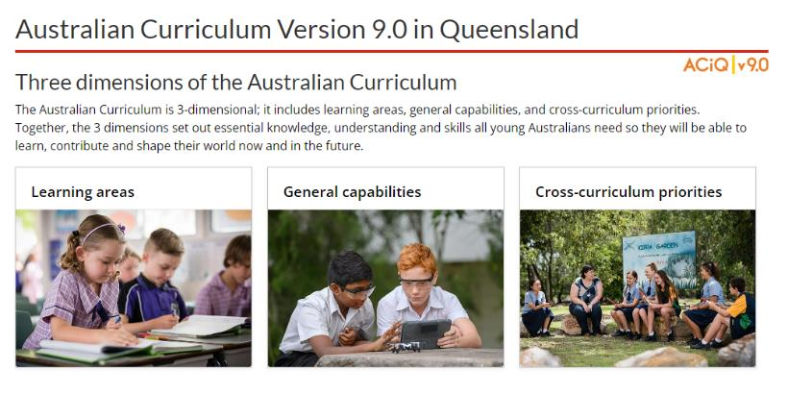
The ACiQ v9.0 webpages
These webpages house advice and resources to support the three dimensions of the Australian Curriculum:
Learning areas
General capabilities
Cross-curriculum priorities.
Notes:
The Version 9.0 webpages support familiarisation with all three dimensions of the curriculum.
Teachers can access advice and resources for their learning area and/or subject, or the general capabilities, and the cross-curriculum priorities.
Source: Screenshot from QCAA website www.qcaa.qld.edu.au/p-10/aciq/version-9.

Slide 52
Examples of QCAA Resources
Comparison of AC v8.4 to v9.0 (P–10)
Sequence of achievement standards
Sequence of content descriptions
Achievement standard aligned to content descriptions (P–10)
Prepopulated curriculum and assessment plans
Assessment techniques and conditions (P–10)
Standards elaborations
QCAA P–10 Planning app
Notes:
On screen is a snapshot of some of the Mathematics resources. These resources have been hyperlinked in the slide.

Slide 53
Learning goal
Understand the implications of changes in the Years 7–10 Australian Curriculum from v8.4 to v9.0: Mathematics for planning.
Success criteria
You will know you are successful if you:
have more knowledge about the intent and structure of the Years 7–10 Australian Curriculum v9.0: Mathematics
can identify actions for planning in your school.

Slide 54
Contact
K–10 Curriculum and Assessment Branch​ ​
T +61 7 3120 6102
E australiancurriculum@qcaa.qld.edu.au
W www.qcaa.qld.edu.au
Notes:
If you have any queries regarding Australian Curriculum v9.0: Mathematics, please contact the K–10 Curriculum and Assessment Branch.

Slide 55
References
Australian Curriculum, Assessment and reporting Authority 2013, The Shape of the Australian Curriculum Version 4.0, https://docs.acara.edu.au/resources/The_Shape_of_the_Australian_Curriculum_v4.pdf

Slide 56
Acknowledgments
Third-party copyright material, and QCAA material not covered by the CC BY licence is listed below:
Queensland Government coat of arms, and the QCAA and QSA trademarks may not be reproduced without permission.
Unless otherwise indicated, material from Australian Curriculum is © ACARA 2010–present, licensed CC BY 4.0. For the latest information and additional terms of use, see the Australian Curriculum website and its copyright notice.
Acknowledgment of Country artwork (2023) ‘Growth through Learning’ by Chern’ee, Brooke and Jesse Sutton, Kalkadoon. www.cherneesutton.com.au
Student and staff images have been used with permission.
The three-dimensional curriculum diagram is 'Excluded Material' used under the terms of the Australian Curriculum and its copyright notice and not modified. © Australian Curriculum, Assessment and Reporting Authority (ACARA) 2009 to present, unless otherwise indicated. You may view, download, display, print, reproduce (such as by making photocopies) and distribute these Excluded Materials in unaltered form only for your personal, non-commercial educational purposes or for the non-commercial educational purposes of your organisation, provided that you make others aware it can only be used for these purposes and attribute ACARA as the source of the Excluded Material. For the avoidance of doubt, this means that you cannot edit, modify or adapt any of these materials, and you cannot sub-licence any of these materials to others. Apart from any uses permitted under the Copyright Act 1968 (Cth), and those explicitly granted above, all other rights are reserved by ACARA. If you want to use such material in a manner

Slide 57
Copyright notice
© State of Queensland (QCAA) 2024
Licence: https://creativecommons.org/licenses/by/4.0 | Copyright notice: www.qcaa.qld.edu.au/copyright — lists the full terms and conditions, which specify certain exceptions to the licence. | Attribution: © State of Queensland (QCAA) 2024 www.qcaa.qld.edu.au/copyright.
Other copyright material in this presentation is listed on the previous slide/s.

Slide 58
QCAA social media
Notes:
If you don’t do so already, we recommend you follow QCAA on one or more social media platforms to stay in touch with us, and to find out about upcoming resources and professional learning.

