Slide 1
Familiarisation and planning
240879
Australian Curriculum v9.0: Languages — Years 7–10
Notes:
This presentation is designed to introduce curriculum leaders and teachers to the Australian Curriculum Version 9.0: Languages — Years 7‒10.

Slide 2
Acknowledgment of Country
Notes:
Acknowledgment of Country
The QCAA acknowledges the Traditional Owners and Traditional Custodians of the lands on which we meet today.
We pay our respects to their Elders and their descendants, who continue cultural and spiritual connections to Country, and we extend that respect to Aboriginal people and Torres Strait Islander people here today.
We thank them for sharing their cultures and spiritualities and recognise the important contribution of this knowledge to our understanding of this place we call home.

Slide 3
Learning goal
Understand the implications of changes in the Years 7–10 Australian Curriculum from v8.4 to v9.0: Languages for planning.
Success criteria
You will know you are successful if you:
have more knowledge about the intent and structure of the Years 7–10 Australian Curriculum v9.0: Languages
can identify actions for planning in your school.

Slide 4
Outline
Introduction to Australian Curriculum v9.0: Languages
Understand this learning area
Formulating next steps
Curriculum elements

Slide 5
Outline
Introduction to Australian Curriculum v9.0: Languages
Understand this learning area
Formulating next steps
Curriculum elements

Slide 6
Languages in the three-dimensional Australian Curriculum
Source: ACARA, www.v9.australiancurriculum.edu.au/help/website-tour
Notes:
In the Australian Curriculum Version 9.0, the three-dimensional interrelated structure has not changed as part of the review. The diagram visually represents these three dimensions.
Source: Script and picture adapted (addition of labels) from video at www.v9.australiancurriculum.edu.au/help/website-tour (time stamp 50 seconds).

Slide 7
Languages in the three-dimensional Australian Curriculum
Source: ACARA, www.v9.australiancurriculum.edu.au/help/website-tour
Notes:
The Australian Curriculum consists of eight learning areas. Languages is indicated in the magenta colour second from the right.
Source: Script and picture adapted (addition of labels) from video at www.v9.australiancurriculum.edu.au/help/website-tour (time stamp 50 seconds).

Slide 8
Languages in the three-dimensional Australian Curriculum
Source: ACARA, www.v9.australiancurriculum.edu.au/help/website-tour
Notes:
There are seven general capabilities:
Literacy
Numeracy
Digital literacy
Critical and creative thinking
Personal and social capability
Intercultural understanding, and
Ethical understanding.
As part of the review, the general capabilities have been refined.
The Information, Communications and Technologies (ICT) general capability in v8.4 has been renamed Digital literacy in v9.0 to reflect current understandings in the field.
The Literacy and Numeracy general capabilities are no longer continua. In v9.0 they are progressions representing the fine-grained indicators of the typical trajectory of literacy and numeracy development.
The remaining general capabilities have had refinements to elements, sub-elements and continua.
Source: Script and picture adapted (addition of labels) from video at www.v9.australiancurriculum.edu.au/help/website-tour (time stamp 50 seconds).

Slide 9
Languages in the three-dimensional Australian Curriculum
Source: ACARA, www.v9.australiancurriculum.edu.au/help/website-tour
Notes:
There are three cross-curriculum priorities:
Aboriginal and Torres Strait Islander Histories and Cultures
Asia and Australia’s engagement with Asia, and
Sustainability.
Source: Script and picture adapted (addition of labels) from video at www.australiancurriculum.edu.au/help/website-tour (time stamp 50 seconds).

Slide 10
Organisation of Languages and changes
Version 8.4
Version 9.0
Understand how the learning area works
Rationale
Aims
Key ideas
Structure
Resources (learning area specific)
Understand this learning area
Introduction
Rationale
Aims
Structure
Key considerations
Key connections
Resources
Learning area curriculum
Year level description
Achievement standard
Strands and sub-strands
Content descriptions
Threads (learning area specific)
Content elaborations
Curriculum elements
Level description
Achievement standard
Strands and sub-strands
Content descriptions
Content elaborations
Notes:
This is an overview of the organisation of the Australian Curriculum Version 8.4: Languages compared with Version 9.0, with the main changes noted.
Source: Image created in house using SmartArt. Adapted from: https://v9.australiancurriculum.edu.au/teacher-resources/understand-this-learning-area/languages.

Slide 11
Organisation of Languages and changes
Version 8.4
Version 9.0
Understand how the learning area works
Rationale
Aims
Key ideas
Structure
Resources (learning area specific)
Understand this learning area
Introduction
Rationale
Aims
Structure
Key considerations
Key connections
Resources
Learning area curriculum
Year level description
Achievement standard
Strands and sub-strands
Content descriptions
Threads (learning area specific)
Content elaborations
Curriculum elements
Level description
Achievement standard
Strands and sub-strands
Content descriptions
Content elaborations
Notes:
The organisation of the Australian Curriculum in Version 8.4 is in two parts:
Understand how the learning area works, which includes the rationale, aims, key ideas, structure and resources.
Learning area curriculum including the year level description, the achievement standard, strands and sub-strands, content descriptions, threads and content elaborations.
Source: Image created in house using SmartArt. Adapted from: https://v9.australiancurriculum.edu.au/teacher-resources/understand-this-learning-area/languages.

Slide 12
Organisation of Languages and changes
Version 8.4
Version 9.0
Understand how the learning area works
Rationale
Aims
Key ideas
Structure
Resources (learning area specific)
Understand this learning area
Introduction
Rationale
Aims
Structure
Key considerations
Key connections
Resources
Learning area curriculum
Year level description
Achievement standard
Strands and sub-strands
Content descriptions
Threads (learning area specific)
Content elaborations
Curriculum elements
Level description
Achievement standard
Strands and sub-strands
Content descriptions
Content elaborations
Notes:
The Version 9.0 learning area structure helps teachers organise the teaching and assessment for Languages.
It is organised into two sections:
Understand this learning area and
Curriculum elements.
The Understand this learning area section provides detail of the intent of the Australian Curriculum v9.0: Languages and a snapshot of the structure. In magenta are two new sections: key considerations and key connections.
The Curriculum elements section shows the elements associated with Languages.
Source: Image created in house using SmartArt. Adapted from: https://v9.australiancurriculum.edu.au/teacher-resources/understand-this-learning-area/languages.

Slide 13
Outline
Introduction to Australian Curriculum v9.0: Languages
Understand this learning area
Formulating next steps
Curriculum elements

Slide 14
Organisation of Languages
Version 9.0
Understand this learning area
Introduction
Rationale
Aims
Structure
Key considerations
Key connections
Resources
Introduction
Rationale
Aims
Curriculum elements
Level description
Achievement standard
Strands and sub-strands
Content descriptions
Content elaborations
Notes:
Languages share a common introduction, rationale and aims.
This introduction states that: ‘The Australian Curriculum: Languages has been developed to give all students the opportunity to engage in learning a language in addition to English. The design of the Languages curriculum recognises features that all languages share as well as the distinctiveness of each language.’ (ACARA, 2022, https://v9.australiancurriculum.edu.au/teacher-resources/understand-this-learning-area/languages)
It also identifies the three different learner groups in Australia: second language learners, background language learners and first language learners.
The rationale and aims, common to all languages, capture the intent of teaching Languages and inform teachers’ planning in a school context.
Note that there are also language-specific introductions and rationales for each language.
Source: Image created in house using SmartArt. Adapted from: https://v9.australiancurriculum.edu.au/teacher-resources/understand-this-learning-area/languages.

Slide 15
Organisation of Languages
Version 9.0
Understand this learning area
Introduction
Rationale
Aims
Structure
Key considerations
Key connections
Resources
Structure
Curriculum elements
Level description
Achievement standard
Strands and sub-strands
Content descriptions
Content elaborations
Notes:
Exploring the structure of the revised curriculum provides a way for teachers to conceptualise the Australian Curriculum: Languages.
Source: Image created in house using SmartArt. Adapted from: https://v9.australiancurriculum.edu.au/teacher-resources/understand-this-learning-area/languages.

Slide 16
Structure of Languages: Strands and sub-strands
Version 9.0 | (Header row)
Communicating Communicating meaning in [Language] | Understanding Understanding language and culture
Socialising Interacting in [Language] Informing Mediating meaning in and between languages Creating Creating text in [Language] Translating Reflecting | Systems of language Understanding systems of language Language variation and change The role of language and culture Understanding the interrelationship of language and culture
Notes:
There have been refinements to the strand and sub-strand structure. In black text are the revised Version 9.0 names of strands and sub-strands. In grey and with a strikethrough are the names of the Australian Curriculum Version 8.4 sub-strands.
Source: Adapted from https://v9.australiancurriculum.edu.au/teacher-resources/understand-this-learning-area/languages.

Slide 17
Structure of Languages: Strands and sub-strands
Version 9.0 | (Header row)
Communicating Communicating meaning in [Language] | Understanding Understanding language and culture
Socialising Interacting in [Language] Informing Mediating meaning in and between languages Creating Creating text in [Language] Translating Reflecting | Systems of language Understanding systems of language Language variation and change The role of language and culture Understanding the interrelationship of language and culture
Notes:
The first strand is now called Communicating meaning in [Language] and would change according to the language being taught. For example, if Italian is taught in your context, it would be Communicating meaning in Italian. In this first strand, students learn to use language for communicative purposes.
The content for this strand has been reorganised under three sub-strands in Version 9.0, instead of five in Version 8.4. The new sub-strands are: Interacting in [Language], Mediating meaning in and between languages and Creating text in [Language].
Although Translating and Reflecting are no longer separate sub-strands, there are still content descriptions about interpreting and reflecting. Version 9.0 moves away from asking students to simply translate one language to another and, instead, aims for students to understand and explain what they translate. This shift can be observed in the Mediating meaning in and between languages sub-strand, in which students are taught how to move between languages and cultures. The definition of ‘mediating’ in Version 9.0 of the Australian Curriculum is ‘negotiating meaning between different linguistic and cultural systems, referencing first language and culture while negotiating meaning of the language and culture of the target language’. (Quoted verbatim and unaltered from ACARA http://v9.australiancurriculum.edu.au/downloads/learning-areas)
Source: Adapted from https://v9.australiancurriculum.edu.au/teacher-resources/understand-this-learning-area/languages.

Slide 18
Structure of Languages: Strands and sub-strands
Version 9.0 | (Header row)
Communicating Communicating meaning in [Language] | Understanding Understanding language and culture
Socialising Interacting in [Language] Informing Mediating meaning in and between languages Creating Creating text in [Language] Translating Reflecting | Systems of language Understanding systems of language Language variation and change The role of language and culture Understanding the interrelationship of language and culture
Notes:
In the second strand, now named Understanding language and culture, students learn to analyse and understand language and culture as resources for interpreting and shaping meaning in intercultural exchange. This strand is clearly linked to the General capability for Intercultural understanding.
Through this, students learn that our culture shapes the way we communicate, verbally and non-verbally, and understand that this, in turn, shapes our identity and how we make meaning of texts –– see the new Understanding systems of language sub-strand.
In the sub-strand Understanding the relationship of language and culture, students learn to examine how culture influences perspectives and to develop and apply strategies for open, flexible communication (e.g. asking for repetition, clarification and confirmation to sustain interactions, learning that translation equivalence is not always possible, understanding that intercultural understanding runs both ways, developing sensitivity to cultural differences).
Source: Adapted from https://v9.australiancurriculum.edu.au/teacher-resources/understand-this-learning-area/languages.

Slide 19
Organisation of Languages
Version 9.0
Understand this learning area
Introduction
Rationale
Aims
Structure
Key considerations
Key connections
Resources
Key considerations
Key connections
Resources
Curriculum elements
Level description
Achievement standard
Strands and sub-strands
Content descriptions
Content elaborations
Notes:
The final section of Understand this learning area includes the key considerations, key connections and resources that provide further support and advice for teachers when planning for Version 9.0 in Languages.
A useful resource for differentiation when planning is the optional Language support resource, available from the Downloads tab on the Australian Curriculum website.
Source: Image created in house using SmartArt. Adapted from https://v9.australiancurriculum.edu.au/.
Source: Image created in house using SmartArt. Adapted from: https://v9.australiancurriculum.edu.au/teacher-resources/understand-this-learning-area/languages.

Slide 20
Key considerations
Flexible entry points to F–10 and Years 7–10 sequences
Use of English
Macro skills
Protocols for engaging First Nations Australians
Meeting the needs of diverse learners
Texts
Notes:
The key considerations is a new section in v9.0 consistent across all learning areas and includes the refined key ideas from v8.4. It helps teachers to think about teaching and learning specific to Languages. This section offers information about sequences of learning, when to use English in the language classroom, how macro skills are interrelated, what constitutes a text and how purposeful activities should be organised around chosen texts.
There are also two new considerations in all learning areas which are Protocols for engaging First Nations Australians and Meeting the needs of diverse learners.
Source: Image created in house using SmartArt based on https://v9.australiancurriculum.edu.au/teacher-resources/understand-this-learning-area/languages#accordion-2506735f7f-item-a1ea1047e6.

Slide 21
Key connections
Learning areas
General capabilities
Cross-curriculum priorities
Source: ACARA, https://v9.australiancurriculum.edu.au/help/website-tour
Notes:
The key connections in the curriculum support teachers to integrate Languages with other learning areas, embed relevant general capabilities and provide possible contexts for learning through the cross-curriculum priorities.
This integration can enrich and deepen student engagement with learning area content.
These connections should only be considered when they provide appropriate and authentic opportunities to strengthen learning area content.

Slide 22
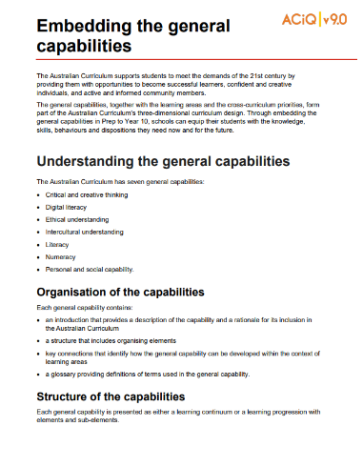
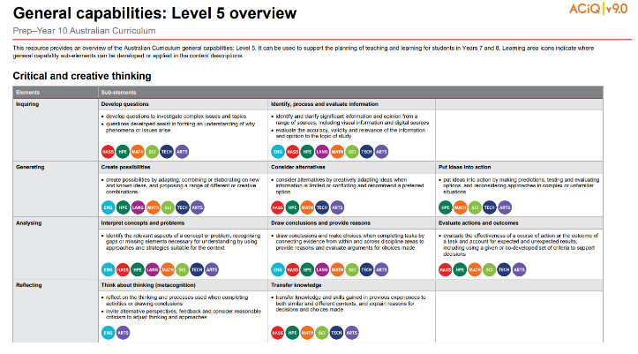
General capabilities advice and resources
www.qcaa.qld.edu.au/p-10/aciq/version-9/cross-curriculum-priorities
Notes:
The QCAA has resources that identify the connections the Australian Curriculum has made between learning areas and the general capabilities.
The general capability level overviews provide an overview of where each general capability can be developed or applied in the content descriptions of the learning areas. For example, the general capability Level 5 and Level 6 align with Years 7–10 learning areas.
The continua resources are available for the general capabilities:
critical and creative thinking
digital literacy
ethical understanding
intercultural understanding, and
personal and social capability.
There are resources available that provide a sequence of learning for the capability from Level 1 to Level 6. This can be helpful for teachers when catering for students with diverse needs.
The QCAA has advice documents to support teachers to use the Literacy and Numeracy progressions. These progressions provide observable indicators of increasing complexity in literacy and numeracy which can help teachers to develop targeted teaching and learning programs for students who are working at, above, and below year-level expectations.
These resources can support teaching teams to interrogate connections between the general capabilities and the learning area content in more detail.

Slide 23
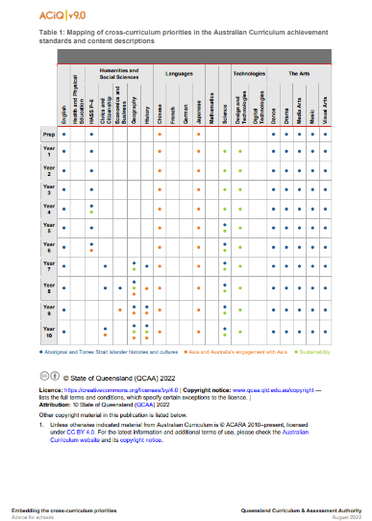
Cross-curriculum priorities advice and resources
www.qcaa.qld.edu.au/p-10/aciq/version-9/cross-curriculum-priorities
Notes:
The QCAA has resources to support schools with understanding how to connect the curriculum with cross-curriculum priorities.
Cross-curriculum priorities are incorporated through learning area content, in ways that are appropriate and authentic. The resources provide an overview of, as well as mapping across learning area and/or subject content descriptions and achievement standards to identify connections to each of the cross-curriculum priorities. ​

Slide 24
Outline
Introduction to Australian Curriculum v9.0: Languages
Understand this learning area
Formulating next steps
Curriculum elements

Slide 25
Organisation of Languages
Version 9.0
Understand this learning area
Introduction
Rationale
Aims
Structure
Key considerations
Key connections
Resources
Curriculum elements
Level description
Achievement standard
Strands and sub-strands
Content descriptions
Content elaborations
Level description
Achievement standard
Notes:
The Languages level description in the Curriculum elements section provides a high-level overview of the learning students should experience each year.
In Queensland, the achievement standard represents the C standard (or equivalent).
Source: Image created in house using SmartArt. Adapted from https://v9.australiancurriculum.edu.au/teacher-resources/understand-this-learning-area/languages.

Slide 26
Languages: Achievement standard structure
Version 8.4​ | Version 9.0​
Communicating​ ​ ​ | Communicating meaning in [Language]​ ​
Understanding​ ​ ​ | Understanding language and culture​ ​
Two paragraphs
Notes:
The organisation of the achievement standard in Version 9.0 has been revised.
The achievement standard now has two paragraphs:
Communicating meaning in [Language]
Understanding language and culture.

Slide 27
Languages: Achievement standard structure
By the end of Year 8, students use Italian language to interact and collaborate with others, and to share information and plan activities in familiar contexts. They respond to others’ contributions, and recognise familiar gestures, questions and instructions in exchanges. They recognise relationships between spoken and written forms. They locate and respond to information in texts and use non-verbal, visual and contextual cues to help make meaning. They respond in Italian or English, and demonstrate understanding of context, purpose and audience in texts. They use familiar language, and modelled sentence and grammatical structures to create texts, and demonstrate understanding of how some language reflects cultural practices.
Students approximate Italian sound patterns, intonation and rhythms, and demonstrate understanding that Italian has conventions and rules for non-verbal, spoken and written communication. They comment on aspects of Italian and English language structures and features, using metalanguage. They demonstrate awareness that the Italian language is connected with culture and identity, and that this is reflected in their own language(s), culture(s) and identity.
Communicating meaning in Italian
Understanding language and culture
Source: Quoted verbatim and unaltered from AC https://v9.australiancurriculum.edu.au/f-10-curriculum/learning-areas/italian-7-10-sequence/year-8?view=quick&detailed-content-descriptions=0&hide-ccp=0&hide-gc=0&side-by-side=1&strands-start-index=0
Notes:
Across all languages, the achievement standard appears as two paragraphs with the content related to the Communicating meaning in Italian (or German, Japanese, Indonesian, etc.) strand represented first.
The example on the screen is from Years 7–8 Italian (7–10 sequence).

Slide 28
Languages: Achievement standard structure
By the end of Year 8, students use Italian language to interact and collaborate with others, and to share information and plan activities in familiar contexts. They respond to others’ contributions, and recognise familiar gestures, questions and instructions in exchanges. They recognise relationships between spoken and written forms. They locate and respond to information in texts and use non-verbal, visual and contextual cues to help make meaning. They respond in Italian or English, and demonstrate understanding of context, purpose and audience in texts. They use familiar language, and modelled sentence and grammatical structures to create texts, and demonstrate understanding of how some language reflects cultural practices.
Students approximate Italian sound patterns, intonation and rhythms, and demonstrate understanding that Italian has conventions and rules for non-verbal, spoken and written communication. They comment on aspects of Italian and English language structures and features, using metalanguage. They demonstrate awareness that the Italian language is connected with culture and identity, and that this is reflected in their own language(s), culture(s) and identity.
Communicating meaning in Italian
Understanding language and culture
Source: Quoted verbatim and unaltered from AC https://v9.australiancurriculum.edu.au/f-10-curriculum/learning-areas/italian-7-10-sequence/year-8?view=quick&detailed-content-descriptions=0&hide-ccp=0&hide-gc=0&side-by-side=1&strands-start-index=0
Notes:
The second paragraph relates to the Understanding language and culture strand.
Both paragraphs of the achievement standard are mostly consistent across all languages, with some differences relating to scripted languages, such as Chinese.

Slide 29
Languages: Achievement standard structure
By the end of Year 8, students use French language to interact and collaborate with others, and to share information and plan activities in familiar contexts. They respond to others’ contributions, and recognise familiar gestures, questions and instructions in exchanges. They recognise relationships between spoken and written forms. They locate and respond to information in texts and use non-verbal, visual and contextual cues to help make meaning. They respond in French or English, and demonstrate understanding of context, purpose and audience in texts. They use familiar language, and modelled sentence and grammatical structures to create texts, and demonstrate understanding of how some language reflects cultural practices.
Students approximate French sound patterns, intonation and rhythms, and demonstrate understanding that French has conventions and rules for non-verbal, spoken and written communication. They comment on aspects of French and English language structures and features, using metalanguage. They demonstrate awareness that the French language is connected with culture and identity, and that this is reflected in their own language(s), culture(s) and identity.
Paragraph structure:
Interacting in French
Mediating meaning in and between languages
Creating text in French
Understanding systems of language
Understanding the interrelationship of language and culture
Notes:
In Languages, the achievement standard paragraphs are structured in a uniform way.
On the left are the languages’ sub-strands, which dictate the structure of the achievement standards.
Highlighted in green is the assessable content linked to Interacting in French.
Highlighted in yellow is the assessable content linked to Mediating meaning in and between languages, and so on.
This structure is consistent across all bands.

Slide 30
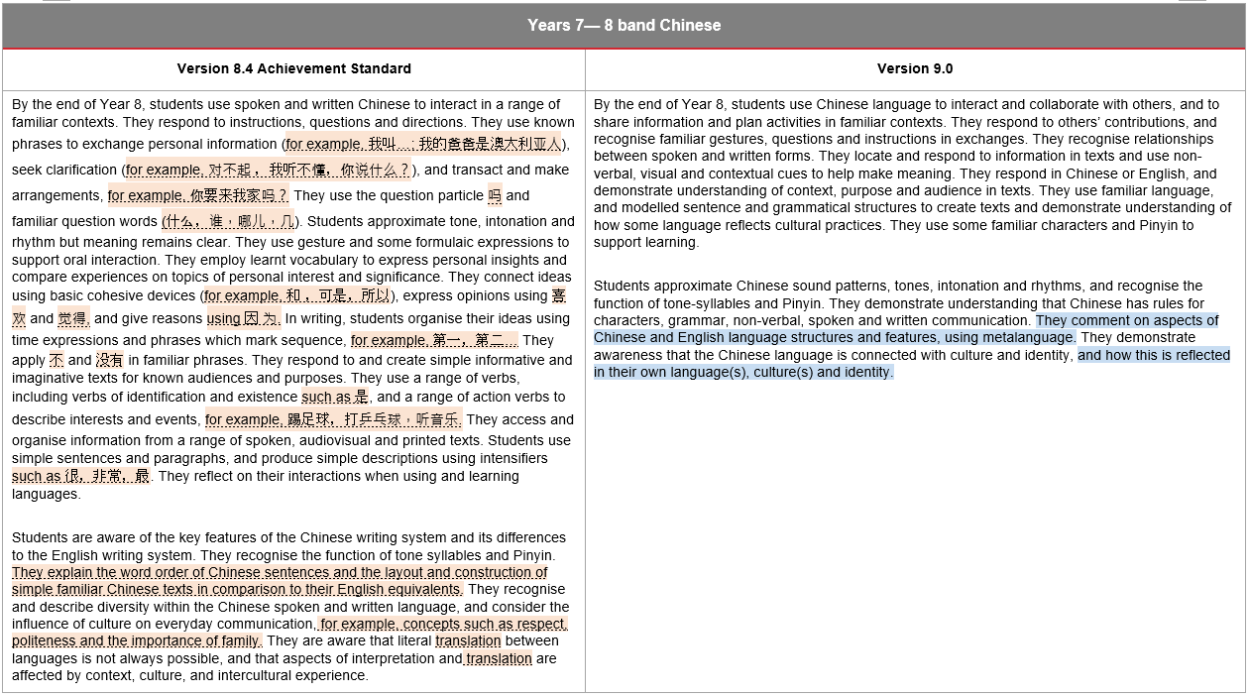
Things you may have noticed: Years 7–8
1
3
4
2
Notes:
Changes have occurred to the Languages achievement standard. The orange highlight (with dotted underlining) represents aspects from Version 8.4 that have been removed. The blue highlighting represents new information required to evidence achievement for a particular band level in Version 9.0.
For all languages:
Language examples that were present in Version 8.4 have been removed from Version 9.0. Language examples can now be found in the optional content elaborations and the optional Australian Curriculum language support resource for each language.
References to translation have been removed from Version 9.0. The focus is now on interpretation.
More consistent and explicit references to metalanguage are present in Version 9.0 than in Version 8.4. Students are now asked to use metalanguage in the achievement standard across all languages from Years 5–6 to Years 9–10 in the P–10 sequence and from Years 7 to 10 in the 7–10 sequence.
In Version 9.0, students are explicitly asked to reflect on their own language(s), culture(s) and identity. This is a new addition to Version 9.0.

Slide 31
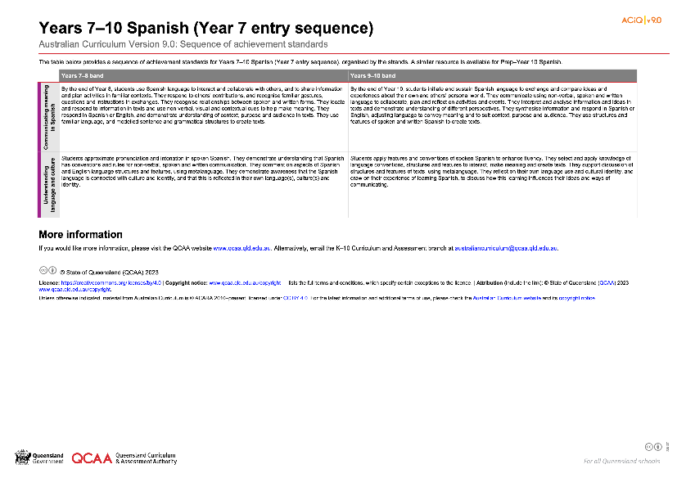
Languages: Achievement standard structure
www.qcaa.qld.edu.au/downloads/aciqv9/languages/curriculum/ac9_lang_spanish_yr7-10_as_sequence.pdf
Notes:
On the QCAA website, there is a resource illustrating the sequence of achievement standards from Years 7‒10 for each language and for both sequences. There is a similar resource for Prep–Year 6.

Slide 32
Organisation of Languages
Version 9.0
Understand this learning area
Introduction
Rationale
Aims
Structure
Key considerations
Key connections
Resources
Curriculum elements
Level description
Achievement standard
Strands and sub-strands
Content descriptions
Content elaborations
Strands and sub-strands
Content descriptions
Content elaborations
Notes:
The final section of Curriculum elements provides further information about the content descriptions in the strands and sub-strands, which inform teaching and learning and assessment.
Content descriptions specify the knowledge, understanding and skills that students learn and that teachers are expected to teach. The content elaborations provide optional examples of how to teach the content descriptions.
Source: Image created in house using SmartArt. Adapted from https://v9.australiancurriculum.edu.au/teacher-resources/understand-this-learning-area/languages.

Slide 33
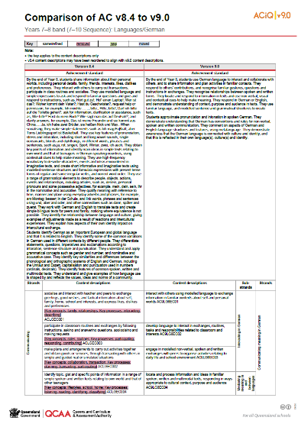
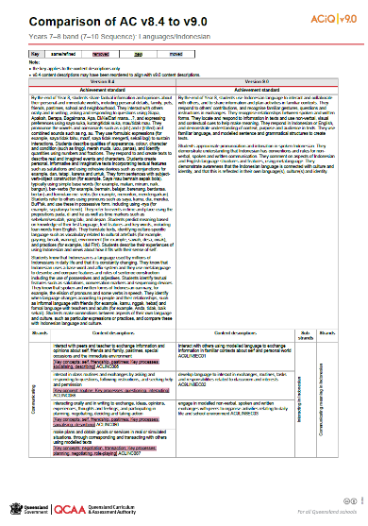
Comparison of AC v8.4 with v9.0 documents
One document for each band is available on the QCAA website.
www.qcaa.qld.edu.au/p-10/aciq/version-9/learning-areas/p-10-languages/german
www.qcaa.qld.edu.au/p-10/aciq/version-9/learning-areas/p-10-languages/indonesian
Notes:
The comparison documents show the changes to the content descriptions for Languages. The examples on screen are for German and Indonesian.

Slide 34
New content
Notes:
A key is used to show the changes from Version 8.4 to Version 9.0.
The example is a snip of the Years 7–8 Japanese (7–10 Sequence). For example, new content is highlighted in green.

Slide 35
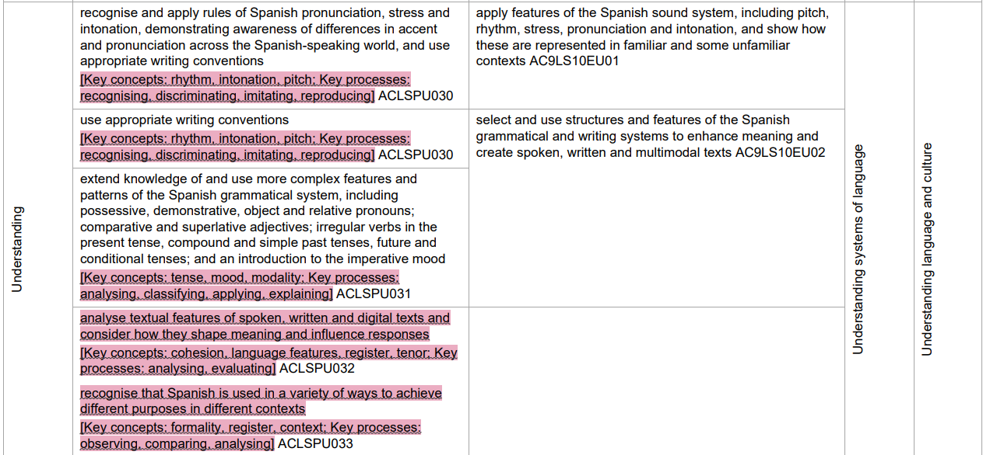
Refined content
Notes:
If something has been refined from Version 8.4, it is not highlighted, such as in these examples from Years 9–10 Spanish (7–10 Sequence).

Slide 36
Removed content
Notes:
If something has been removed from Version 8.4 and no longer appears in Version 9.0, it is highlighted in red, such as the examples on the screen from Years 9–10 Spanish (7–10 Sequence).

Slide 37
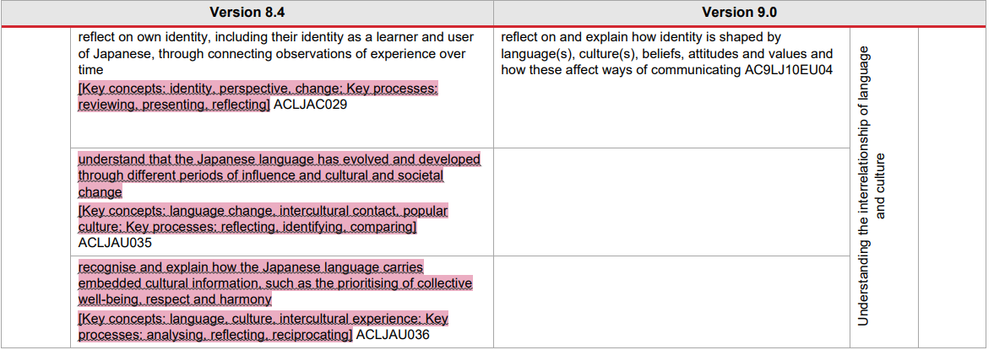
Removed content
Notes:
In this example, from Years 9–10 Japanese (7–10 Sequence), references to the sub-strand Language change and variation have been removed from Version 9.0 of the Australian Curriculum.

Slide 38
Removed content
Notes:
This example illustrates elements removed from Years 9–10 Japanese (7–10 Sequence). Throughout Version 9.0 the key concepts have been removed from all languages.

Slide 39
Outline
Introduction to Australian Curriculum v9.0: Languages
Understand this learning area
Formulating next steps
Curriculum elements

Slide 40
Australian Curriculum in Queensland (ACiQ) v9.0 webpages
QCAA website www.qcaa.qld.edu.au/p-10/aciq
Notes:
Resources to support the Australian Curriculum Version 9.0 can be found within the Australian Curriculum in Queensland Version 9.0 webpages.
These webpages only include resources that have been created or updated to align with Version 9.0.
Source: Screenshot from QCAA website www.qcaa.qld.edu.au/p-10/aciq.

Slide 41
The ACiQ v9.0 webpages
These webpages house advice and resources to support the three dimensions of the Australian Curriculum:
Learning areas
General capabilities
Cross-curriculum priorities.
Notes:
The Version 9.0 webpages support familiarisation with all three dimensions of the curriculum.
Teachers can access advice and resources for their learning area and/or subject, or the general capabilities, and the cross-curriculum priorities.
Source: Screenshot from QCAA website www.qcaa.qld.edu.au/p-10/aciq/version-9.

Slide 42
Examples of QCAA resources for Languages
Resource | How to find the resource
Curriculum and assessment plan templates | Select language from the QCAA v9.0 Languages landing page Select the Planning tab Select the Curriculum and assessment plans dropdown Select the document for the relevant band/year.
Sample curriculum and assessment plans | Select language from the QCAA v9.0 Languages landing page Select the Planning tab Select the Curriculum and assessment plans dropdown Click the link under the heading ‘Samples’.
Achievement standards aligned to content descriptions | Select language from the QCAA v9.0 Languages landing page Select the Australian Curriculum v9.0 tab Select the Achievement standards and content descriptions v9.0 dropdown Select the document for the relevant band/year.
Notes:
On screen is a snapshot of some of the Languages resources. Hyperlinks and instructions to locate each resource have been included.

Slide 43
Examples of QCAA resources for Languages
Resource | How to find the resource
Techniques and conditions | Select language from the QCAA v9.0 Languages landing page Select the Assessment tab Select the Techniques and conditions dropdown Select the document for the relevant band/year.
Standards elaborations | Select language from the QCAA v9.0 Languages landing page Select the Assessment tab Select the Standards elaborations dropdown Select the document for the relevant band/year.
P–10 Planning app | Go to www.qcaa.qld.edu.au/p-10/aciq/version-9/p10-planning-app
Notes:
On screen is a snapshot of some of the Languages resources. Hyperlinks and instructions to locate each resource have been included.

Slide 44
Learning goal
Understand the implications of changes in the Years 7–10 Australian Curriculum from v8.4 to v9.0: Languages for planning.
Success criteria
You will know you are successful if you:
have more knowledge about the intent and structure of the Years 7–10 Australian Curriculum v9.0: Languages
can identify actions for planning in your school.

Slide 45
Contact
K–10 Curriculum and Assessment Branch​ ​
T +61 7 3120 6102
E australiancurriculum@qcaa.qld.edu.au
W www.qcaa.qld.edu.au
Notes:
If you have any queries regarding Australian Curriculum v9.0: Languages, please contact the K–10 Curriculum and Assessment Branch.
​

Slide 46
References
Australian Curriculum, Assessment and reporting Authority 2013, The Shape of the Australian Curriculum Version 4.0, https://docs.acara.edu.au/resources/The_Shape_of_the_Australian_Curriculum_v4.pdf

Slide 47
Acknowledgments
Third-party copyright material, and QCAA material not covered by the CC BY licence is listed below:
Queensland Government coat of arms, and the QCAA and QSA trademarks may not be reproduced without permission.
Unless otherwise indicated, material from Australian Curriculum is © ACARA 2010–present, licensed CC BY 4.0. For the latest information and additional terms of use, see the Australian Curriculum website and its copyright notice.
Acknowledgment of Country artwork (2023) ‘Growth through Learning’ by Chern’ee, Brooke and Jesse Sutton, Kalkadoon. www.cherneesutton.com.au
Student and staff images have been used with permission.
The three-dimensional curriculum diagram and glossary are 'Excluded Material' used under the terms of the Australian Curriculum and its copyright notice and not modified. © Australian Curriculum, Assessment and Reporting Authority (ACARA) 2009 to present, unless otherwise indicated. You may view, download, display, print, reproduce (such as by making photocopies) and distribute these Excluded Materials in unaltered form only for your personal, non-commercial educational purposes or for the non-commercial educational purposes of your organisation, provided that you make others aware it can only be used for these purposes and attribute ACARA as the source of the Excluded Material. For the avoidance of doubt, this means that you cannot edit, modify or adapt any of these materials, and you cannot sub-licence any of these materials to others. Apart from any uses permitted under the Copyright Act 1968 (Cth), and those explicitly granted above, all other rights are reserved by ACARA.

Slide 48
Copyright notice
© State of Queensland (QCAA) 2024
Licence: https://creativecommons.org/licenses/by/4.0 | Copyright notice: www.qcaa.qld.edu.au/copyright — lists the full terms and conditions, which specify certain exceptions to the licence. | Attribution: © State of Queensland (QCAA) 2024 www.qcaa.qld.edu.au/copyright.
Other copyright material in this presentation is listed on the previous slide/s.

Slide 49
QCAA social media
Notes:
If you don’t do so already, we recommend you follow QCAA on one or more social media platforms to stay in touch with us, and to find out about upcoming resources and professional learning.

