Slide 1
Exploring and planning for new subject matter
241012
Years 7–10 Australian Curriculum v9.0: History
Notes:
This resource reproduces key slides from the webinar delivered in Semester 2, 2024. ​
For more resources see the Australian Curriculum v9.0 in Queensland (ACiQ) History page: www.qcaa.qld.edu.au/p-10/aciq/version-9/learning-areas/p-10-humanities-and-social-sciences/history.

Slide 2
Acknowledgment of Country

Slide 3
Learning goal
Success criteria
Design effective curriculum and assessment plans for the Australian Curriculum v9.0: History, incorporating new subject matter.
You will know you are successful if you can:
develop focused and manageable units of work, aligned with the curriculum for middle years learners
integrate new History subject matter from the Knowledge and understanding strand, including Year 7 Deep time history of Australia
understand how historical skills progress in complexity across the middle years.

Slide 4
Outline
Development of historical skills across Years 7–10
New subject matter in the Knowledge and understanding strand
Planning focused and manageable units of work for middle years learners

Slide 5
Planning units of work for middle years learners
Skills development
Subject matter
Engagement
Focused and manageable
Notes:
Planning units of work that are manageable and focused requires consideration of:
how to approach the subject matter in the knowledge and understanding sub-strands, including narrowing the focus
how to build students’ historical skills in a gradual way, that considers the age and stage of our learners, and
how to engage middle years learners — for example, identifying a hook for each unit and ways to sustain interest in and enjoyment of historical studies.

Slide 6
Outline
Development of historical skills across Years 7–10
New subject matter in the Knowledge and understanding strand
Planning focused and manageable units of work for middle years learners

Slide 7
Knowledge and understanding Sub-strands: History
Year 7 |  | Year 8 |  | Year 9 |  | Year 10
Deep time history of Australia |  | Medieval Europe and the early modern world |  | Making and transforming the Australian nation (1750–1914) |  | World War II
The ancient world |  | Empires and expansions |  | World War I (1914–1918) |  | Building modern Australia
 |  | Asia-Pacific world |  | The Industrial Revolution and the movement of peoples (1750–1900) |  | The globalising world
 |  |  |  | Asia and the world (1750–1914)
History v9.0
*Bold titles indicate those sub-strands that are expected to be studied in the year level.
Notes:
These are the Knowledge and Understanding sub-strands for Version 9.0 of the 7–10 Australian Curriculum: History.
In History, some sub-strands are studied by all students (indicated in bold).
In Version 9.0, schools teach at least two sub-strands per year level, which is a significant reduction in subject matter from Version 8.4.
Source: Adapted from ACARA 2024, History 7–10, https://v9.australiancurriculum.edu.au/f-10-curriculum/learning-areas/history-7-10/year-7_year-8_year-9_year-10?view=quick&detailed-content-descriptions=0&hide-ccp=0&hide-gc=0&side-by-side=1&strands-start-index=0

Slide 8
Knowledge and understanding Sub-strands: History
Year 7 |  | Year 8 |  | Year 9 |  | Year 10
Deep time history of Australia |  | Medieval Europe and the early modern world |  | Making and transforming the Australian nation (1750–1914) |  | World War II
The ancient world |  | Empires and expansions |  | World War I (1914–1918) |  | Building modern Australia
 |  | Asia-Pacific world |  | The Industrial Revolution and the movement of peoples (1750–1900) |  | The globalising world
 |  |  |  | Asia and the world (1750–1914)
Select one from the following:
Greece
Rome
Egypt
India
China.
History v9.0
*Bold titles indicate those sub-strands that are expected to be studied in the year level.
Notes:
In Year 7 students study both sub-strands, with a choice of topics in The ancient world sub-strand.
In Version 8.4 schools taught two of The ancient world topics.
Reflection point:
The transition to Version 9.0 is an opportunity to reflect on what is working well in your context.
Which ancient world topic will be most suitable for your students to build their historical skills and gain an appreciation and understanding of the ancient world?
What range and balance of History topics will your students experience across Years 7–10?
Source: Adapted from ACARA 2024, History 7–10, https://v9.australiancurriculum.edu.au/f-10-curriculum/learning-areas/history-7-10/year-7_year-8_year-9_year-10?view=quick&detailed-content-descriptions=0&hide-ccp=0&hide-gc=0&side-by-side=1&strands-start-index=0

Slide 9
Deep time history of Australia
‘Deep time history is a study of early First Nations Peoples of Australia, a period defined by the development of cultural practices and organised societies. It is a framework to describe immense scales of geological time used by geologists, archaeologists and anthropologists to investigate the past lives of First Nations Peoples.
The Year 7 Deep time history of Australia sub-strand ensures that Aboriginal and Torres Strait Islander Peoples’ 65,000 years of connection to this place is taught to all young people.’
ACARA 2024 Deep time history of Australia resource p. 2. https://v9.australiancurriculum.edu.au/teacher-resources/learning-area-resources/deep_time_history_of_australia_resource.html
Notes:
A new sub-strand in Version 9.0 is Deep time history of Australia.
This explanation of deep time comes from the Deep time history of Australia: Preparing to teach the Version 9.0 Australian Curriculum: History Year 7 resource developed by the Australian Curriculum.
Source: ACARA 2024 Deep time history of Australia: Preparing to teach the Version 9.0 Australian Curriculum: History Year 7 p .2,
https://v9.australiancurriculum.edu.au/teacher-resources/learning-area-resources/deep_time_history_of_australia_resource.html

Slide 10
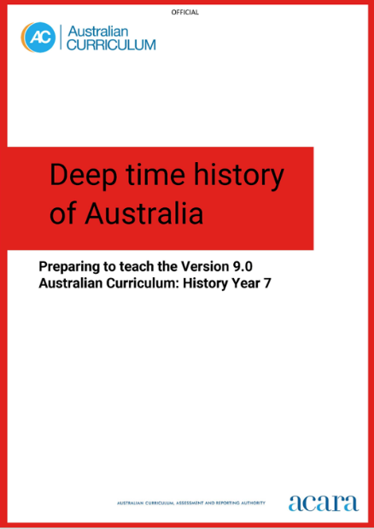
Deep time history of Australia resource
Themes
We are here — creation stories, and timelines of arrival and connection to locations across Sahul.
We survive change — survival knowledges used to adjust and thrive during environmental changes happening over extensive timeframes.
Our Cultures continue — ongoing use of technological and ecological knowledge systems.
ACARA 2024 Deep time history of Australia resource p. 2. https://v9.australiancurriculum.edu.au/teacher-resources/learning-area-resources/deep_time_history_of_australia_resource.html
Notes:
The Australian Curriculum Deep time history of Australia: Preparing to teach the Version 9.0 Australian Curriculum: History Year 7 resource may support you with resourcing, focusing and sequencing the new subject matter in your Deep time history of Australia unit.
‘The resource has been designed around three themes. These themes support teachers to organise the knowledge, understanding and skills described in the content descriptions and achievement standard into a coherent sequence of lessons.’ (ACARA, 2024, p. 2)
‘The guide provides teachers with a curated list of resources that are developed and endorsed by First Nations Australians.’ (ACARA, 2024. p. 3)
Source: ACARA 2024 Deep time history of Australia: Preparing to teach the Version 9.0 Australian Curriculum: History Year 7 pp. 1–3,
https://v9.australiancurriculum.edu.au/teacher-resources/learning-area-resources/deep_time_history_of_australia_resource.html

Slide 11
Deep time history of Australia: Content descriptions
Code | Content descriptions
AC9HH7K01 | theories and historical interpretations about early human evolution and migration, such as the theory that people moved out of Africa and the causes of migration to other parts of the world, including Australia
AC9HH7K02 | theories about the causes and effects of the arrival of early First Nations Australians on the Australian continent and their migration routes across the continent
AC9HH7K03 | how First Nations Australians are the world’s oldest continuing cultures, displaying evidence of both continuity and change over deep time
AC9HH7K04 | how First Nations Australians have responded to environmental processes and changes over time
AC9HH7K05 | the technological achievements of early First Nations Australians, and how these developed in different places and contributed to daily life, and land and water source management
AC9HH7K06 | the social organisation and cultural practices of early First Nations Australians, and their continuity and change over time
AC9HH7K07 | the cultural obligations of First Nations Australians about significant heritage sites, including ancestral remains, material culture and artefacts, and the role of collaboration between First Nations Australians and other individuals and groups to ensure cultural preservation
Notes:
Some general considerations for planning using the content descriptions are:
Could some content descriptions be taught at a higher level over one or two lessons and more time be spent delving deeply into others?
Do the content descriptions need to be taught in the order presented in the curriculum?
Which content description might make a suitable entry point for your unit and for your students?
Is there a content description where you can bring in subject matter particularly relevant to your local context?
Is there a content description that could provide an organising idea for your unit?
Is there a content description that suggests a focus for an assessment task?
Source: content descriptions from ACARA 2024 History 7–10 — Year 7, https://v9.australiancurriculum.edu.au/f-10-curriculum/learning-areas/history-7-10/year-7?view=quick&detailed-content-descriptions=0&hide-ccp=0&hide-gc=0&side-by-side=1&strands-start-index=0&subjects-start-index=0

Slide 12
An approach to planning for Year 7
Notes:
Sample curriculum and assessment plans that show a variety of approaches to planning are available on the on the QCAA 7–10 History page (Planning tab) — www.qcaa.qld.edu.au/p-10/aciq/version-9/learning-areas/p-10-humanities-and-social-sciences/history.
The following slides unpack this sample Year 7 curriculum and assessment plan.
Source: State of Queensland (QCAA) 2023, Year 7 History curriculum and assessment plan: Example, www.qcaa.qld.edu.au/downloads/aciqv9/humanities-and-social-sciences/planning/ac9_hass_history_yr7_cap_example.pdf

Slide 13
An approach to planning for Year 7
Years 11–12
AC v9.0 History
Prep–Year 6 HASS
Notes:
When planning, consider how Year 7 fits in the sequence of a student’s learning. What have students been learning prior to their entry to the middle years? How does learning in the Australian Curriculum prepare students for senior pathways?

Slide 14
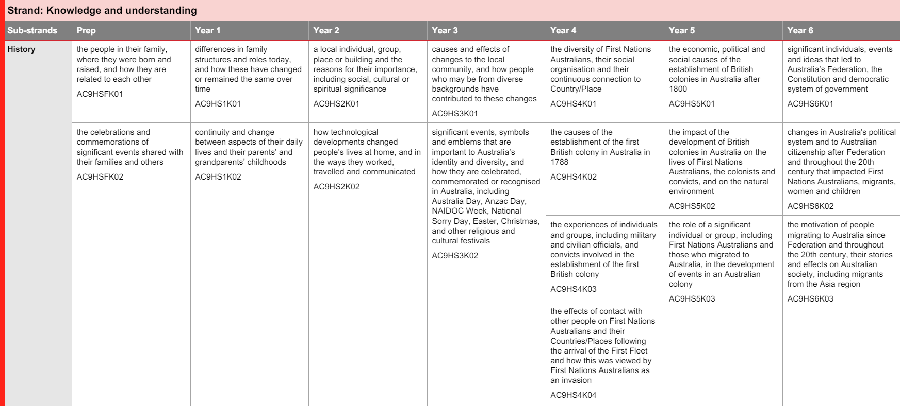
An approach to planning for Year 7
Source: QCAA 2022 Prep-Year 6 HASS: Sequence of content descriptions
Notes:
The QCAA Prep–Year 6 HASS Australian Curriculum Version 9.0: Sequence of content descriptions resource shows students’ HASS learning in the primary years.
Reflection point:
How does learning in HASS in the primary years influence your planning for Year 7?
Source: State of Queensland (QCAA) 2023, Prep–Year 6 HASS Australian Curriculum Version 9.0: Sequence of content descriptions, www.qcaa.qld.edu.au/downloads/aciqv9/humanities-and-social-sciences/curriculum/ac9_hass_p-6_cd_sequence.pdf

Slide 15
An approach to planning for Year 7
Source: QCAA 2023 ‘Year 7 History Curriculum and assessment plan’
Notes:
The following slides unpack the sample Year 7 History curriculum and assessment plan.
The first planning consideration was the order of units.
In this example, the Ancient World unit was delivered first and the Deep time history of Australia unit built on this learning.
This also supports one of the key considerations for History: Australian history within a world history approach.
Source: State of Queensland (QCAA) 2023, Year 7 History curriculum and assessment plan: Example, www.qcaa.qld.edu.au/downloads/aciqv9/humanities-and-social-sciences/planning/ac9_hass_history_yr7_cap_example.pdf

Slide 16
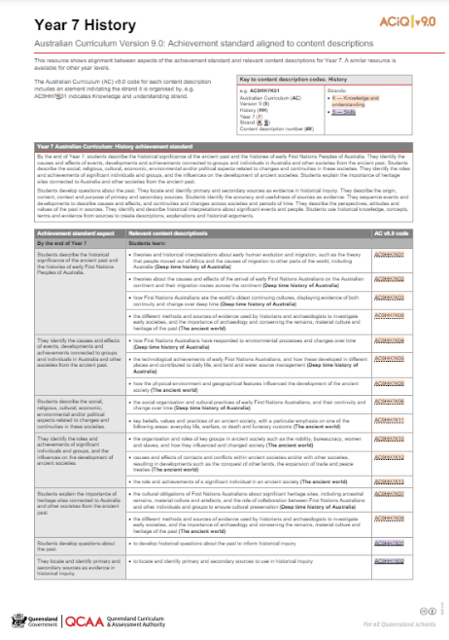
An approach to planning for Year 7
Decisions to be made about authentic connections to AS for your context
Notes:
The next consideration in planning for this year level was to review the QCAA content descriptions aligned to the achievement standard resource to make decisions about which aspects of the achievement standard would be assessed in each unit.
For example, the particular aspect of the achievement standard in the grey box on the left of screen has subject matter connections to both Knowledge and understanding sub-strands.
The decision was made to assess this aspect of the achievement standard in Unit 1 The ancient world in the sample curriculum and assessment plan.
Source: State of Queensland (QCAA) 2023, Year 7 History Australian Curriculum Version 9.0: Achievement standard aligned to content descriptions, www.qcaa.qld.edu.au/downloads/aciqv9/humanities-and-social-sciences/curriculum/ac9_history_yr7_as_cd_alignment.pdf

Slide 17
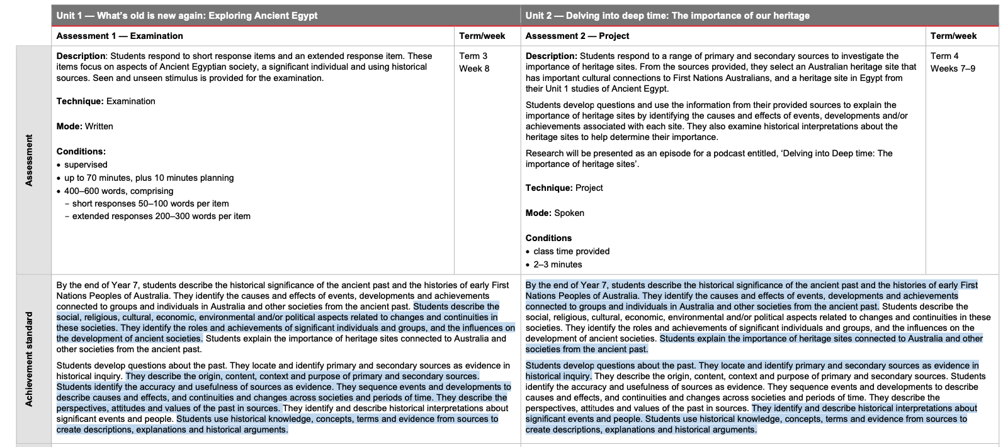
An approach to planning for Year 7
Source: QCAA 2023 ‘Year 7 History Curriculum and assessment plan’
Notes:
On the second page of the sample curriculum and assessment plan, the aspects of the achievement standard to be assessed in each unit are highlighted in blue.
In the sample curriculum and assessment plan, the three aspects of the achievement standard that refer to both Australia and other societies from the ancient past are assessed in Unit 2 (Deep time history of Australia sub-strand).
Source: State of Queensland (QCAA) 2023, Year 7 History curriculum and assessment plan: Example, www.qcaa.qld.edu.au/downloads/aciqv9/humanities-and-social-sciences/planning/ac9_hass_history_yr7_cap_example.pdf

Slide 18
An approach to planning for Year 7
Source: QCAA 2023 ‘Year 7 History Curriculum and assessment plan’
Notes:
Consideration was then given to the assessment tasks that would facilitate assessment of the targeted aspects of the achievement standard.
The assessment task for Unit 2 described in the sample curriculum and assessment plan focuses on exploring the importance of heritage sites for both Australia and the other ancient society selected for study.
In this sample, the scheduling of the Deep time history of Australia sub-strand after the Ancient Egypt unit allows students to build on their prior learning from Unit 1 to support the preparation of their project on heritage sites in Unit 2. As part of Unit 1, it is envisaged that the teaching and learning activities would allow students to learn about Ancient Egyptian heritage sites in preparation for this aspect of their assessment in Unit 2.
Note, the sample curriculum and assessment plan represents only one possible approach to year level planning.
Source: State of Queensland (QCAA) 2023, Year 7 History curriculum and assessment plan: Example, www.qcaa.qld.edu.au/downloads/aciqv9/humanities-and-social-sciences/planning/ac9_hass_history_yr7_cap_example.pdf

Slide 19
Other deep time resources
FIRST Framework
National Museum of Australia
Australia’s Defining Moments Digital Classroom
Deep time history of Australia
ACARA 2024 'FIRST Framework' https://v9.australiancurriculum.edu.au/resources/aboriginal-and-torres-strait-islander-histories-and-cultures/first-framework
National Museum of Australia 2024 'Deep time history of Australia https://digital-classroom.nma.gov.au/learning-modules/deep-time-history-australia
Notes:
Sources:
ACARA 2024, FIRST Framework, https://v9.australiancurriculum.edu.au/resources/aboriginal-and-torres-strait-islander-histories-and-cultures/first-framework
National Museum of Australia 2024, Deep time history of Australia https://digital-classroom.nma.gov.au/learning-modules/deep-time-history-australia

Slide 20
Knowledge and understanding Sub-strands: History
Year 7 |  | Year 8 |  | Year 9 |  | Year 10
Deep time history of Australia |  | Medieval Europe and the early modern world |  | Making and transforming the Australian nation (1750–1914) |  | Second World War
The ancient world |  | Empires and expansions |  | First World War (1914–1918) |  | Building modern Australia
 |  | Asia-Pacific world |  | The Industrial Revolution and the movement of peoples (1750–1900) |  | The globalising world
 |  |  |  | Asia and the world (1750–1914)
Select one from the following:
Medieval Europe (c.590‒c.1500)
The Renaissance (c.1400‒c.1600)
The emergence of the modern world (c.1500‒1650)
History v9.0
*Bold titles indicate those sub-strands that are expected to be studied in the year level.
Notes:
In Year 8, while three sub-strands are available for study, at least two sub-strands are expected to be studied. One of these will be Medieval Europe and the early modern world as indicated in bold.
In Year 8, students study at least one topic from the sub-strand Medieval Europe and the early modern world.
Two of these topics, Medieval Europe and The Renaissance, were included in v8.4 while The emergence of the modern world is a new topic in this sub-strand.
Reflection points:
If your school has been teaching Medieval Europe or The Renaissance in v8.4, the transition to a new curriculum is an opportunity to reflect on what’s working well and where plans could be refreshed.
If one of these topics was not included as a depth study in your v8.4 planning, at least one of these topics is expected to be studied with the transition to v9.0.
Source: Adapted from ACARA 2024, History 7–10, https://v9.australiancurriculum.edu.au/f-10-curriculum/learning-areas/history-7-10/year-7_year-8_year-9_year-10?view=quick&detailed-content-descriptions=0&hide-ccp=0&hide-gc=0&side-by-side=1&strands-start-index=0

Slide 21
Knowledge and understanding sub-strands: History
Year 7 |  | Year 8 |  | Year 9 |  | Year 10
Deep time history of Australia |  | Medieval Europe and the early modern world |  | Making and transforming the Australian nation (1750–1914) |  | Second World War
The ancient world |  | Empires and expansions |  | First World War (1914–1918) |  | Building modern Australia
 |  | Asia-Pacific world |  | The Industrial Revolution and the movement of peoples (1750–1900) |  | The globalising world
 |  |  |  | Asia and the world (1750–1914)
Select one topic from the following:
Mongol Empire (c.1206–c.1368)
Ottoman Empire (c.1299–c.1683)
Vikings (c.790–c.1066)
The Spanish conquest of the Americas (c.1492–c.1572)
History v9.0
Select one topic from the following:
Angkor/Khmer Empire (c.802–c.1431)
Japan under the Shoguns (c.794–1867)
Polynesian expansion across the Pacific (c.700–1756)
*Bold titles indicate those sub-strands that are expected to be studied in the year level.
Notes:
Students are expected to study at least one topic from either of the other two sub-strands, Empires and expansions or Asia-Pacific world.
Reflection point:
Within these choices are all of the v8.4 topics, except The Black Death (which could be studied as part of the Medieval Europe sub-strand).
Does the transition to a new curriculum provide an opportunity to reimagine the topics of study you include in your Year 8 curriculum and assessment plan?
Source: Adapted from ACARA 2024, History 7–10, https://v9.australiancurriculum.edu.au/f-10-curriculum/learning-areas/history-7-10/year-7_year-8_year-9_year-10?view=quick&detailed-content-descriptions=0&hide-ccp=0&hide-gc=0&side-by-side=1&strands-start-index=0

Slide 22
Knowledge and understanding sub-strands: History
Year 7 |  | Year 8 |  | Year 9 |  | Year 10
Deep time history of Australia |  | Medieval Europe and the early modern world |  | Making and transforming the Australian nation (1750–1914) |  | Second World War
The ancient world |  | Empires and expansions |  | First World War (1914–1918) |  | Building modern Australia
 |  | Asia-Pacific world |  | The Industrial Revolution and the movement of peoples (1750–1900) |  | The globalising world
 |  |  |  | Asia and the world (1750–1914)
History v9.0
*Bold titles indicate those sub-strands that are expected to be studied in the year level.
Notes:
In Year 9 four sub-strands are available for study.
Students are expected to study the two sub-strands in bold: Making and transforming the Australian nation (1750–1914) and the sub-strand First World War (1914–1918).
The Industrial Revolution and movement of peoples (1750–1900) and the Asia and the World (1750–1914) sub-strands may be studied as additional options.
Reflection point:
In v8.4. Making a Nation was an option for study. This is now a sub-strand that is expected to be studied in v9.0.
The v8.4 depth study Progressive ideas and movements is not a v9.0 sub-strand.
The v8.4 depth studies The Industrial Revolution and Movement of peoples have been combined into one optional v9.0 sub-strand.
Source: Adapted from ACARA 2024, History 7–10, https://v9.australiancurriculum.edu.au/f-10-curriculum/learning-areas/history-7-10/year-7_year-8_year-9_year-10?view=quick&detailed-content-descriptions=0&hide-ccp=0&hide-gc=0&side-by-side=1&strands-start-index=0

Slide 23
Knowledge and understanding sub-strands: History
Year 7 |  | Year 8 |  | Year 9 |  | Year 10
Deep time history of Australia |  | Medieval Europe and the early modern world |  | Making and transforming the Australian nation (1750–1914) |  | Second World War
The ancient world |  | Empires and expansions |  | First World War (1914–1918) |  | Building modern Australia
 |  | Asia-Pacific world |  | The Industrial Revolution and the movement of peoples (1750–1900) |  | The globalising world
 |  |  |  | Asia and the world (1750–1914)
History v9.0
*Bold titles indicate those sub-strands that are expected to be studied in the year level.
Notes:
In Year 10, three sub-strands are available for study. Students are expected to study the two sub-strands in bold: Second World War and Building modern Australia.
The globalising world is a sub-strand that may be studied as an additional option.
Reflection point:
The v8.4 depth studies Rights and freedoms, Popular culture, Migration experiences and The environment movement are not in v9.0, but aspects of the content has been included in the sub-strands Building a modern Australia and The globalising world.
Source: Adapted from ACARA 2024, History 7–10, https://v9.australiancurriculum.edu.au/f-10-curriculum/learning-areas/history-7-10/year-7_year-8_year-9_year-10?view=quick&detailed-content-descriptions=0&hide-ccp=0&hide-gc=0&side-by-side=1&strands-start-index=0

Slide 24
Pause and reflect
Which of these key messages resonated with you?
To plan focused and manageable units of work consider your approach to the subject matter, development of skills and student engagement.
Careful sequencing of content descriptions for Deep time and mapping the Year 7 achievement standard across the year creates focused, manageable units of work.
There are sub-strands in v9.0 that are expected to be studied where they were options in v8.4.

Slide 25
Outline
Development of historical skills across Years 7–10
New subject matter in the Knowledge and understanding strand
Planning focused and manageable units of work for middle years learners

Slide 26
Structure of Skills strand: v8.4 to v9.0
— Sub-strands — | History v8.4
 | Chronology, terms and concepts
 | Historical questions and research |  | Questioning and researching
 | Analysis and use of sources |  | Using historical sources
 | Perspectives and interpretations |  | Historical perspectives and interpretations
 | Explanation and communication |  | Communicating
History v9.0
Notes:
Highlighted in red are the revised Skills sub-strands for v9.0 History.
Source: Adapted from ACARA 2024, History 7–10, https://v9.australiancurriculum.edu.au/f-10-curriculum/learning-areas/history-7-10/year-7_year-8_year-9_year-10?view=quick&detailed-content-descriptions=0&hide-ccp=0&hide-gc=0&side-by-side=1&strands-start-index=0

Slide 27
Gradual development of historical skills
Years 11–12
AC v9.0 History
Prep–Year 6 HASS
Notes:
When we plan to teach historical skills, we’d also begin by looking at the middle years curriculum in the wider context of a student’s learning by examining what skills development has occurred prior and the senior pathways students move on to.
Reflection point:
How does teaching the Australian Curriculum v9.0: History prepare students for senior pathways?

Slide 28
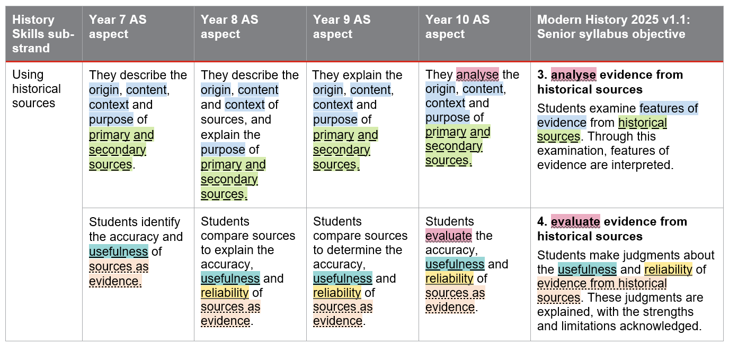
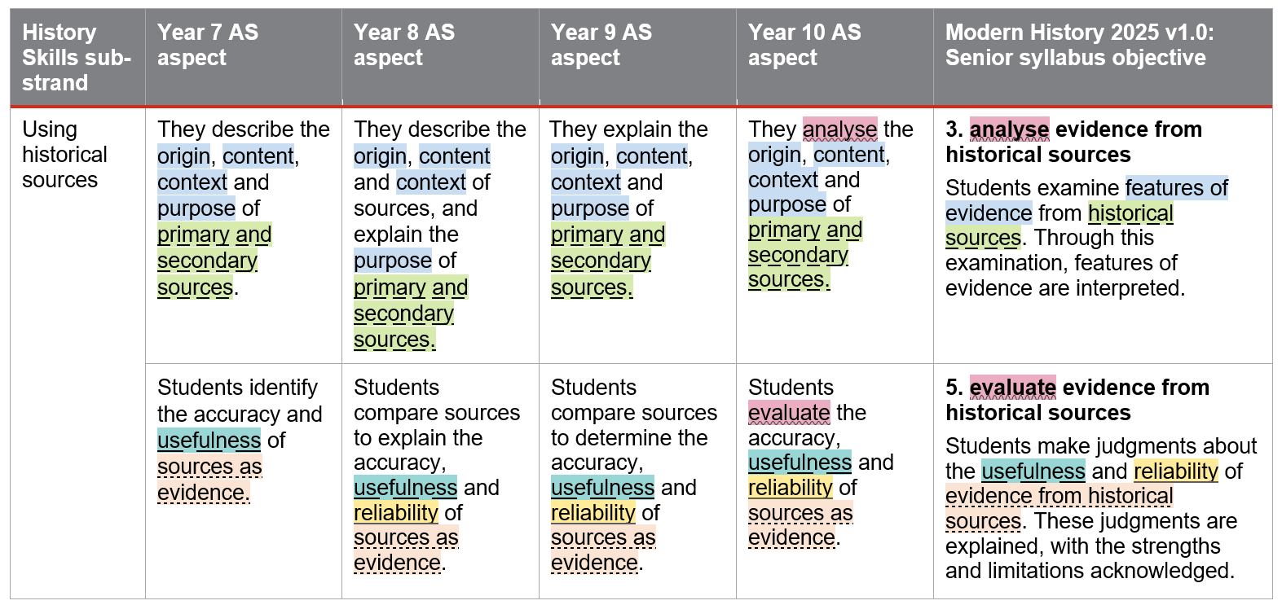
Gradual development of historical skills
AS to syllabus objective
Notes:
Shown here is just one Years 7–10 Skills sub-strand ‘Using historical sources’ placed next to relevant syllabus objectives from the revised Modern History 2025 syllabus.
There are clear links between the skills developed across Years 7–10 History and the skills students develop further in senior as they work with ‘features of evidence’ from ‘historical sources’.
Reflection point:
What do you notice about how skills develop across the middle years?
What do you notice about how teaching the Years 7–10 Australian Curriculum prepares students for senior pathways?
How can planning reflect the progressive development of historical skills across the middle years?
Source: adapted from
ACARA 2024 History 7–10 — Year 7, https://v9.australiancurriculum.edu.au/f-10-curriculum/learning-areas/history-7-10/year-7?view=quick&detailed-content-descriptions=0&hide-ccp=0&hide-gc=0&side-by-side=1&strands-start-index=0&subjects-start-index=0
State of Queensland (QCAA) 2024, Modern History 2025 v1.1 General senior Syllabus July 2024, www.qcaa.qld.edu.au/downloads/senior-qce/syllabuses/snr_modern_history_25_syll.pdf

Slide 29
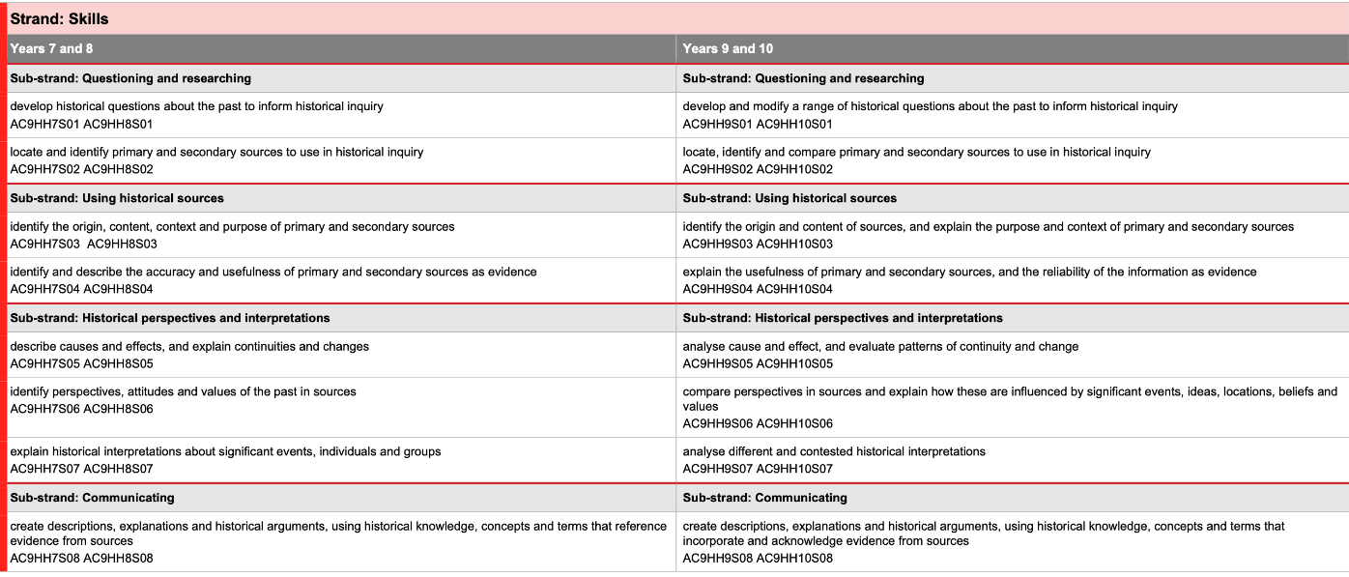
Sequence of content descriptions resource
Notes:
This QCAA resource may support planning for Skills development as it shows the Skills content descriptions for Years 7‒8 and Years 9‒10 side by side, showing how the skills step up across the two bands.
Source: State of Queensland (QCAA) 2022, Year 7–10 History: Australian Curriculum Version 9.0: Sequence of content descriptions, www.qcaa.qld.edu.au/downloads/aciqv9/humanities-and-social-sciences/curriculum/ac9_hass_hist_yr7-10_cd_sequence.pdf p. 4

Slide 30
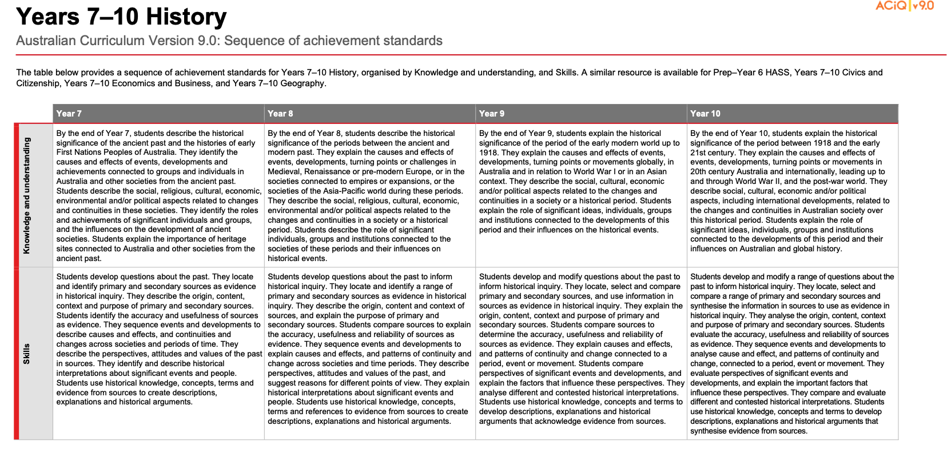
Sequence of achievement standards resource
Notes:
However, it’s important to note that in the achievement standards, the skills step up a little each year — reflecting how students’ skills develop across the two-year bands in the content descriptions.
This Sequence of achievement standards resource places the achievement standard for each year level side by side to support planning for skills development for Version 9.0 of the History curriculum.
Source: State of Queensland (QCAA) 2022, Year 7–10 History: Australian Curriculum Version 9.0: Sequence of achievement standards, www.qcaa.qld.edu.au/downloads/aciqv9/humanities-and-social-sciences/curriculum/ac9_hass_hist_yr7-10_as_sequence.pdf

Slide 31
Pause and reflect
Which of these key messages resonated with you?
The Skills strand has been refined and reorganised.
There are explicit links between the skills developed across Years 7–10 and the skills students develop further in their senior secondary pathways.
Careful consideration of the expectations described in each year level achievement standard is necessary to ensure activities and assessment are focused and manageable.

Slide 32
References
Australian Curriculum, Assessment and Reporting Authority 2024, Deep time history of Australia: Preparing to teach the Version 9.0 Australian Curriculum: History Year 7. https://v9.australiancurriculum.edu.au/content/acara-curriculum/au/en/teacher-resources/learning-area-resources/deep_time_history_of_australia_resource.html
Australian Curriculum, Assessment and Reporting Authority 2024, FIRST Framework, https://v9.australiancurriculum.edu.au/resources/aboriginal-and-torres-strait-islander-histories-and-cultures/first-framework
National Museum of Australia 2024 'Deep time history of Australia’, Australia’s Defining Moments Digital Classroom. https://digital-classroom.nma.gov.au/learning-modules/deep-time-history-australia

Slide 33
Acknowledgments
Third-party copyright material, and QCAA material not covered by the CC BY licence is listed below:
Queensland Government coat of arms, and the QCAA and QSA trademarks may not be reproduced without permission.
Acknowledgment of Country artwork (2023) ‘Growth through Learning’ by Chern’ee, Brooke and Jesse Sutton, Kalkadoon. www.cherneesutton.com.au
Unless otherwise indicated, material from Australian Curriculum is © ACARA 2010–present, licensed CC BY 4.0. For the latest information and additional terms of use, see the Australian Curriculum website and its copyright notice.
First framework diagram is 'Excluded Material' used under the terms of the Australian Curriculum and its copyright notice and is not modified. © Australian Curriculum, Assessment and Reporting Authority (ACARA) 2009 to present, unless otherwise indicated. You may view, download, display, print, reproduce (such as by making photocopies) and distribute these Excluded Materials in unaltered form only for your personal, non-commercial educational purposes or for the non-commercial educational purposes of your organisation, provided that you make others aware it can only be used for these purposes and attribute ACARA as the source of the Excluded Material. For the avoidance of doubt, this means that you cannot edit, modify or adapt any of these materials, and you cannot sub-license any of these materials to others. Apart from any uses permitted under the Copyright Act 1968 (Cth), and those explicitly granted above, all other rights are reserved by ACARA. If you want to use such material in a manner that is outside this restrictive licence, you must request permission from ACARA by submitting a request through the online enquiry form.
Student and staff images have been used with permission.

Slide 34
Copyright notice
© State of Queensland (QCAA) 2024
Licence: https://creativecommons.org/licenses/by/4.0 | Copyright notice: www.qcaa.qld.edu.au/copyright — lists the full terms and conditions, which specify certain exceptions to the licence. | Attribution (include the link): © State of Queensland (QCAA) 2024 www.qcaa.qld.edu.au/copyright.
Other copyright material in this presentation is listed on the previous slide/s.

Slide 35
QCAA social media

