Slide 1
Planning quality programs for learners in the middle years
241009
Years 7–10 Australian Curriculum v9.0: Civics and Citizenship
Notes:
This resource reproduces key slides from the webinar delivered in Semester 1, 2024.
For more resources see the Australian Curriculum v9.0 in Queensland (ACiQ) Civics and Citizenship page: www.qcaa.qld.edu.au/p-10/aciq/version-9/learning-areas/p-10-humanities-and-social-sciences/civics-and-citizenship.

Slide 2
Acknowledgment of Country

Slide 3
Learning goal
Success criteria
Understand how to design quality curriculum and assessment plans for the Australian Curriculum v9.0: Civics and Citizenship.
You will know you are successful if you can:
consider how the needs of middle years learners inform planning in Civics and Citizenship
understand ways to organise the Civics and Citizenship sub-strands into units of work
identify strategies to develop age-appropriate assessment in Civics and Citizenship.

Slide 4
Outline
Planning units of work using the Knowledge and understanding sub-strands
Developing age-appropriate assessment
Considering middle years learners in Civics and Citizenship

Slide 5
Curriculum planning
Civics and Citizenship curriculum
Middle years learners
Notes:
While the Civics and Citizenship curriculum has been written for the middle years, planning to implement the curriculum also needs to be very cognisant of the needs and interests of middle years learners.

Slide 6
Outline
Planning units of work using the Knowledge and understanding sub-strands
Developing age-appropriate assessment
Considering middle years learners in Civics and Citizenship

Slide 7
Combining the Knowledge and understanding sub-strands
Examples
Year 7
Year 8
Year 9
Unit 1
Unit 1
Unit 1
Laws and citizens
Government and democracy
Citizenship, diversity and identity
Citizenship, diversity and identity
Citizenship, diversity and identity
Unit 2
Laws and citizens
Unit 2
Unit 2
Government and democracy
Laws and citizens
Government and democracy
Notes:
In Civics and Citizenship, the Knowledge and understanding strand contains 3 sub-strands.
One possible approach to planning is to develop a unit of work for each Knowledge and understanding sub-strand.
However, the sample curriculum and assessment plans on the QCAA website combine some Knowledge and understanding sub-strands to develop two units of work out of the three Knowledge and understanding sub-strands.
This graphic shows the different ways the sub-strands have been combined in QCAA sample curriculum and assessment plans to illustrate a range of possible approaches to planning.
Sample curriculum and assessment plans are available on the QCAA 7–10 Civics and Citizenship page (Planning tab): www.qcaa.qld.edu.au/p-10/aciq/version-9/learning-areas/p-10-humanities-and-social-sciences/civics-and-citizenship/planning.

Slide 8
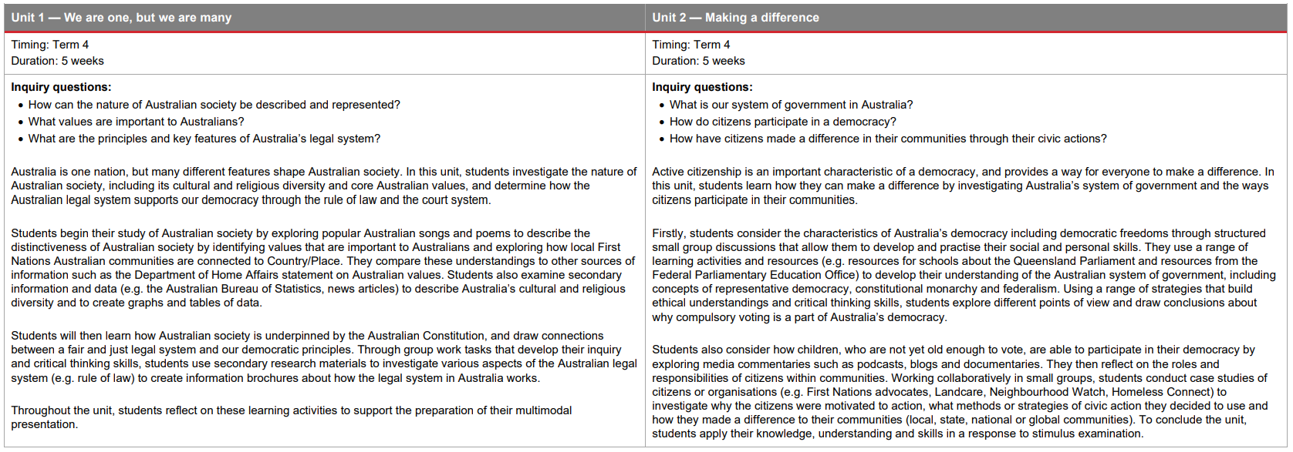
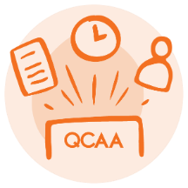
Curriculum and assessment plan
Year 7 example
Laws and citizens
Government and democracy
Citizenship, diversity and identity
Notes:
In the Year 7 Civics and Citizenship curriculum and assessment plan example, two 5-week units have been developed.
The Government and democracy sub-strand is taught as one discrete unit.
The other two sub-strands are taught together in the first unit.
Source: State of Queensland (QCAA) 2023, Year 7 Civics and Citizenship Curriculum and assessment plan: Example, www.qcaa.qld.edu.au/downloads/aciqv9/humanities-and-social-sciences/planning/ac9_hass_civ_cit_yr7_cap_example.pdf

Slide 9
Combining Knowledge and understanding sub-strands
Laws and citizens
Citizenship, diversity and identity
Notes:
In this Year 7 example, the description of the first unit of work incorporates content descriptions from both Knowledge and understanding sub-strands.
Reflection points:
What are the advantages, and the challenges, of combining two sub-strands into one unit of work?
What are other possibilities for organising the content descriptions in the Year 7 Civics and Citizenship curriculum into units of work?

Slide 10
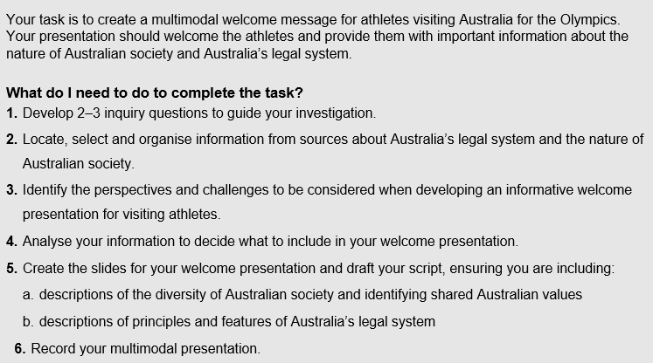
Assessment plan
Laws and citizens
Citizenship, diversity and identity
Notes:
The assessment described in the curriculum and assessment plan provides opportunity for students to demonstrate their learning from both Knowledge and understanding sub-strands.
The task of producing a ‘welcome message’ for athletes coming to the Brisbane Olympics helps to ‘hold’ the content from the two sub-strands together.
An example of what a task might look like is shown here. Students describe the nature of Australian society, its diversity and values, and principles and features of the Australian legal system with a particular purpose in mind.
Students would not be expected to describe every aspect associated with the nature of Australian society, its diversity and values and the legal system, but they would need to think about particular aspects that would be important for an athlete coming to Australia to know. This assessment idea could be adjusted to suit different community contexts.

Slide 11
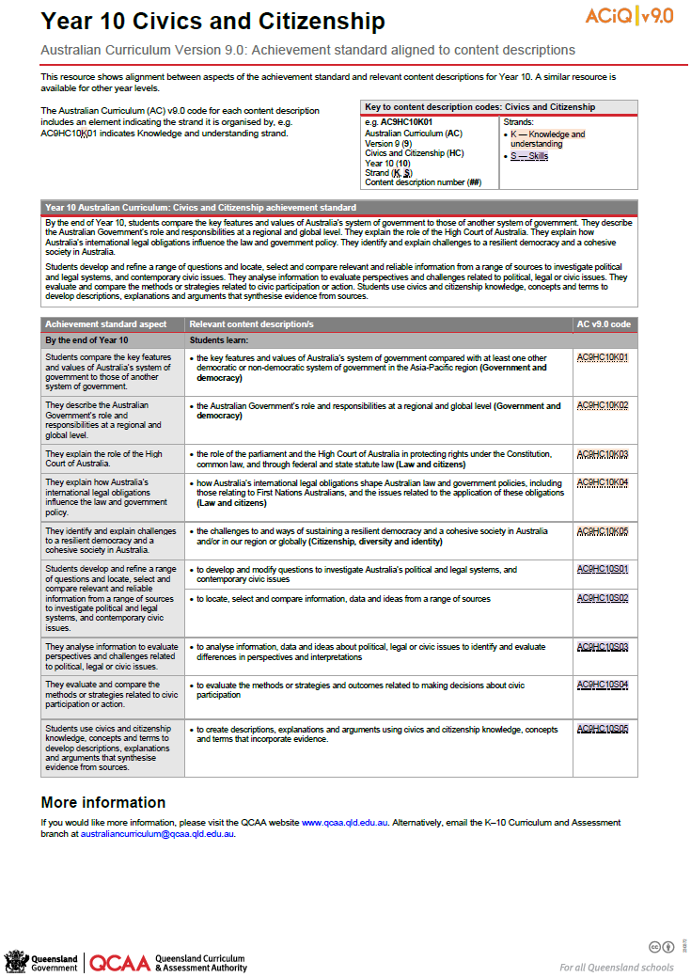
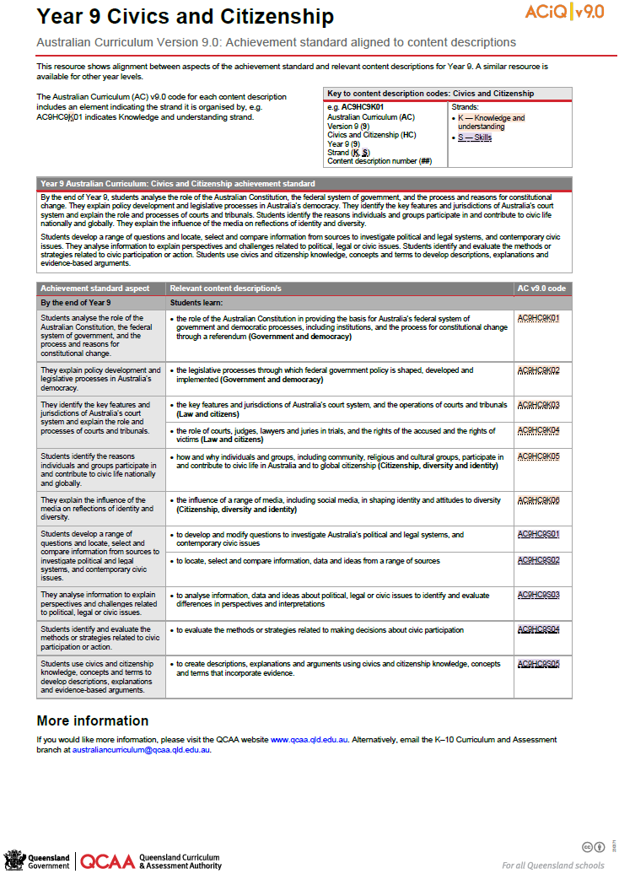
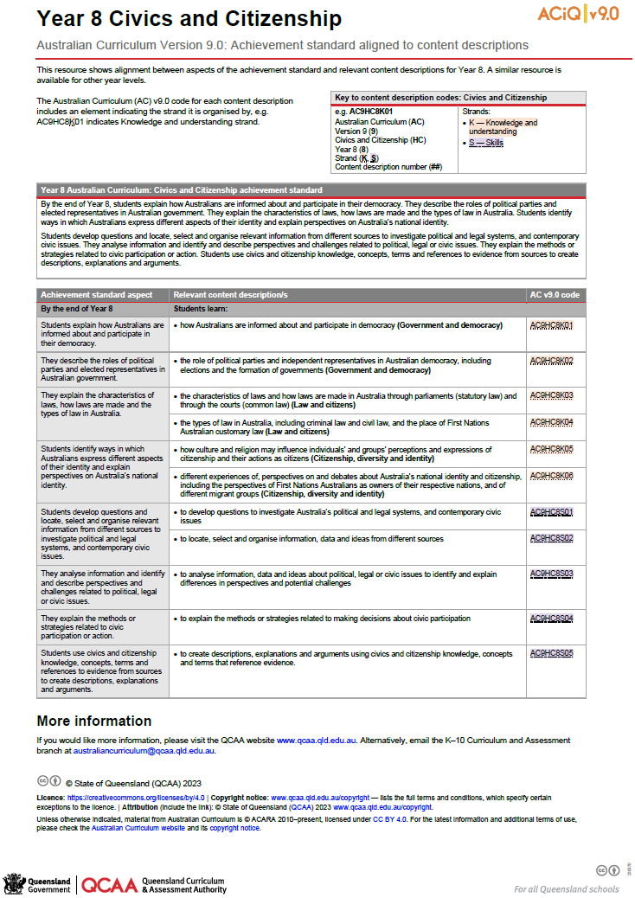
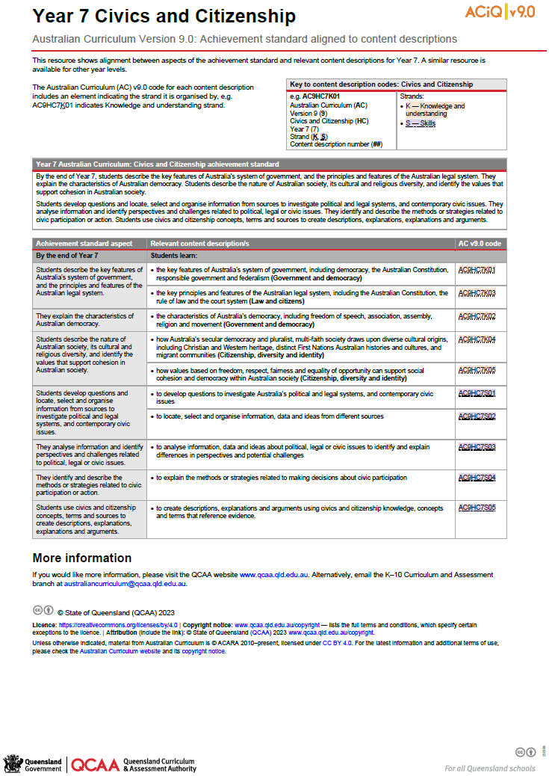
Achievement standard aligned to content descriptions
Available for each year level.
Notes:
Achievement standard aligned to content descriptions resources are available for each year level and support planning for Civics and Citizenship.
These are located on the QCAA 7–10 Civics and Citizenship page: www.qcaa.qld.edu.au/p-10/aciq/version-9/learning-areas/p-10-humanities-and-social-sciences/civics-and-citizenship.
Sources:
State of Queensland 2023, Year 7 Civics and Citizenship — Australian Curriculum Version 9.0: Achievement standard aligned to content descriptions, www.qcaa.qld.edu.au/downloads/aciqv9/humanities-and-social-sciences/curriculum/ac9_civ_cit_yr7_as_cd_alignment.pdf
State of Queensland 2023, Year 8 Civics and Citizenship — Australian Curriculum Version 9.0: Achievement standard aligned to content descriptions, www.qcaa.qld.edu.au/downloads/aciqv9/humanities-and-social-sciences/curriculum/ac9_civ_cit_yr8_as_cd_alignment.pdf
State of Queensland 2023, Year 9 Civics and Citizenship — Australian Curriculum Version 9.0: Achievement standard aligned to content descriptions, www.qcaa.qld.edu.au/downloads/aciqv9/humanities-and-social-sciences/curriculum/ac9_civ_cit_yr9_as_cd_alignment.pdf
State of Queensland 2023, Year 10 Civics and Citizenship — Australian Curriculum Version 9.0: Achievement standard aligned to content descriptions, www.qcaa.qld.edu.au/downloads/aciqv9/humanities-and-social-sciences/curriculum/ac9_civ_cit_yr10_as_cd_alignment.pdf

Slide 12
Outline
Planning units of work using the Knowledge and understanding sub-strands
Developing age-appropriate assessment
Considering middle years learners in Civics and Citizenship

Slide 13
Designing age-appropriate assessment
Student success
Provide engaging contexts
Align to targeted aspects of the achievement standard
Manage scope and scale
Notes:
Three strategies that support the design of age-appropriate assessment are to:
narrow the focus of the task, while ensuring alignment to the targeted aspects of the achievement standard
provide engaging contexts for assessment
manage the scope and scale of tasks.

Slide 14
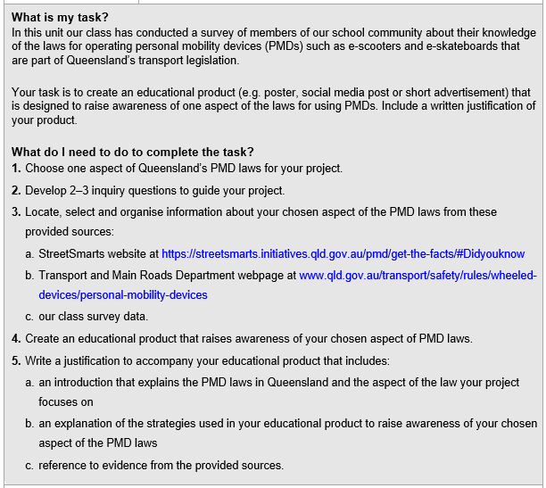
Project: Year 8 example
Example: Year 8 task
Provide engaging contexts
Manage scope and scale
Manage scope and scale
Align to targeted aspects of the achievement standard
Notes:
These three strategies are relevant to all techniques and are also illustrated in this example of a project focused on laws in Queensland for operating personal mobility devices (PMDs) such as e-scooters.
The focus has been narrowed, while ensuring alignment to the targeted aspects of the achievement standard, by:
focusing on one type of law — a statutory law in Queensland
requiring use of only three provided sources for the project
narrowing the civic participation or action to one educational strategy to improve awareness of PMD laws.
An engaging context for assessment has been selected where students:
are working with an authentic real-life issue and topic of potential interest
can be creative in their idea for an educational product
can make choice about the type of personal mobility device, the rule to focus on and the type of educational product.
The scope and scale of the assessment has been managed so that it can be completed within the conditions of the task through limiting the number of:
aspects of the topic to be investigated
inquiry questions required
sources used.

Slide 15
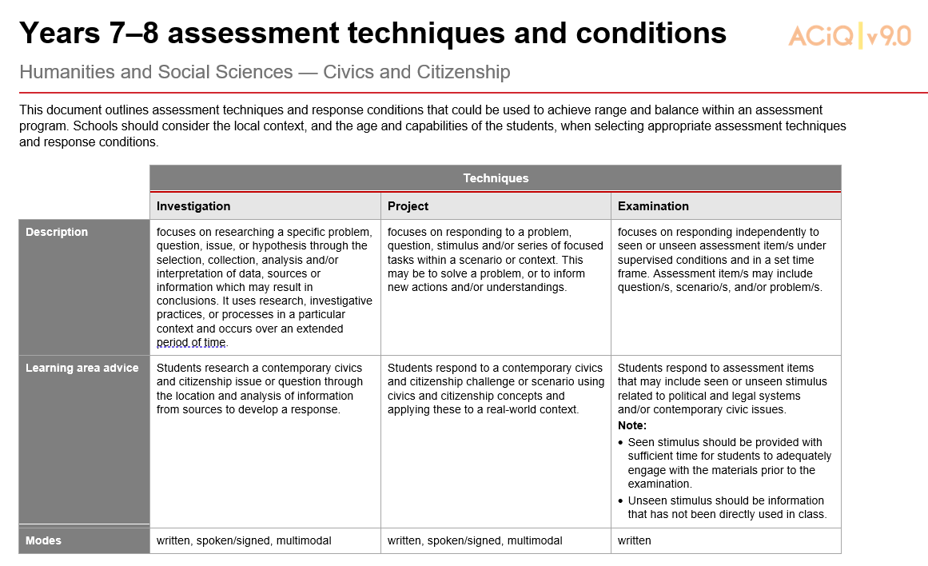
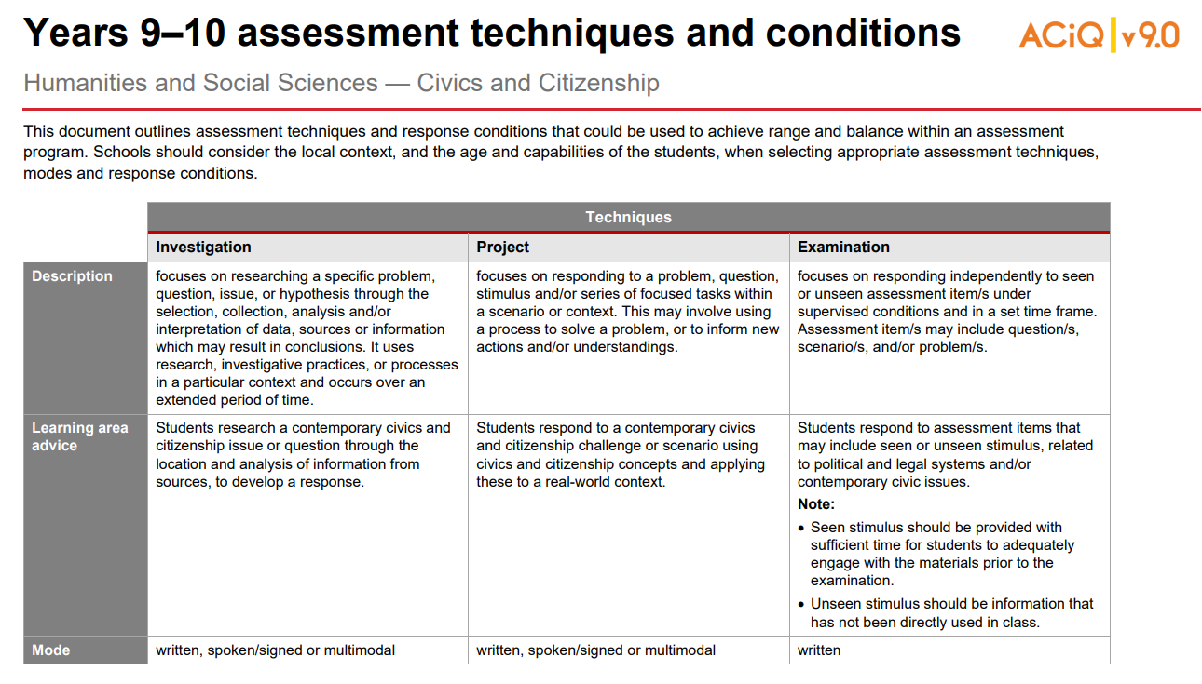
Techniques and conditions advice
Notes:
The QCAA assessment techniques and conditions resources are located on the QCAA 7–10 Civics and Citizenship page (Assessment tab): www.qcaa.qld.edu.au/p-10/aciq/version-9/learning-areas/p-10-humanities-and-social-sciences/civics-and-citizenship/assessment.
They can be used to support teachers in making decisions about scope and scale of assessment tasks.
Sources:
State of Queensland 2023, Years 7–8 assessment techniques and conditions: Humanities and Social Sciences — Civics and Citizenship, www.qcaa.qld.edu.au/downloads/aciqv9/humanities-and-social-sciences/assessment/ac9_civ_cit_tc_yr7-8.pdf
State of Queensland 2023, Years 9–10 assessment techniques and conditions: Humanities and Social Sciences — Civics and Citizenship, www.qcaa.qld.edu.au/downloads/aciqv9/humanities-and-social-sciences/assessment/ac9_civ_cit_tc_yr9-10.pdf

Slide 16
Pause and reflect
Which of these key messages resonated with you?
Middle years learners have unique needs, strengths and challenges that inform assessment design.
The Knowledge and understanding sub-strands can be combined in various ways to create units of work.
A key concept, a question, issue or assessment idea can provide a meaningful focus for units of work.
Assessment tasks that are aligned to the Australian Curriculum, have an engaging context and that manage scope and scale can support student success.
QCAA sample CAPs and other resources are available to assist curriculum and assessment planning.

Slide 17
Acknowledgments
Third-party copyright material, and QCAA material not covered by the CC BY licence is listed below:
Queensland Government coat of arms, and the QCAA and QSA trademarks may not be reproduced without permission.
Acknowledgment of Country artwork (2023) ‘Growth through Learning’ by Chern’ee, Brooke and Jesse Sutton, Kalkadoon. www.cherneesutton.com.au
Unless otherwise indicated, material from Australian Curriculum is © ACARA 2010–present, licensed CC BY 4.0. For the latest information and additional terms of use, see the Australian Curriculum website and its copyright notice.
Student and staff images have been used with permission.

Slide 18
Copyright notice
© State of Queensland (QCAA) 2024
Licence: https://creativecommons.org/licenses/by/4.0 | Copyright notice: www.qcaa.qld.edu.au/copyright — lists the full terms and conditions, which specify certain exceptions to the licence. | Attribution (include the link): © State of Queensland (QCAA) 2024 www.qcaa.qld.edu.au/copyright.
Other copyright material in this presentation is listed on the previous slide/s.

Slide 19
QCAA social media

