Slide 1
Familiarisation and planning
Australian Curriculum v9.0: Civics and Citizenship — Years 7–10
240491-01
Notes:
This presentation is designed to introduce curriculum leaders and teachers to the Australian Curriculum Version 9.0: Civics and Citizenship — Years 7‒10.

Slide 2
Acknowledgment of Country
Notes:
Acknowledgment of Country
The QCAA acknowledges the Traditional Owners and Traditional Custodians of the lands on which we meet today.
We pay our respects to their Elders and their descendants, who continue cultural and spiritual connections to Country, and we extend that respect to Aboriginal people and Torres Strait Islander people here today.
We thank them for sharing their cultures and spiritualities and recognise the important contribution of this knowledge to our understanding of this place we call home.

Slide 3
Learning goal
Understand the implications of changes in the Years 7–10 Australian Curriculum from v8.4 to v9.0: Civics and Citizenship for planning.
Success criteria
You will know you are successful if you:
have more knowledge about the intent and structure of the Years 7–10 Australian Curriculum v9.0: Civics and Citizenship
can identify actions for planning in your school.

Slide 4
Outline
Introduction to the Australian Curriculum v9.0: Civics and Citizenship
Understand this learning area and subject
Formulating next steps
Curriculum elements

Slide 5
Outline
Introduction to the Australian Curriculum v9.0: Civics and Citizenship
Understand this learning area and subject
Formulating next steps
Curriculum elements

Slide 6
HASS in the three-dimensional Australian Curriculum
Source: ACARA, www.v9.australiancurriculum.edu.au/help/website-tour
Notes:
In the Australian Curriculum Version 9.0, the three-dimensional interrelated structure has not changed as part of the review. The diagram visually represents these three dimensions.
Source: Script and picture adapted (addition of labels) from video at www.v9.australiancurriculum.edu.au/help/website-tour (time stamp 50 seconds).

Slide 7
HASS in the three-dimensional Australian Curriculum
Source: ACARA, www.v9.australiancurriculum.edu.au/help/website-tour
Notes:
The Australian Curriculum consists of eight learning areas. Civics and Citizenship which is part of the Humanities and Social Sciences (HASS) learning area is indicated in red.
Source: Script and picture adapted (addition of labels) from video at www.v9.australiancurriculum.edu.au/help/website-tour (time stamp 50 seconds).

Slide 8
HASS in the three-dimensional Australian Curriculum
Source: ACARA, www.v9.australiancurriculum.edu.au/help/website-tour
Notes:
There are seven general capabilities:
Literacy
Numeracy
Digital literacy
Critical and creative thinking
Personal and social capability
Intercultural understanding, and
Ethical understanding.
As part of the review, the general capabilities have been refined.
The Information, Communications and Technologies (ICT) general capability in v8.4 has been renamed Digital literacy in v9.0 to reflect current understandings in the field.
The Literacy and Numeracy general capabilities are no longer continua. In v9.0 they are progressions representing the fine-grained indicators of the typical trajectory of literacy and numeracy development.
The remaining general capabilities have had refinements to elements, sub-elements and continua.
Source: Script and picture adapted (addition of labels) from video at www.v9.australiancurriculum.edu.au/help/website-tour (time stamp 50 seconds).

Slide 9
HASS in the three-dimensional Australian Curriculum
Source: ACARA, www.v9.australiancurriculum.edu.au/help/website-tour
Notes:
There are three cross-curriculum priorities:
Aboriginal and Torres Strait Islander Histories and Cultures
Asia and Australia’s engagement with Asia, and
Sustainability.
Source: Script and picture adapted (addition of labels) from video at www.v9.australiancurriculum.edu.au/help/website-tour (time stamp 50 seconds).

Slide 10
Organisation of Learning areas and changes
Version 8.4
Version 9.0
Understand how the learning area works
Rationale
Aims
Key ideas
Structure
Resources (learning area specific)
Understand this learning area
Introduction
Rationale
Aims
Structure
Key considerations
Key connections
Resources
Learning area curriculum
Year level description
Achievement standard
Strands and sub-strands
Content descriptions
Threads (learning area specific)
Content elaborations
Curriculum elements
Level description
Achievement standard
Strands and sub-strands
Content descriptions
Content elaborations
Notes:
This is an overview of the organisation of all Learning areas in the Australian Curriculum Version 8.4 compared with Version 9.0, with the main changes noted.
The following slides show the organisation as it applies specifically to the HASS learning area, and the the subject, Civics and Citizenship.
Source: Image created in house using SmartArt. Adapted from https://v9.australiancurriculum.edu.au/teacher-resources/understand-this-learning-area/humanities-and-social-sciences.

Slide 11
Organisation of HASS learning area and changes
Humanities and Social Sciences (HASS)
Version 9.0
Civics and Citizenship
Version 9.0
Understand this learning area
Introduction
Rationale
Aims
Structure
Key considerations
Key connections
Resources
Understand this subject
Rationale
Aims
Structure
Key considerations
Curriculum elements
Level description
Achievement standard
Strands and sub-strands
Content descriptions
Content elaborations
Notes:
In the HASS learning area, there is a two-tier structure.
Source: Image created in house using SmartArt. Adapted from https://v9.australiancurriculum.edu.au/teacher-resources/understand-this-learning-area/humanities-and-social-sciences.

Slide 12
Organisation of HASS learning area and changes
HASS
Version 9.0
Civics and Citizenship
Version 9.0
Understand this learning area
Introduction
Rationale
Aims
Structure
Key considerations
Key connections
Resources
Understand this subject
Rationale
Aims
Structure
Key considerations
Curriculum elements
Level description
Achievement standard
Strands and sub-strands
Content descriptions
Content elaborations
Notes:
The first tier for the HASS learning area is called Understand this learning area. It outlines guiding principles of the HASS learning area and provides context for each of the subjects that sit within HASS.
In red, Key considerations and Key connections are new additions in the Australian Curriculum Version 9.0 for HASS.
Source: Image created in house using SmartArt. Adapted https://v9.australiancurriculum.edu.au/teacher-resources/understand-this-learning-area/humanities-and-social-sciences.

Slide 13
Organisation of Civics and Citizenship and changes
HASS
Version 9.0
Civics and Citizenship
Version 9.0
Understand this learning area
Introduction
Rationale
Aims
Structure
Key considerations
Key connections
Resources
Understand this subject
Rationale
Aims
Structure
Key considerations
Curriculum elements
Level description
Achievement standard
Strands and sub-strands
Content descriptions
Content elaborations
Notes:
In the second tier is information about the subject, in this case Civics and Citizenship.
Understand this subject provides detail of the intent of the subject Civics and Citizenship and a snapshot of the structure. In red is a new section, Key considerations, which includes those considerations specific to the subject, Civics and Citizenship.
Curriculum elements provides the content required in Civics and Citizenship, including the achievement standards and content descriptions.
Source: Image created in house using SmartArt. Adapted from https://v9.australiancurriculum.edu.au/teacher-resources/understand-this-learning-area/humanities-and-social-sciences.

Slide 14
Outline
Introduction to Australian Curriculum v9.0: Civics and Citizenship
Understand this learning area and subject
Formulating next steps
Curriculum elements

Slide 15
Organisation of HASS learning area
HASS
Version 9.0
Civics and Citizenship
Version 9.0
Understand this learning area
Introduction
Rationale
Aims
Structure
Key considerations
Key connections
Resources
Introduction
Rationale
Aims
Understand this subject
Rationale
Aims
Structure
Key considerations
Curriculum elements
Level description
Achievement standard
Strands and sub-strands
Content descriptions
Content elaborations
Notes:
In Version 9 the introduction includes information about the 5 subjects that comprise the HASS learning area:
P–6 HASS
Civics and Citizenship
Economics and Business
Geography
History.
The rationale and aims capture the intent of teaching HASS and inform teachers’ planning in a school context.
Source: Image created in house using SmartArt. Adapted from https://v9.australiancurriculum.edu.au/teacher-resources/understand-this-learning-area/humanities-and-social-sciences.

Slide 16
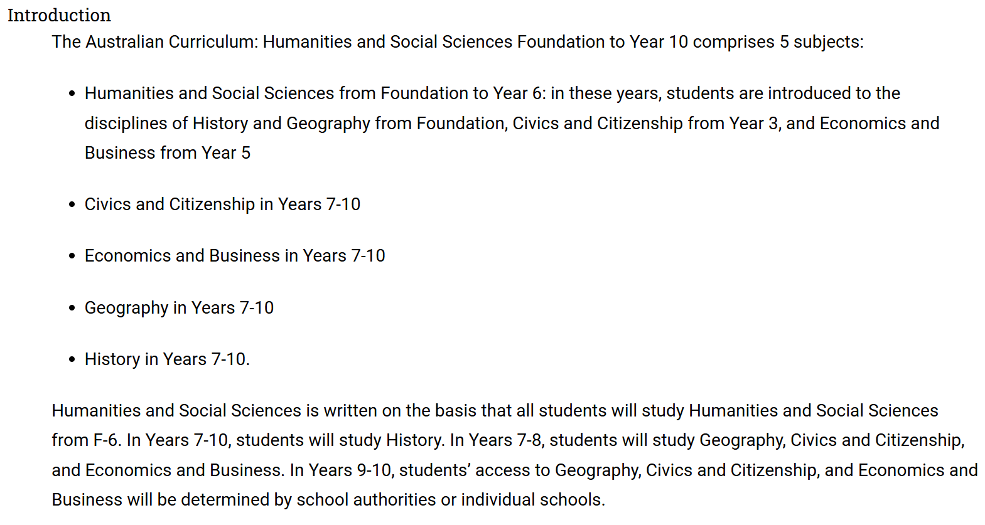
Organisation of HASS learning area
Source: Quoted verbatim and unaltered from AC https://v9.australiancurriculum.edu.au/teacher-resources/understand-this-learning-area/humanities-and-social-sciences
Notes:
The introduction in Understand this learning area also describes the learning entitlement in HASS.

Slide 17
Organisation of HASS learning area
HASS
Version 9.0
Civics and Citizenship
Version 9.0
Understand this learning area
Introduction
Rationale
Aims
Structure
Key considerations
Key connections
Resources
Understand this subject
Rationale
Aims
Structure
Key considerations
Structure
Curriculum elements
Level description
Achievement standard
Strands and sub-strands
Content descriptions
Content elaborations
Notes:
The section on structure includes information about the strands and sub-strands in the HASS learning area.
Source: Image created in house using SmartArt. Adapted https://v9.australiancurriculum.edu.au/teacher-resources/understand-this-learning-area/humanities-and-social-sciences.

Slide 18
Structure of HASS learning area: strands
Version 8.4 | Version 9.0
Knowledge and understanding | Knowledge and understanding
Inquiry and skills | Skills
Notes:
In HASS in Version 9.0, all subjects continue to be organised through strands and sub-strands. The two, interrelated strands in Version 9.0 are:
Knowledge and understanding and
Skills.
This is a small change from Version 8.4. Inquiry is now incorporated into the sub-strands as a skill.

Slide 19
Structure of Knowledge and understanding strand across the HASS learning area
History |  | Geography |  | Civics and Citizenship |  | Economics and Business
Two to four sub-strands per year level |  | Two sub-strands per year level |  | Three sub-strands per year level |  | No sub-strands
Some sub-strands are required |  | All sub-strands are required |  | All sub-strands are required |  | All content descriptions in the strand are required
Selection of topics within each sub-strand
Economics and Business v9.0
Economics and Business v9.0
Notes:
The Knowledge and understanding strand in the v9.0 HASS learning area contains varying numbers of sub-strands depending on the subject.
For example, there are different requirements across the subjects regarding what sub-strands are expected to be studied in a school’s program.
It is important to note that in Civics and Citizenship there are three sub-strands per year level and all sub-strands are expected to be studied.
Source: Adapted from https://v9.australiancurriculum.edu.au/teacher-resources/understand-this-learning-area/humanities-and-social-sciences. Image created in house using SmartArt.

Slide 20
Structure of Skills strand across the HASS learning area
— Sub-strands — | History |  | Geography |  | Civics and Citizenship |  | Economics and Business
 | Questioning and researching |  | Questioning and researching using geographical methods |  | Questioning and researching |  | Questioning and researching
 | Using historical sources |  | Interpreting and analysing geographical data and information |  | Analysis, evaluation and interpretation |  | Interpreting and analysing
 | Historical perspectives and interpretations |  | Concluding and decision-making |  | Civic participation and decision-making |  | Evaluating, concluding and decision-making
 | Communicating |  | Communicating |  | Communicating |  | Communicating
Notes:
Strands are organised into sub-strands depending on the subject.
For example, there is now a consistent number of sub-strands in the Skills strand across the suite of Years 7–10 HASS subjects.
In each HASS subject, there are four Skills sub-strands. These vary depending on the nature of the subject; however, there are certain skills, Questioning and researching and Communicating, that are common to all subjects.
In addition, there are some similarities in the grouping of cognitions in the second and third skills sub-strands.

Slide 21
Organisation of HASS learning area
HASS
Version 9.0
Civics and Citizenship
Version 9.0
Understand this learning area
Introduction
Rationale
Aims
Structure
Key considerations
Key connections
Resources
Understand this subject
Rationale
Aims
Structure
Key considerations
Key considerations
Key connections
Resources
Curriculum elements
Level description
Achievement standard
Strands and sub-strands
Content descriptions
Content elaborations
Notes:
The final section of Understand this learning area includes the key considerations, key connections and resources that provide further support and advice for teachers when planning for Version 9.0 in HASS.
Source: Image created in house using SmartArt. Adapted https://v9.australiancurriculum.edu.au/teacher-resources/understand-this-learning-area/humanities-and-social-sciences.

Slide 22
Key considerations for the HASS learning area
Protocols for engaging First Nations Australians
Meeting the needs of diverse learners
Notes:
The key considerations is a new section in v9.0 consistent across all learning areas.
There are two new considerations in all learning areas which are Protocols for engaging First Nations Australians and Meeting the needs of diverse learners.
Subject-specific key considerations for Civics and Citizenship will be discussed later.
Source: Image created in house using SmartArt based on https://v9.australiancurriculum.edu.au/teacher-resources/understand-this-learning-area/humanities-and-social-sciences.

Slide 23
Key connections
Learning areas
General capabilities
Cross-curriculum priorities
Source: ACARA, www.v9.australiancurriculum.edu.au/help/website-tour
Notes:
The key connections in the curriculum support teachers to integrate HASS with other learning areas, embed relevant general capabilities and provide possible contexts for learning through the cross-curriculum priorities.
This integration can enrich and deepen student engagement with learning area content.
These connections should only be considered when they provide appropriate and authentic opportunities to strengthen learning area content.

Slide 24
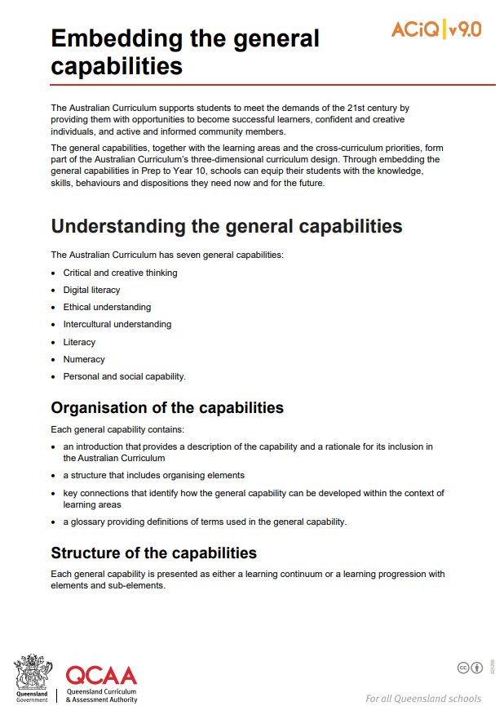
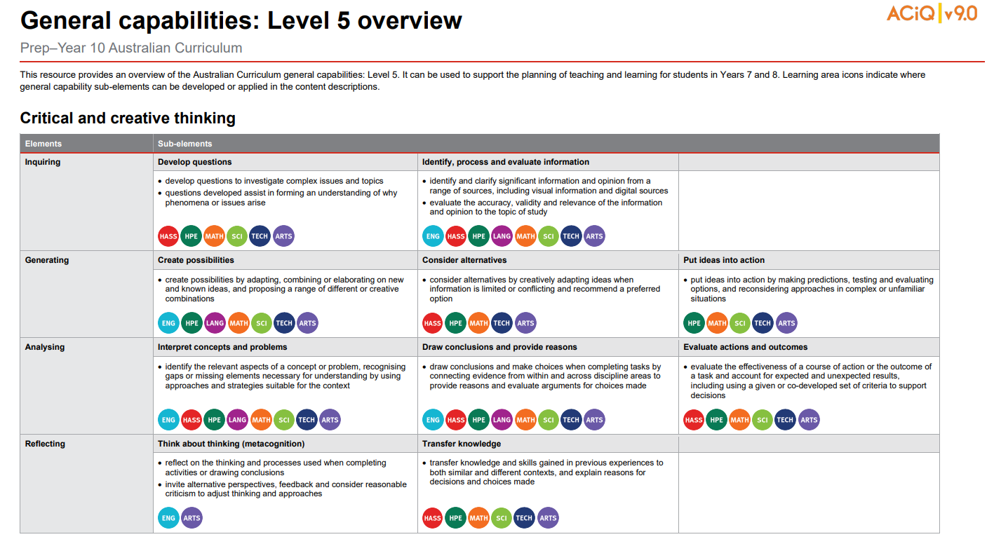
General capabilities advice and resources
www.qcaa.qld.edu.au/p-10/aciq/version-9/cross-curriculum-priorities
Notes:
The QCAA has resources that identify the connections the Australian Curriculum has made between learning areas and the general capabilities.
The general capability level overviews provide an overview of where each general capability can be developed or applied in the content descriptions of the learning areas. For example, the general capability Level 5 and Level 6 align with Years 7–10 learning areas.
The continua resources are available for the general capabilities:
critical and creative thinking
digital literacy
ethical understanding
intercultural understanding, and
personal and social capability.
There are resources available that provide a sequence of learning for the capability from Level 1 to Level 6. This can be helpful for teachers when catering for students with diverse needs.
The QCAA has advice documents to support teachers to use the Literacy and Numeracy progressions. These progressions provide observable indicators of increasing complexity in literacy and numeracy which can help teachers to develop targeted teaching and learning programs for students who are working at, above and below year-level expectations.
These resources can support teaching teams to interrogate connections between the general capabilities and the learning area content in more detail.

Slide 25
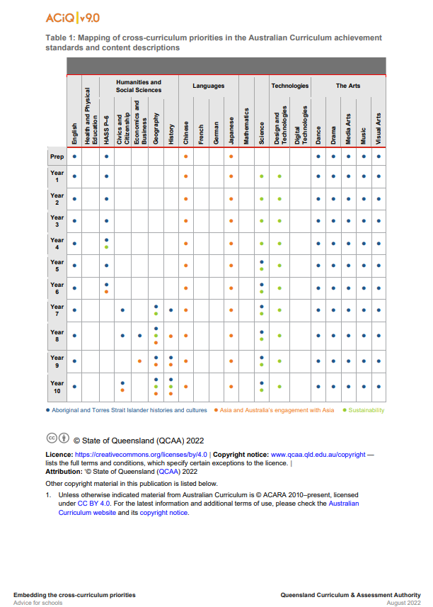
Cross-curriculum priorities advice and resources
www.qcaa.qld.edu.au/p-10/aciq/version-9/cross-curriculum-priorities
Notes:
The QCAA has resources to support schools with understanding how to connect the curriculum with cross-curriculum priorities.
Cross-curriculum priorities are incorporated through learning area content, in ways that are appropriate and authentic. The resources provide an overview of, as well as mapping across learning area and/or subject content descriptions and achievement standards to identify connections to each of the cross-curriculum priorities. ​

Slide 26
Organisation of Civics and Citizenship
HASS
Version 9.0
Civics and Citizenship
Version 9.0
Understand this learning area
Introduction
Rationale
Aims
Structure
Key considerations
Key connections
Resources
Understand this subject
Rationale
Aims
Structure
Key considerations
Rationale
Aims
Curriculum elements
Level description
Achievement standard
Strands and sub-strands
Content descriptions
Content elaborations
Notes:
The subject organisation varies slightly from the Understand this learning area section of the curriculum.
The subject-specific rationale and aims capture the intent of teaching Civics and Citizenship and inform teachers’ planning in a school context. For example, Civics and Citizenship fosters deep understanding of Australia’s federal system of government and the liberal democratic values that underpin it, and the curriculum supports students to become active and informed citizens who can participate in and sustain Australia’s democracy.
Source: Image created in house using SmartArt. Adapted https://v9.australiancurriculum.edu.au/teacher-resources/understand-this-learning-area/humanities-and-social-sciences.

Slide 27
Organisation of Civics and Citizenship
HASS
Version 9.0
Civics and Citizenship
Version 9.0
Understand this learning area
Introduction
Rationale
Aims
Structure
Key considerations
Key connections
Resources
Understand this subject
Rationale
Aims
Structure
Key considerations
Structure
Curriculum elements
Level description
Achievement standard
Strands and sub-strands
Content descriptions
Content elaborations
Notes:
While there are some consistent structural elements across the learning area (e.g. strands for Knowledge and understanding, and Skills), schools also need to consider the structure of the sub-strands for each subject.
Source: Image created in house using SmartArt. Adapted https://v9.australiancurriculum.edu.au/teacher-resources/understand-this-learning-area/humanities-and-social-sciences.

Slide 28
Civics and Citizenship: Knowledge and understanding sub-strands
Strand | Knowledge and understanding
Sub-strands | Government and democracy
 | Laws and citizens
 | Citizenship, diversity and identity
Civics and Citizenship v9.0
Notes:
In Civics and Citizenship, the three Knowledge and understanding sub-strands used to create units are:
Government and democracy
Laws and citizens and
Citizenship, diversity and identity.
These are consistent across all year levels and remain the same as those in Version 8.4.
There may be an opportunity with Version 9 to consider how schools can use these sub-strands a little differently to refresh their Civics and Citizenship programs. For example, schools might create a unit by combining the Government and democracy and Laws and citizens sub-strands, and develop a second unit using the Citizenship, diversity or identity sub-strand. Various combinations would be possible.
Source: Adapted from https://v9.australiancurriculum.edu.au/teacher-resources/understand-this-learning-area/humanities-and-social-sciences#civics-and-citizenship-7–10. Image created in house using SmartArt.

Slide 29
Structure of Skills strand: v8.4 to v9.0
— Sub-strands — | Civics and Citizenship v8.4
 | Questioning and research |  | Questioning and researching
 | Analysis, synthesis and interpretation |  | Analysis, evaluation and interpretation
 | Problem-solving and decision-making |  | Civic participation and decision-making
 | Communication and reflection |  | Communicating
Civics and Citizenship v9.0
Notes:
Highlighted in red are the Skills sub-strands for Version 9 of Civics and Citizenship compared with Version 8.4.
While there are still four Skills sub-strands, there have been revisions that might influence schools’ planning.
There are some refinements to the Questioning and researching sub-strand, but the substance of this first sub-strand is the same as version 8.4.
In particular:
In the second sub-strand, there has been a change of cognitions in the name, signalling some shift in focus.
The third sub-strand now emphasises civic participation rather than problem-solving.
The reflection component of the Communicating sub-strand has been removed.

Slide 30
Organisation of Civics and Citizenship
HASS
Version 9.0
Civics and Citizenship
Version 9.0
Understand this learning area
Introduction
Rationale
Aims
Structure
Key considerations
Key connections
Resources
Understand this subject
Rationale
Aims
Structure
Key considerations
Key considerations
Curriculum elements
Level description
Achievement standard
Strands and sub-strands
Content descriptions
Content elaborations
Notes:
The final section of Understand this subject provides further support and advice for teachers when planning for Version 9 in Civics and Citizenship.
Source: Image created in house using SmartArt. Adapted https://v9.australiancurriculum.edu.au/teacher-resources/understand-this-learning-area/humanities-and-social-sciences.

Slide 31
Key considerations for Civics and Citizenship
Inquiry questions
Contemporary issues
Active citizenship
Meeting the needs of diverse learners
Protocols for engaging First Nations Australians
Notes:
On screen, in red, are the key considerations that inform teaching and learning in Civics and Citizenship.
Inquiry as a pedagogical approach is valued across the HASS subjects. Inquiry questions provide a framework for developing students’ knowledge and understanding and skills. Teachers may develop inquiry questions to guide units of work and several inquiry questions are provided in the curriculum for each year level. These are examples only, but schools may find them useful for planning. In Civics and Citizenship, students also learn how to develop and use questions to guide investigations into political and legal systems and contemporary civic issues.
Contemporary issues emphasises that ‘Making connections between what is learned in class and events or issues that are occurring in the students’ local area, Australia and the world is vital to the study of Civics and Citizenship.’ (ACARA, 2022, https://v9.australiancurriculum.edu.au/teacher-resources/understand-this-learning-area/humanities-and-social-sciences). This section encourages schools to select issues, examples and case studies used in learning activities that are within the recent memory of students to keep learning relevant and engaging.
Active citizenship encourages a focus on understanding the actions that citizens can take to improve their community. And the definition of community is broad to allow schools to plan appropriate and achievable teaching and learning activities and assessment for their specific context – it may be the school, local, state, national or even global community.
As explained previously, the two key considerations in grey are common to all HASS subjects and all learning areas.
Source: Image created in house using SmartArt based on https://v9.australiancurriculum.edu.au/teacher-resources/understand-this-learning-area/humanities-and-social-sciences.

Slide 32
Outline
Introduction to Australian Curriculum v9.0: Civics and Citizenship
Understand this learning area and subject
Formulating next steps
Curriculum elements

Slide 33
Organisation of Civics and Citizenship
HASS
Version 9.0
Civics and Citizenship
Version 9.0
Understand this learning area
Introduction
Rationale
Aims
Structure
Key considerations
Key connections
Resources
Understand this subject
Rationale
Aims
Structure
Key considerations
Curriculum elements
Level description
Achievement standard
Strands and sub-strands
Content descriptions
Content elaborations
Level description
Achievement standard
Notes:
The Civics and Citizenship level description in the Curriculum elements section provides a high-level overview of the learning students should experience each year. The level description provides some possible inquiry questions that teachers can use to structure their units of work. These are examples only.
In Queensland, the achievement standard represents the C standard (or equivalent).
Source: Image created in house using SmartArt. Adapted https://v9.australiancurriculum.edu.au/teacher-resources/understand-this-learning-area/humanities-and-social-sciences.

Slide 34
Achievement standard structure
 | Version 8.4 | Version 9.0
Knowledge & understanding | By the end of Year 8, students analyse features of Australian democracy, and explain features of Australia’s democracy that enable active participation. They recognise different types of law in Australia and explain how laws are made. They identify the diverse belief systems in Australia and analyse issues about national identity and the factors that contribute to people’s sense of belonging. | By the end of Year 8, students explain how Australians are informed about and participate in their democracy. They describe the roles of political parties and elected representatives in Australian government. They explain the characteristics of laws, how laws are made and the types of law in Australia. Students identify ways in which Australians express different aspects of their identity and explain perspectives on Australia’s national identity.
Skills | When researching, students develop a range of questions to investigate Australia’s political and legal systems and critically analyse information gathered from different sources for relevance. They explain different points of view on civics and citizenship issues. When planning for action, students take into account multiple perspectives, use democratic processes, and develop solutions to an issue. Students develop and present reasoned arguments on civics and citizenship issues using appropriate texts, subject-specific language and concepts. They identify ways they can be active and informed citizens in different contexts. | Students develop questions and locate, select and organise relevant information from different sources to investigate political and legal systems, and contemporary civic issues. They analyse information and identify and describe perspectives and challenges related to political, legal or civic issues. They explain the methods or strategies related to civic participation or action. Students use civics and citizenship knowledge, concepts, terms and references to evidence from sources to create descriptions, explanations and arguments.
Notes:
The organisation of the achievement standards remains the same in Version 9.0 of the Civics and Citizenship curriculum.
There are two-paragraphs, one for Knowledge and understanding, followed by a Skills paragraph.
However, the wording within the paragraphs has changed to align with revised content descriptions in Version 9.0 of the Civics and Citizenship curriculum.
Across the Humanities and Social Sciences subjects, the achievement standards have been revised for all year levels.

Slide 35
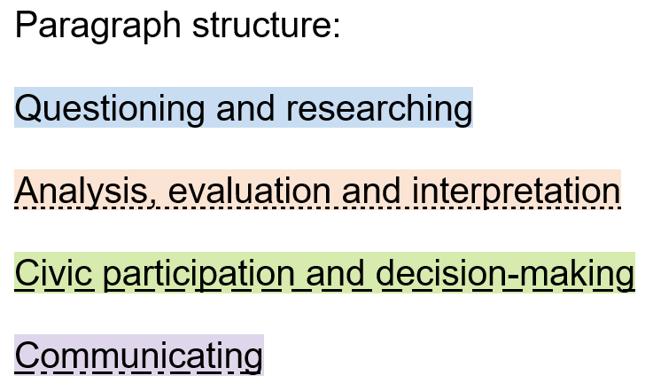
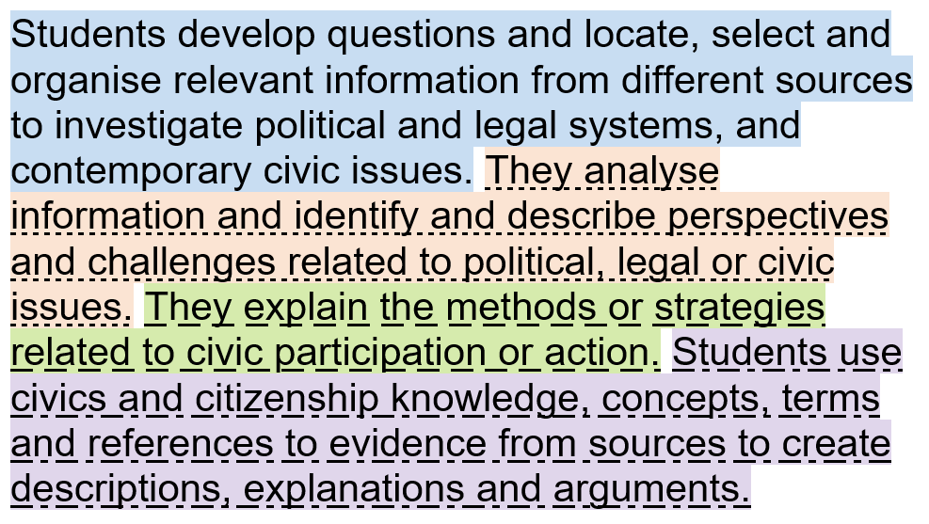
Achievement standard structure: Skills
Year 8 Civics and Citizenship example:
Notes:
The Knowledge and understanding paragraph in the Achievement standards in Civics and Citizenship is structured according to the subject matter in the Knowledge and understanding content descriptions for each year level.
However, the Skills paragraph does have a consistent structure across all year levels.
This example from Year 8 Civics and Citizenship shows how the four Skills sub-strands are used to organise this paragraph in the achievement standard. This model is replicated across the suite of HASS subjects.

Slide 36
Achievement standard structure: Language
Notes:
A close read of the language in the achievement standard in versions 8.4 and 9.0 can help schools to identify aspects requiring consideration when aligning programs to Version 9 of the Civics and Citizenship curriculum.
To exemplify, on screen is the Year 8 Civics and Citizenship Knowledge and understanding paragraph that has been split up into separate sentences to enable examination of the alignment, sentence by sentence. The following example shows how one sentence may be unpacked.
Start by identifying the cognitions used (in blue). In Version 8.4 students are only required to ‘recognise’ different types of law. Whereas, in Version 9 students are required to ‘explain’ the types of law. They do have to ‘explain’ how laws are made in both versions 8.4 and 9.0.
Next, the sentences include reference to types of law in Australia and how laws are made. However, in version 9 there is a new inclusion, the characteristics of laws (in orange).
Identifying where there are differences in the cognitions or the specific focus in versions 8.4 and 9.0 of the achievement standards can be a useful way to identify new elements that need to be considered in planning for Version 9.0.
Source: https://www.australiancurriculum.edu.au/f-10-curriculum/humanities-and-social-sciences/civics-and-citizenship/?year=12495&strand=Civics+and+Citizenship+Knowledge+and+Understanding&strand=Civics+and+Citizenship+Skills&capability=ignore&capability=Literacy&capability=Numeracy&capability=Information+and+Communication+Technology+%28ICT%29+Capability&capability=Critical+and+Creative+Thinking&capability=Personal+and+Social+Capability&capability=Ethical+Understanding&capability=Intercultural+Understanding&priority=ignore&priority=Aboriginal+and+Torres+Strait+Islander+Histories+and+Cultures&priority=Asia+and+Australia’s+Engagement+with+Asia&priority=Sustainability&elaborations=true&elaborations=false&scotterms=false&isFirstPageLoad=false and https://v9.australiancurriculum.edu.au/f-10-curriculum/learning-areas/civics-and-citizenship-7-10/year-7_year-8_year-9_year-10?view=quick&detailed-content-descriptions=0&hide-ccp=0&hide-gc=0&side-by-side=1&strands-start-index=0

Slide 37
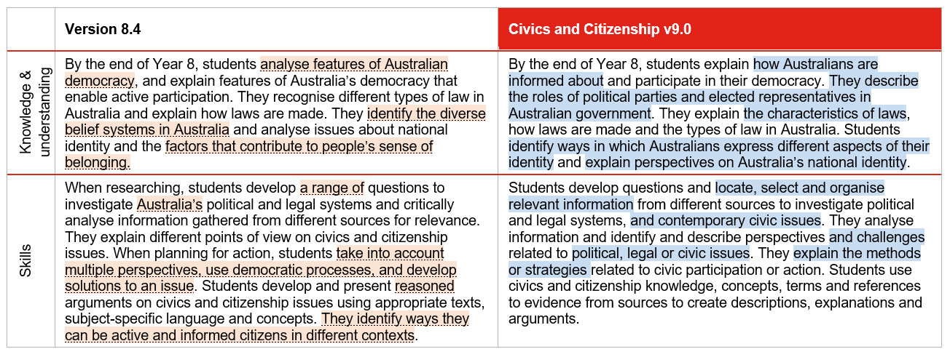
Achievement standard: changes
Notes:
Another way to work through the changes to the Civics and Citizenship achievement standard is to use two different highlight colours to identify what has been removed and what has been added to the achievement standard.
Continuing with the Year 8 example, on the left, in orange shading, are those aspects from version 8.4 that no longer appear in the Version 9.0 achievement standard. By examining content shaded in orange, schools can consider the implications for teaching and learning, and assessment.
On the right, shaded in blue, are those aspects that have been added in Version 9.0.
When reviewing teaching and learning programs, and assessment, these new aspects will need to be addressed.
Source: https://v9.australiancurriculum.edu.au/f-10-curriculum/learning-areas/civics-and-citizenship-7-10/year-8?view=quick&detailed-content-descriptions=0&hide-ccp=0&hide-gc=0&side-by-side=1&strands-start-index=0

Slide 38
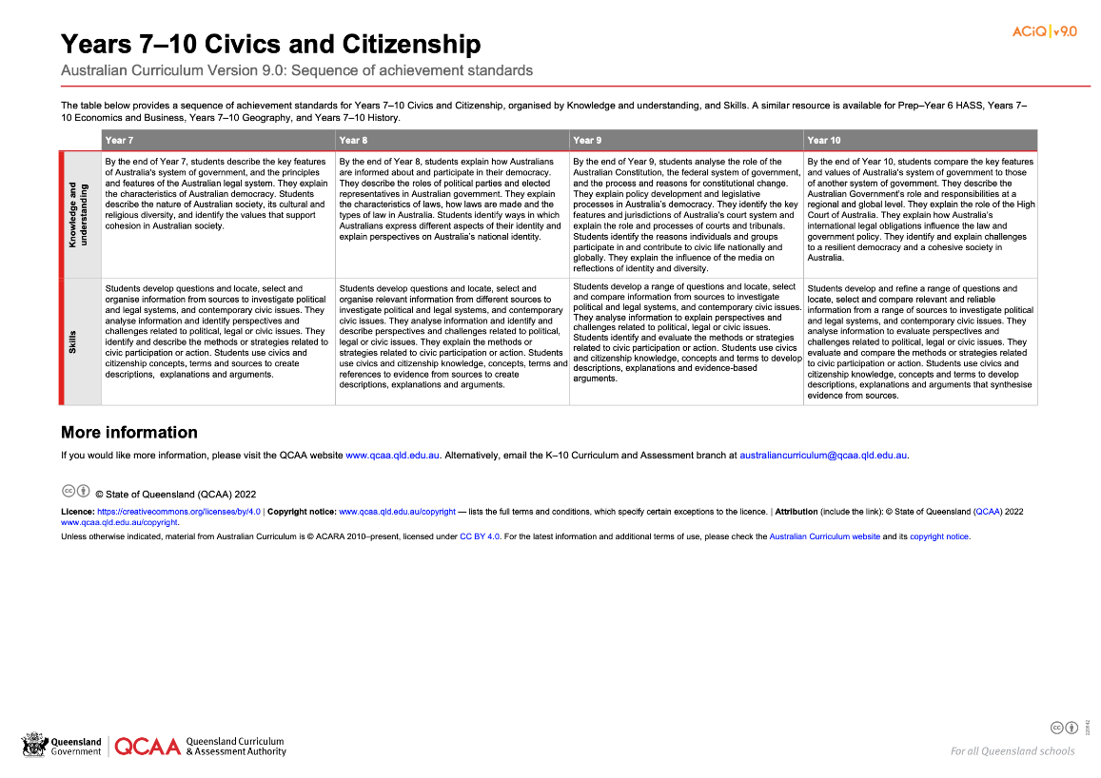
HASS: Achievement standard structure
www.qcaa.qld.edu.au/downloads/aciqv9/humanities-and-social-sciences/curriculum/ac9_hass_civ_cit_yr7-10_as_sequence.pdf
Notes:
On the QCAA website, there is a resource illustrating the sequence of achievement standards from Years 7‒10. There is a similar resource for HASS in Prep–Year 6.

Slide 39
Organisation of Civics and Citizenship
HASS
Version 9.0
Civics and Citizenship
Version 9.0
Understand this learning area
Introduction
Rationale
Aims
Structure
Key considerations
Key connections
Resources
Understand this subject
Rationale
Aims
Structure
Key considerations
Curriculum elements
Level description
Achievement standard
Strands and sub-strands
Content descriptions
Content elaborations
Strands and sub-strands
Content descriptions
Content elaborations
Notes:
The final section of Curriculum elements provides further information regarding the content descriptions in the strands and sub-strands which inform teaching and learning and assessment.
Content descriptions specify the knowledge, understanding and skills that students learn and that teachers are expected to teach. The content elaborations provide optional examples of how to teach the content descriptions.
Source: Image created in house using SmartArt. Adapted https://v9.australiancurriculum.edu.au/teacher-resources/understand-this-learning-area/humanities-and-social-sciences.

Slide 40
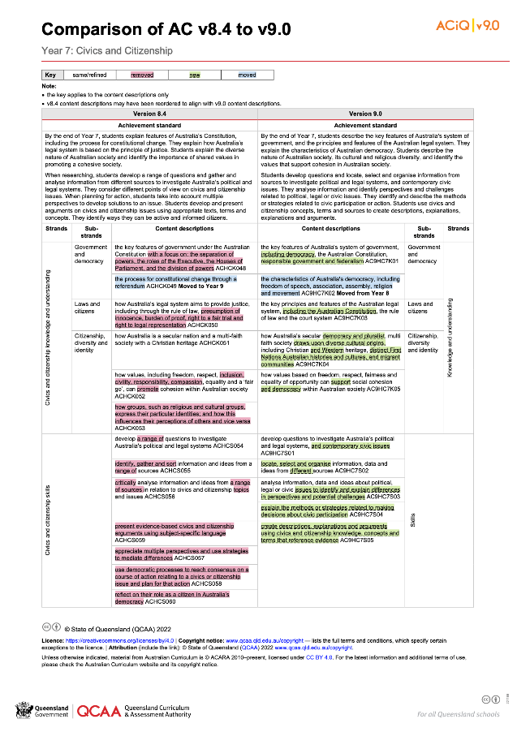
Comparison of AC v8.4 with v9.0 documents
One document for each year level is available on the QCAA website.
www.qcaa.qld.edu.au/downloads/aciqv9/humanities-and-social-sciences/curriculum/ac9_civ_cit_yr7_comp.pdf
Notes:
The comparison documents show the changes to the content descriptions for Civics and Citizenship.

Slide 41
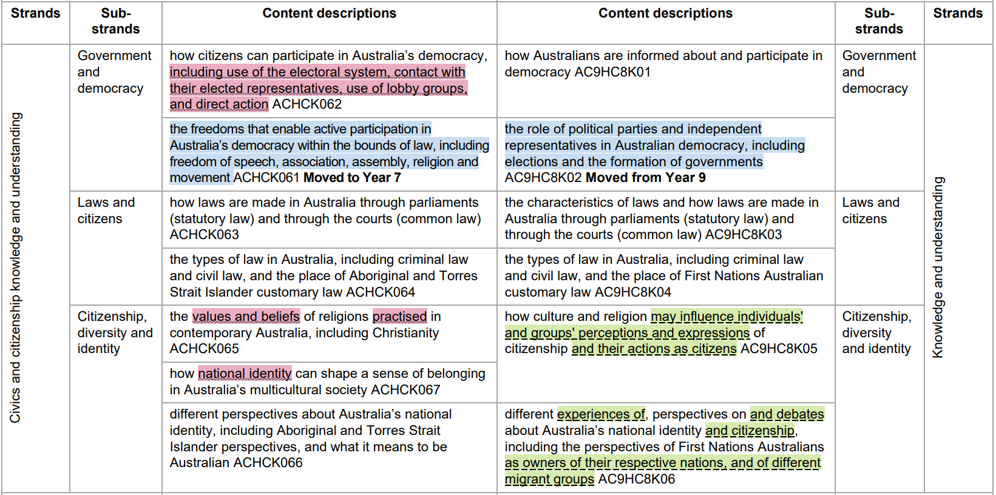
Comparison of AC v8.4 to v9.0 documents
Notes:
A key is used to show the changes from Version 8.4 to Version 9.0.

Slide 42
Same/refined content
Notes:
If something has been refined from Version 8.4, it does not appear in colour.
For example, content descriptions related to Laws and citizens are substantially the same from Version 8.4 to 9.0, with some revisions to wording.

Slide 43
Removed content
Notes:
If a content description or part of a content description has been removed from Version 8.4 and no longer appears in Version 9.0, it has been highlighted in red.
For example, some detail about how Australians can participate in their democracy has been removed, leaving just the main point of focus in Version 9.0.

Slide 44
New content
Notes:
If a new content description has been added to Version 9.0, it has been highlighted in green.
For example, there is more specificity with the inclusion of consideration of how culture and religion may influence groups’ perceptions and expressions of citizenship.

Slide 45
Moved content
Notes:
If a content description has moved year levels from Version 8.4 to Version 9.0, it has been highlighted in blue. There is also a bold note to indicate the year level from or to which it has moved.

Slide 46
Moved content descriptions: Civics and Citizenship
Year 8 to Year 7 | The characteristics of Australian democracy, including freedom of speech, association, assembly, religion and movement
Year 9 to Year 8 | The role of political parties and independent representatives in Australia’s system of government, including the formation of governments
Year 7 to Year 9 | The process for constitutional change through a referendum
Notes:
On screen are the three key movements of content from one year level to another for Civics and Citizenship. These changes may require some refinement of existing teaching and learning resources for the age and stage of the learners to whom this content will now be delivered.

Slide 47
Outline
Introduction to Australian Curriculum v9.0: Civics and Citizenship
Understand this learning area and subject
Formulating next steps
Curriculum elements

Slide 48
Australian Curriculum in Queensland (ACiQ) v9.0 webpages
QCAA website www.qcaa.qld.edu.au/p-10/aciq
Notes:
Resources to support the Australian Curriculum Version 9.0 can be found within the Australian Curriculum in Queensland Version 9.0 webpages.
These webpages only include resources that have been created or updated to align with Version 9.0.
Source: Screenshot from QCAA website www.qcaa.qld.edu.au/p-10/aciq.

Slide 49
The ACiQ v9.0 webpages
These webpages house advice and resources to support the three dimensions of the Australian Curriculum:
Learning areas
General capabilities
Cross-curriculum priorities.
Notes:
The Version 9.0 webpages support familiarisation with all three dimensions of the curriculum.
Teachers can access advice and resources for their learning area and/or subject, or the general capabilities, and the cross-curriculum priorities.
Source: Screenshot from QCAA website www.qcaa.qld.edu.au/p-10/aciq/version-9.

Slide 50
Examples of QCAA resources for Civics and Citizenship
Comparison of AC v8.4 to v9.0 (P–10)
Sequence of achievement standards
Sequence of content descriptions
Achievement standard aligned to content descriptions (P–10)
Prepopulated curriculum and assessment plans
Assessment techniques and conditions (P–10)
Standards elaborations
QCAA P–10 Planning app
Notes:
On screen is a snapshot of some of the Civics and Citizenship resources. These resources have been hyperlinked in the slide.

Slide 51
Learning goal
Understand the implications of changes in the Years 7–10 Australian Curriculum from v8.4 to v9.0: Civics and Citizenship for planning.
Success criteria
You will know you are successful if you:
have more knowledge about the intent and structure of the Years 7–10 Australian Curriculum v9.0: Civics and Citizenship
can identify actions for planning in your school.

Slide 52
Contact
K–10 Curriculum and Assessment Branch​ ​
T +61 7 3120 6102
E australiancurriculum@qcaa.qld.edu.au
W www.qcaa.qld.edu.au
Notes:
If you have any queries regarding Australian Curriculum v9.0: Civics and Citizenship, please contact the K–10 Curriculum and Assessment Branch.
​

Slide 53
References
Australian Curriculum, Assessment and reporting Authority 2013, The Shape of the Australian Curriculum Version 4.0, https://docs.acara.edu.au/resources/The_Shape_of_the_Australian_Curriculum_v4.pdf

Slide 54
Acknowledgments
Third-party copyright material, and QCAA material not covered by the CC BY licence is listed below:
Queensland Government coat of arms, and the QCAA and QSA trademarks may not be reproduced without permission.
Unless otherwise indicated, material from Australian Curriculum is © ACARA 2010–present, licensed CC BY 4.0. For the latest information and additional terms of use, see the Australian Curriculum website and its copyright notice.
Acknowledgment of Country artwork (2023) ‘Growth through Learning’ by Chern’ee, Brooke and Jesse Sutton, Kalkadoon. www.cherneesutton.com.au
Student and staff images have been used with permission.
The three-dimensional curriculum diagram is 'Excluded Material' used under the terms of the Australian Curriculum and its copyright notice and not modified. © Australian Curriculum, Assessment and Reporting Authority (ACARA) 2009 to present, unless otherwise indicated. You may view, download, display, print, reproduce (such as by making photocopies) and distribute these Excluded Materials in unaltered form only for your personal, non-commercial educational purposes or for the non-commercial educational purposes of your organisation, provided that you make others aware it can only be used for these purposes and attribute ACARA as the source of the Excluded Material. For the avoidance of doubt, this means that you cannot edit, modify or adapt any of these materials, and you cannot sub-licence any of these materials to others. Apart from any uses permitted under the Copyright Act 1968 (Cth), and those explicitly granted above, all other rights are reserved by ACARA.

Slide 55
Copyright notice
© State of Queensland (QCAA) 2024
Licence: https://creativecommons.org/licenses/by/4.0 | Copyright notice: www.qcaa.qld.edu.au/copyright — lists the full terms and conditions, which specify certain exceptions to the licence. | Attribution: © State of Queensland (QCAA) 2024 www.qcaa.qld.edu.au/copyright.
Other copyright material in this presentation is listed on the previous slide/s.

Slide 56
QCAA social media
Notes:
If you don’t do so already, we recommend you follow QCAA on one or more social media platforms to stay in touch with us, and to find out about upcoming resources and professional learning.

