Slide 1
Understanding the P–10 Digital literacy general capability ACv9.0
240883

Slide 2
Acknowledgment of Country

Slide 3
Learning goal
Understand how the Australian Curriculum v9.0: Digital literacy general capability can deepen and enrich student learning.
Success criteria
You will know you are successful if you:
have more knowledge about the organisation and structure of the Digital literacy general capability
can identify learning area opportunities to authentically embed the Digital literacy general capability in planning
can effectively use QCAA resources to plan intentional opportunities for students to learn and practise digital literacy skills.

Slide 4
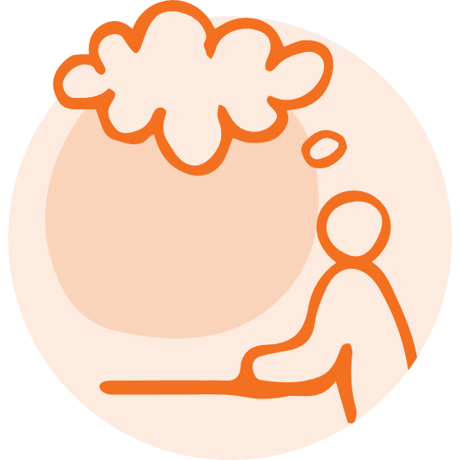
Pause and reflect
Consider…
What digital literacy skills do students need by the time they finish school?
Notes:
Reflection point:
What digital literacy skills do students need by the time they finish school?
Answers may include being able to:
search and navigate online for information
create, communicate and collaborate through software such as spreadsheets to record and review data, email software to send and receive emails or word processing software to create documents and reports
think critically and analyse information.

Slide 5
Outline
Understanding digital literacy
Digital literacy general capability structure
Embedding the digital literacy general capability in teaching and learning programs
QCAA resources

Slide 6
Outline
Understanding digital literacy
Digital literacy general capability structure
Embedding the digital literacy general capability in teaching and learning programs
QCAA resources

Slide 7
Alice Springs (Mparntwe) Education Declaration, 2019
Vision: A world-class education system
Goal 1:
The Australian education system promotes excellence and equity.
Goal 2:
All young Australians become confident and creative individuals, successful lifelong learners and active and informed members of the community.
Source: Education Council 2019, www.education.gov.au/alice-springs-mparntwe-education-declaration/resources/alice-springs-mparntwe-education-declaration, pp. 2–4
Notes:
The Alice Spring Mparntwe Education Declaration is a good starting point when considering the particular the digital literacy skills students require to navigate the changing world in which they live.
The Education Declaration has two distinct, but interrelated goals. The digital literacy general capability aligns closely with Goal 2: All young Australians become confident and creative individuals, successful lifelong learners, and active and informed members of the community. For our students to be active, informed, successful lifelong learners, we need to support them to become digitally literate members of society.

Slide 8
Alice Springs (Mparntwe) Education Declaration ― Digital literacy
Successful lifelong learners who …
are productive and informed users of technology as a vehicle for information gathering and sharing, and are able to adapt to emerging technologies into the future.
Education Council 2019, www.education.gov.au/alice-springs-mparntwe-education-declaration/resources/alice-springs-mparntwe-education-declaration, p. 7
Notes:
Looking further at Goal 2, the Declaration states that successful lifelong learners [are those] who ‘are productive and informed users of technology as a vehicle for information gathering and sharing and are able to adapt to emerging technologies into the future’.

Slide 9
Three-dimensional Australian Curriculum
Source: ACARA 2010 to present, www.v9.australiancurriculum.edu.au/help/website-tour
Notes:
Digital literacy is one of the general capabilities in the three-dimensional Australian Curriculum that consists of 8 learning areas, 3 cross curriculum priorities and 7 general capabilities.
These three dimensions are interrelated and together set out the knowledge, understandings and skills that students should learn.
This structure has not changed between Version 8.4 and Version 9.0 of the curriculum. However, there has been a language change — Digital literacy was previously called ICT capabilities. This name change reflects the more contemporary understanding of the digital knowledge and skills our students need to be successful, lifelong learners today.

Slide 10
Taught through the learning areas
‘In the Australian Curriculum, general capabilities are addressed through the content of the learning areas; they are not separate learning areas, subjects or isolated skills. The teaching of learning area content will be strengthened by the application of relevant general capabilities, as will the development of the general capabilities through appropriate learning area contexts.’
Quoted verbatim and unaltered from ACARA, 2010 to present, v9.australiancurriculum.edu.au/f-10-curriculum/f-10-curriculum-overview/general-capabilities
Notes:
Digital literacy, like all general capabilities, is developed through the content of the learning areas.
It is not a set of skills that can or should be taught in isolation.

Slide 11
What is digital literacy?
‘ … Digital literacy encompasses the knowledge and skills students need to create, manage, communicate and investigate data, information and ideas, and solve problems. It assists students to work collaboratively at school and in their lives beyond school …’
ACARA, 2010 to present, v9.australiancurriculum.edu.au/teacher-resources/understand-this-general-capability/digital-literacy
Notes:
Digital literacy is defined in the introduction of the Understand this general capability: Digital literacy section of the Australian Curriculum: v9.australiancurriculum.edu.au/curriculum-information/understand-this-general-capability/digital-literacy.
The first paragraph of the introduction emphasises that lifelong learners need digital literacy knowledge and skills to thrive in the world today.

Slide 12
What is digital literacy?
‘ … Digital literacy involves students critically identifying and appropriately selecting and using digital devices or systems, and learning to make the most of the technologies available to them. Students adapt to new ways of doing things as technologies evolve, and protect the safety of themselves and others in digital environments.’
ACARA, 2010 to present, v9.australiancurriculum.edu.au/teacher-resources/understand-this-general-capability/digital-literacy
Notes:
The second paragraph of the introduction to this general capability explains that for students to be digitally literate, they also need other skills including the ability to think critically and to be flexible and adaptive.
There is also an emphasis on digital safety, to ensure that students have the skills to recognise and address online risks.
Digital literacy, therefore, is more than just the ability to use digital tools, although these do form an important part of digital literacy.

Slide 13
What are digital tools?
Digital tools | Online tools
Digital hardware, software, platforms and resources used to develop and communicate learning, ideas and information, e.g. software and hardware to compose and record music. | Digital hardware, software, platforms and resources that are connected and support communications between users. Examples of online tools include websites for online shopping and fitness apps.
Source: ACARA 2010 to present, ‘Digital Literacy Glossary’, v9.australiancurriculum.edu.au/downloads/general-capabilities#accordion-afa194f119-item-c260117f4e
Notes:
Within the learning areas, the terms ‘digital tools’ or ‘online tools’ or a similar term indicates where there are opportunities for students to use digital tools to develop and apply their digital literacy.
Digital tools include digital devices such as laptops and computers, as well as the software programs, systems and platforms that students may use.

Slide 14
Pause and reflect
Consider…
What digital tools do you and your students use in your classroom?
Notes:
Reflection point:
Based on this definition of digital tools, what digital tools do you and your students use in your classroom?
Examples of tools may include:
devices: laptops, computers, iPads/tablets
software: Microsoft (incl. word processor), Google (incl. Google docs sheets, calendar), web browsers, websites, apps
platforms and LMS: Qlearn or other LMS
other digital tools/equipment: robotics, drones, microcontrollers, video equipment.

Slide 15
Outline
Understanding digital literacy
Digital literacy general capability structure
Embedding the digital literacy general capability in teaching and learning programs
QCAA resources

Slide 16
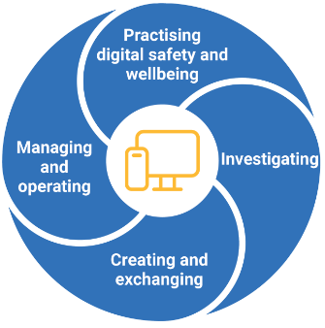
Digital literacy elements
Image source: ACARA, 2010 to present, v9.australiancurriculum.edu.au/teacher-resources/understand-this-general-capability/digital-literacy
Notes:
The Digital literacy general capability is organised into four elements:
Practising digital safety and wellbeing
Investigating
Creating and exchanging
Managing and operating.
Each of these elements has three sub-elements.

Slide 17
Practising digital safety and wellbeing: Sub-elements
Manage online safety
Students:
Manage digital privacy and identity
Students:
Manage digital wellbeing
Students:
develop the appropriate technical, social, cognitive, communicative and decision-making skills to address online risks
recognise the content risks that they face online … and the strategies involved in dealing with them.
recognise the importance of controlling and shaping their own digital identity
create and curate their online identities to positively tell their stories while recognising how personal use of digital media may have implications for their digital footprint.
consider the nature and impact of digital tool use
develop understanding that behaviours such as excessive screen time, digital workload, distraction and multi-tasking can have an impact on their health, work productivity, wellbeing and lifestyles
understand the benefits and risks of digital participation in relation to health and wellbeing outcomes.
Source: ACARA, 2010 to present, v9.australiancurriculum.edu.au/teacher-resources/understand-this-general-capability/digital-literacy
Notes:
The first sub-element of Practicing digital safety and wellbeing focuses on online safety. Students need opportunities to develop their skills to address online risks and also to recognise the strategies involved in dealing with these risks.
The second sub-element, Manage digital privacy and identity, ensures students are aware of their own digital identity and their digital footprint. Students need the skills to control and shape their online digital footprint including recognising how the use of digital media affects this.
The third sub-element includes developing understanding of the impact of digital tools on students’ own health and wellbeing.

Slide 18
Investigating: Sub-elements
Locate information
Students:
Acquire and collect data
Students:
Interpret data
Students:
curate information from digital resources
effectively use research strategies to locate information and other resources
articulate their information and content needs, and effectively navigate information and content they encounter.
understand how data can be generated and how to process data
explore relevant data sets and read, manage and process data from a variety of sources.
create and build knowledge by analysing data and communicating its meaning to others using various data visualisation tools
present patterns, trends and analytical insights from data to facilitate problem-solving and decision-making.
Source: ACARA, 2010 to present, v9.australiancurriculum.edu.au/teacher-resources/understand-this-general-capability/digital-literacy
Notes:
The first sub-element of Investigating focuses on locating information — students need to develop their research strategies as they navigate online to find information and content.
The second sub-element focuses on acquiring and collecting data — students are exploring data sets, and reading, managing and processing data from a variety of sources.
The third sub-element is about interpreting data — students are analysing data, communicating the meaning of data using data visualisation tools, as they present patterns, trends and analytical insights.

Slide 19
Creating and exchanging: Sub-elements
Plan
Students:
Create, communicate and collaborate
Students:
Respect intellectual property
Students
use digital tools to plan and manage a process that considers design constraints and risks.
execute plans for the design of digital content and to develop, test and refine models to create original products
recognise different types of peer-to-peer communication and collaboration strategies, tools and formats and decide which methods are most effective for individual or collaborative goals.
understand the ethical and legal responsibilities around ownership and remixing of digital content
demonstrate responsibility and respect for others by protecting their own digital creations and crediting others’ content when appropriate.
Source: ACARA, 2010 to present, v9.australiancurriculum.edu.au/teacher-resources/understand-this-general-capability/digital-literacy
Notes:
The three sub-elements of Creating and exchanging require students to:
use digital tools to plan and manage their process, considering design constraints and risks
create and communicate their plan to develop, test and refine models, while also collaborating via different tools and formats
understand the ethical and legal responsibilities of intellectual property, protecting both their own creations but also crediting other content.

Slide 20
Managing and operating: Sub-elements
Manage content
Students:
Protect content
Students:
Select and operate tools
Students:
interact with information and data, save content using appropriate and logical conventions, and retrieve content from personal, networked and cloud spaces.
identify potential threats and implement relevant cyber security practices
use technology without compromising their data and devices.
apply technical knowledge and skills to select, use and troubleshoot appropriate digital tools.
develop an understanding of hardware and software components, and the operations of appropriate digital systems, including their functions, processes and procedures.
Source: ACARA, 2010 to present, v9.australiancurriculum.edu.au/teacher-resources/understand-this-general-capability/digital-literacy
Notes:
The three sub-elements for Managing and operating include students:
managing content by interacting with information and data, understanding how to save this content and then retrieve it from personal, networked and cloud spaces
protecting content by identifying threats and understanding the cyber security needs when they are using technology
selecting and operating tools by applying their knowledge and skills to be able to select, use and troubleshoot their digital tools, developing understanding of both hardware and software components of their digital systems.

Slide 21
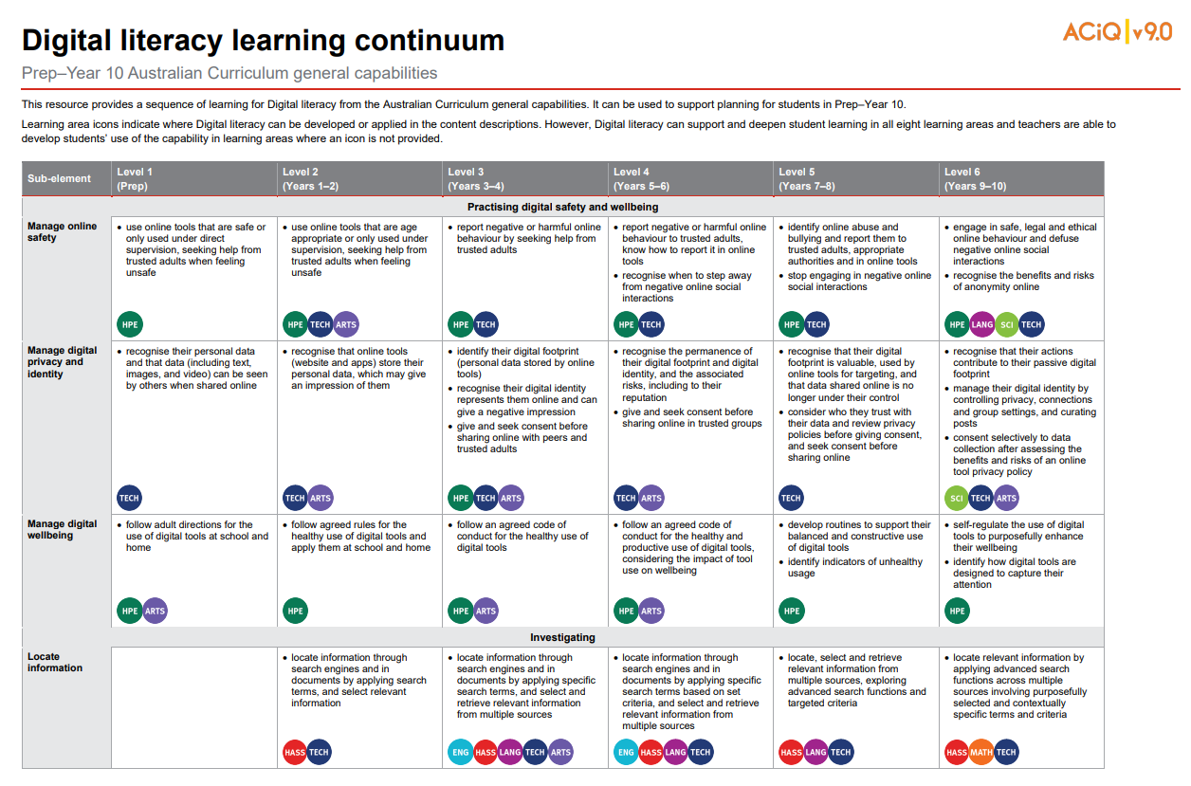
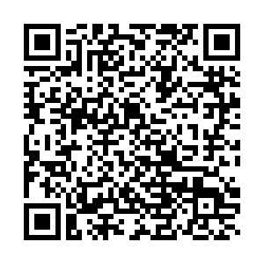
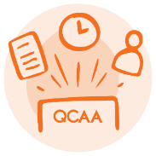
Digital literacy learning continuum
Notes:
The learning continuum for Digital Literacy describes how each sub-element develops over 6 levels from Prep to Year 10. For example, Level 3 is Years 3–4.
This QCAA resource shows the Digital literacy learning continuum as well as where opportunities to include teaching of digital literacy in each learning area have been identified in the Australian Curriculum.
Source: State of Queensland (QCAA) 2022, Digital literacy learning continuum, www.qcaa.qld.edu.au/downloads/aciqv9/general-resources/ac9_gc_digital_literacy_learning_continuum.pdf

Slide 22
Outline
Understanding digital literacy
Digital literacy general capability structure
Embedding the digital literacy general capability in teaching and learning programs
QCAA resources

Slide 23
A process for embedding Digital literacy
Identify
Where are the opportunities in the curriculum to develop digital literacy?
Consider
How do the targeted sub-elements typically develop students' capabilities?
Plan
What strategies can I use to develop students’ capabilities in the targeted sub-element/s?
Which sub-element/s can I explicitly teach in my learning area this year?
How can I make this explicit in my curriculum planning?
What digital literacy skills can I expect students to demonstrate at this level?
Notes:
This is a possible process for planning how to authentically embed the Digital literacy general capability into teaching and learning programs.

Slide 24
Identifying opportunities to embed
Identify
Where are the opportunities in the curriculum to develop digital literacy?
Which sub-element/s can I explicitly teach in my learning area this year?
Notes:
Firstly, identify where there may be opportunities in the learning area curriculum to develop digital literacy and which sub-elements can be taught.

Slide 25
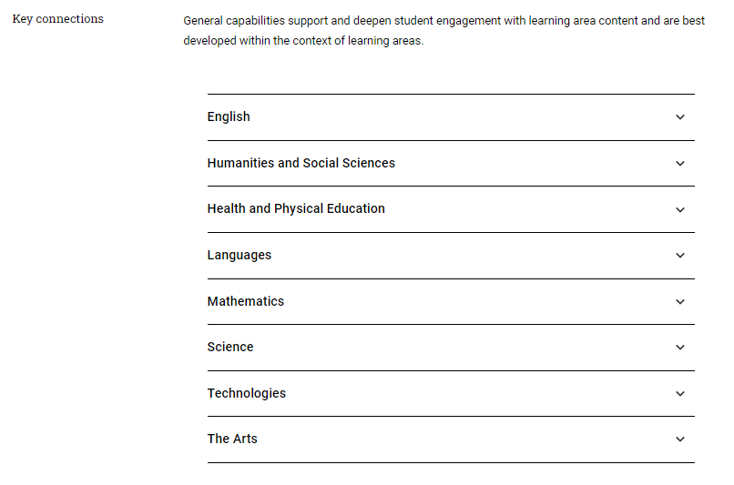
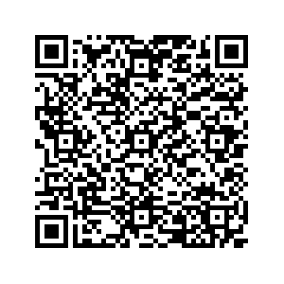
Key connections
Identify
Source: ACARA 2010 to present, v9.australiancurriculum.edu.au/teacher-resources/understand-this-general-capability/digital-literacy
Notes:
A useful starting point is the Key connections section of the Understand this general capability: Digital literacy information: v9.australiancurriculum.edu.au/curriculum-information/understand-this-general-capability/digital-literacy.

Slide 26
Key connections — Science example
digital literacy skills developed
Students develop digital literacy as they operate and manage digital systems and practise digital safety and wellbeing while investigating, creating and communicating. In particular, they use digital literacy to access information; collect, analyse and represent data and information; model and interpret concepts and relationships; and communicate science ideas, processes and information.
Digital tools such as animations and simulation software can support student understanding of abstract phenomena, as they give opportunities to view phenomena and test predictions that cannot be investigated through practical investigations in the classroom.
how digital literacy is applied
suggested digital tools
how the tools support student learning
ACARA, 2010 to present, https://v9.australiancurriculum.edu.au/teacher-resources/understand-this-general-capability/digital-literacy#accordion-63f168f3e0-item-98e83e1c64
Notes:
This is the Key connections statement for Science in the Understand this general capability: Digital literacy information.
There is a short description of the types of digital literacy skills that can be developed through this learning area. All four elements of the Digital literacy general capability can be addressed.
Then, there is a description about how digital literacy is applied in Science, including when students access information; collect, analyse and represent data, model concepts and communicate ideas and information.
Suggested digital tools that are appropriate for learning in Science are described, including animations and simulation software, and then a description of how these tools support student learning in Science is provided.

Slide 27
Pause and reflect
Review the Key connections statement in the Understand this general capability: Digital literacy information for a learning area you teach.
Consider…
What opportunities to incorporate teaching of the Digital literacy general capability resonate with you?
Notes:
Reflection point:
Review the Key connections statement in the Understand this general capability: Digital literacy information for a learning area you teach: https://v9.australiancurriculum.edu.au/curriculum-information/understand-this-general-capability/digital-literacy.
Where do you see opportunities to incorporate teaching of the Digital literacies in your learning area?

Slide 28
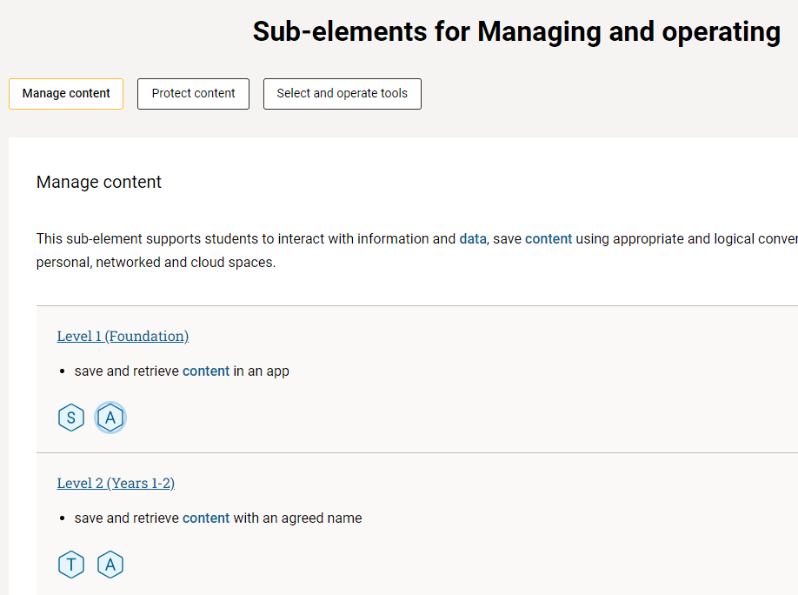
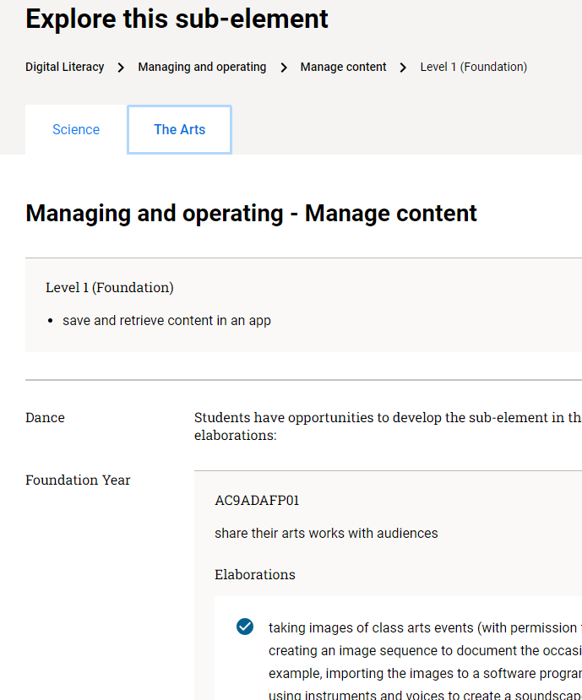
Links to learning area content
Identify
Notes:
In the description of each sub-element of the Digital literacy general capability, there are links to opportunities to teach the general capability in the learning areas.
In this example of the Manage content sub-element at Level 1, links to learning area content in Science and The Arts are identified.

Slide 29
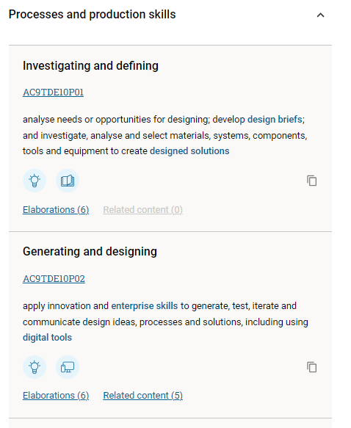
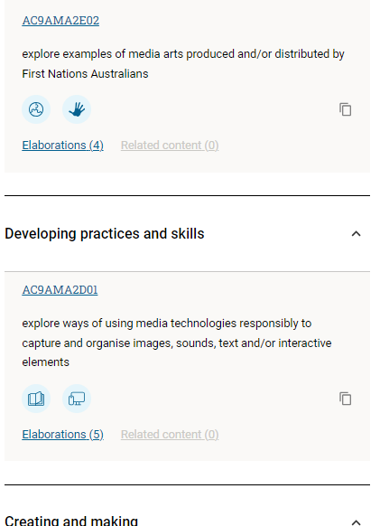
Scanning for identified links using the icon
Design and Technologies Years 9–10
The Arts: Media Arts Years 1–2
Identify
Image source: ACARA 2010 to present, v9.australiancurriculum.edu.au/f-10-curriculum/learning-areas/design-and-technologies/year-9
Image source: ACARA 2010 to present, v9.australiancurriculum.edu.au/f-10-curriculum/learning-areas/media-arts/year-1_year-2?
Notes:
In the learning area curriculum, the Digital literacy icon identifies opportunities to incorporate teaching of particular sub-elements of the Digital literacy general capability.
Note, there may be other opportunities to incorporate this general capability into planning in addition to those identified in the curriculum.

Slide 30
QCAA resources: General capabilities mapping
Identify
Notes:
A range of QCAA mapping resources assist with the location of opportunities to engage with the Digital literacy general capability across all learning areas and subjects.
This resource maps the general capabilities across each learning area and subject in Years 7–10.
For example, the mapping shows that opportunities have been identified in the curriculum to develop the Digital literacy element Creating and exchanging in Years 7–10 in the subject Media Arts.
These resources support a high-level overview that is useful at the whole-school or year planning level, as well as providing a quick overview of alignment at the unit planning level.
Source: State of Queensland (QCAA) 2022, Mapping the general capabilities: Years 7–10, www.qcaa.qld.edu.au/downloads/aciqv9/general-resources/ac9_gc_mapping_phases_yr7-10.pdf

Slide 31
QCAA resources: General capabilities mapping
Identify
Notes:
There are also mapping resources for each year level in Prep to Year 6.
This Year 6 resource shows that there are two learning areas where it may be particularly appropriate to embed teaching of the Digital literacy element Practicing digital safety and wellbeing.
This resource is helpful to quickly see which learning areas readily provide opportunities to address each element of this general capability.
Source: State of Queensland (QCAA) 2022, Mapping the general capabilities: Year 6, www.qcaa.qld.edu.au/downloads/aciqv9/general-resources/ac9_gc_mapping_primary_yr6.pdf

Slide 32
QCAA resources: Mapping Years 7–10 Geography
Identify
Notes:
In Years 7–10 mapping resources are available by learning area or subject.
These resources identify the specific content descriptions in the Australian Curriculum where there are identified opportunities to develop the general capability sub-elements.
This excerpt is from the resource Mapping the general capabilities: Years 7–10 Geography.
It shows that two sub-elements from Creating and exchanging have an identified alignment to Geography content descriptions in Years 7–10.
Source: State of Queensland (QCAA) 2022, Mapping the general capabilities: Years 7–10 Geography, www.qcaa.qld.edu.au/downloads/aciqv9/general-resources/ac9_gc_mapping_geography_yr7-10.pdf

Slide 33
Considering the level descriptions in the continua
Consider
How do the targeted sub-elements typically develop?
What digital literacy skills can I expect students to demonstrate at this level?
Notes:
Planning is also informed by consideration of how the targeted sub-elements typically develop across each of the sub-elements of the Digital Literacy general capability.

Slide 34
QCAA resource: Learning continuum
Consider
Notes:
This excerpt from the QCAA Digital literacy learning continuum resource shows the progression of skills in the Plan sub-element of the Creating and exchanging element:
Years 1–2 or Level 2 ‘use simple digital tools to contribute to a basic plan to complete a task’
Years 3–4 or Level 3 ‘use familiar digital tools to develop and follow a basic plan to complete a task
Years 5–6 or Level 4 ‘select and use digital tools to develop and follow a plan to complete individual tasks and group projects’
Years 7–8 or Level 5 ‘use simple planning tools to develop and follow a plan to complete individual and collaborative projects’
Years 9–10 or Level 6 ‘use project management tools to develop and track a plan to complete individual and collaborative projects’.
If you were planning for a particular sub-element of Digital literacy in Year 7, the first year of Level 5, you might use this learning continuum resource to look closely at the Level 4 descriptor which is the level you are aiming to move students on from.
If you were planning for Year 8, the second year of Level 5, you might also look at the Level 6 descriptor to understand the level that students are moving towards.
This resource can also be used to consider how to progress the digital literacy skills of students who are not working at level from any point on this continuum.
Source: Excerpt from State of Queensland (QCAA) 2022, Digital literacy learning continuum, www.qcaa.qld.edu.au/downloads/aciqv9/general-resources/ac9_gc_digital_literacy_learning_continuum.pdf

Slide 35
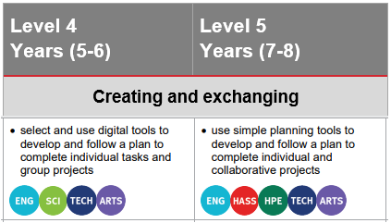
QCAA resource: Learning continuum
Consider
Year 7-8 Digital Technologies
‘… and plan and manage individual and collaborative agile projects’
ACARA, 2010 to present, v9.australiancurriculum.edu.au/f-10-curriculum/general-capabilities/digital-literacy/slideout?code=DLCA5&element=2&sub-element=0
Notes:
The learning continuum identifies an opportunity to incorporate explicit teaching of the sub-element Plan from the Creating and exchanging element in Years 7–8 Digital Technologies. The relevant content description is shown on the left.
It is important to consider the Level 4 descriptor to plan how to develop students’ digital literacy skills.
For example, in Years 5–6 at Level 4 students may have constructed a checklist in a Word document. At level 5 in Years 7–8 students could learn how to create a spreadsheet with extra elements such as the date the task is due to be completed. Teachers might also help students working in collaborative projects to see how an online version of a spreadsheet allows multiple users to view and edit the document simultaneously.

Slide 36
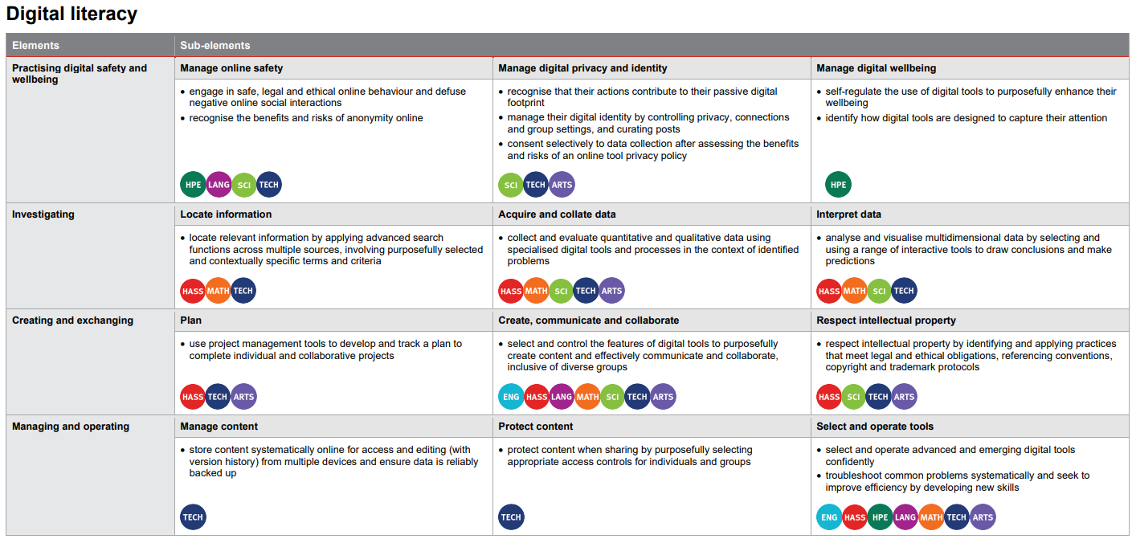
QCAA resources: Level overviews
Consider
Notes:
To support planning, level overviews for the general capabilities are also available for each level.
This is an excerpt from the General Capabilities: Level 6 overview that shows where opportunities have been identified in the learning areas to engage with the elements and sub-elements of the Digital literacy general capability at this level.
Source: State of Queensland (QCAA) 2022, General capabilities: Level 6 overview, www.qcaa.qld.edu.au/downloads/aciqv9/general-resources/ac9_gc_level_6_overview.pdf

Slide 37
Planning to embed the general capability
Plan
What strategies can I use to develop students’ capabilities in the targeted sub-element/s?
How can I make this explicit in my curriculum planning?

Slide 38
Planning teaching and learning strategies
Plan
Approaches could include:
modelling how to use the digital tool (demonstration and recorded video)
thinking aloud and modelling troubleshooting processes
providing direct instruction on use, purpose and outcomes
providing scaffolded resource, e.g. visual guide, sequence of steps, sample response
providing time for independent and collaborative student exploration.
Notes:
In the final step, decisions are made about intentional strategies to teach the targeted sub-elements of the Digital literacy general capability. These strategies are incorporated into curriculum plans for the learning area or subject.

Slide 39
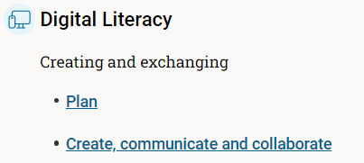
Example: Science Year 5
identify
Content description
write and create texts to communicate ideas and findings for specific purposes and audiences, including selection of language features, using digital tools as appropriate AC9S5I03
consider
plan
Learning continuum
 | Level 4 (Years 5–6)
Plan | select and use digital tools to develop and follow a plan to complete individual tasks and group projects
Create, communicate and collaborate | select and control a variety of features in appropriate digital tools to create content and communicate and collaborate with trusted groups
ACARA, 2010 to present, v9.australiancurriculum.edu.au/f-10-curriculum/learning-areas/science/year-5?
Notes:
This Year 5 Science example shows an approach to authentically embed the Digital literacy general capability in planning.
Firstly, the opportunity to teach two sub-elements of the Digital literacy general capability in Year 5 Science was identified.
The Level 4 learning continuum was considered to make decisions about the particular skills to develop at this level for each sub-element.
And finally, activities to incorporate the explicit teaching of these sub-elements of the general capability in Science were planned.
Examples of activities where the Create, communicate and collaborate sub-element could be developed include:
create a video
write a blog post
create an animation to communicate scientific findings
create a Word document to communicate an idea using software features to select appropriate formatting
check the spelling, grammar and sentence structure
draw or add images to a Word document.

Slide 40
Outline
Understanding digital literacy
Digital literacy general capability structure
Embedding the digital literacy general capability in teaching and learning programs
QCAA resources

Slide 41
General capabilities v9.0
Notes:
Advice and resources for the General Capabilities can be accessed from the Prep–Year 10 tab on the QCAA website.
Select the first tile: Advice and resources.

Slide 42
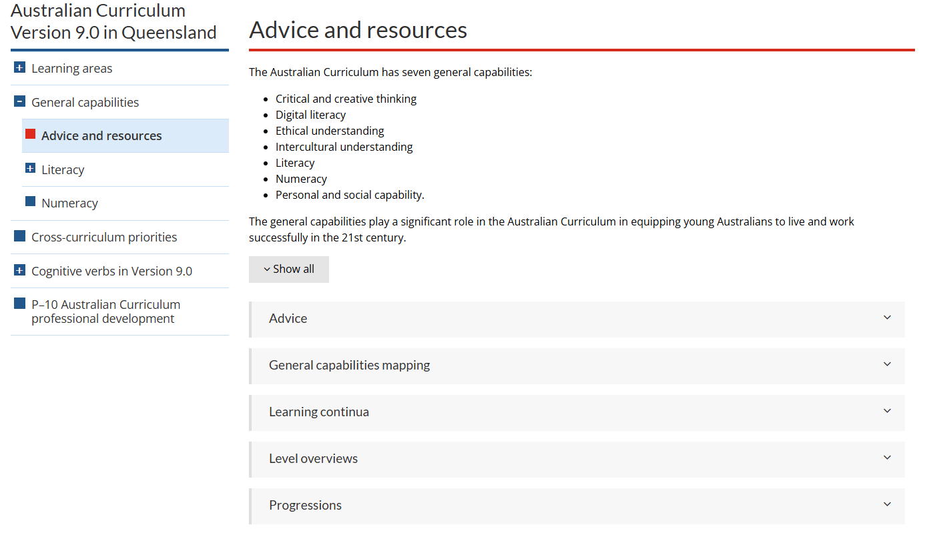
General capabilities: Advice and resources
Notes:
The QCAA general capability resources referred to in this presentation are located in the Advice and resources accordion menu: www.qcaa.qld.edu.au/p-10/aciq/version-9/general-capabilities/advice-and-resources

Slide 43
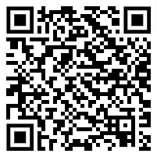
Pause and reflect
Scan the QCAA resources available for the Digital literacy general capability in the Advice and resources accordion menu.
Consider…
Which resources will you explore further to support planning for intentional opportunities for students to learn and practise digital literacy skills
Notes:
Reflection point:
Scan the QCAA resources for the Digital literacy general capability.
Which resources will you explore further to support planning for intentional opportunities for students to learn and practice digital literacy skills?

Slide 44
Learning goal
Understand how the Australian Curriculum v9.0: Digital literacy general capability can deepen and enrich student learning.
Success criteria
You will know you are successful if you:
have more knowledge about the organisation and structure of the Digital literacy general capability
can identify learning area opportunities to authentically embed the Digital literacy general capability in planning
can effectively use QCAA resources to plan intentional opportunities for students to learn and practise digital literacy skills.

Slide 45
Acknowledgments
Third-party copyright material, and QCAA material not covered by the CC BY licence is listed below:
Queensland Government coat of arms, and the QCAA and QSA trademarks may not be reproduced without permission.
Acknowledgment of Country artwork (2023) ‘Growth through Learning’ by Chern’ee, Brooke and Jesse Sutton, Kalkadoon. www.cherneesutton.com.au
Unless otherwise indicated, material from Australian Curriculum is © ACARA 2010–present, licensed CC BY 4.0. For the latest information and additional terms of use, see the Australian Curriculum website and its copyright notice.
Student and staff images have been used with permission.
The Alice Springs (Mparntwe) Education Declaration 2019 © Education Services Australia, as the legal entity for the Council of Australian Governments Education Council. Licensed under a Creative Commons Attribution, Non-Commercial 4.0 International Licence.
ACARA glossary items, the three-dimensional curriculum diagram, and other AC diagrams are 'Excluded Material' used under the terms of the Australian Curriculum and its copyright notice and is not modified. © Australian Curriculum, Assessment and Reporting Authority (ACARA) 2009 to present, unless otherwise indicated. You may view, download, display, print, reproduce (such as by making photocopies) and distribute these Excluded Materials in unaltered form only for your personal, non-commercial educational purposes or for the non-commercial educational purposes of your organisation, provided that you make others aware it can only be used for these purposes and attribute ACARA as the source of the Excluded Material. For the avoidance of doubt, this means that you cannot edit, modify or adapt any of these materials, and you cannot sub-licence any of these materials to others. Apart from any uses permitted under the Copyright Act 1968 (Cth), and those explicitly granted above, all other rights are reserved by ACARA. If you want to use such material in a manner that is outside this restrictive licence, you must request permission from ACARA by emailing (copyright@acara.edu.au).
OpenClipart-Vectors (2016) Android, Devices, Laptop. Royalty-Free Vector Graphic, Pixabay.com, https://pixabay.com/vectors/android-devices-laptop-mobile-1293981/

Slide 46
Copyright notice
© State of Queensland (QCAA) 2024
Licence: https://creativecommons.org/licenses/by/4.0 | Copyright notice: www.qcaa.qld.edu.au/copyright — lists the full terms and conditions, which specify certain exceptions to the licence. | Attribution (include the link): © State of Queensland (QCAA) 2024 www.qcaa.qld.edu.au/copyright.
Other copyright material in this presentation is listed on the previous slide/s.

Slide 47
QCAA social media

