Slide 1
Australian Curriculum general capabilities Identifying the changes in Version 9.0
240871

Slide 2
Acknowledgment of Country

Slide 3
Learning goal
Success criteria
To outline the changes to the Australian Curriculum Version 9.0 general capabilities.
You will know you are successful if you can identify the changes to Version 9.0 of the general capabilities.

Slide 4
Activity: Word association
In a moment …
Consider your response to the following question:
What word/s come to mind when you think about the general capabilities?
Notes:
Reflection point:
Think about your knowledge of and/or experience in using the general capabilities in the past.
What word/s come to mind when you think about the general capabilities?
If you are viewing this presentation with others, share your words. Discuss what is common and what is different.

Slide 5
Outline
1. What was the review process for the Australian Curriculum general capabilities?
3. What support is offered by the QCAA?
2. What are the changes in Version 9.0 general capabilities?

Slide 6
Outline
1. What was the review process for the Australian Curriculum general capabilities?
3. What support is offered by the QCAA?
2. What are the changes in Version 9.0 general capabilities?

Slide 7
Alice Springs (Mparntwe) Education Declaration 2019
Vision: A world class education system
Goal 1:
The Australian education system promotes excellence and equity.
Goal 2:
All young Australians become confident and creative individuals, successful lifelong learners and active and informed members of the community.
Education Council 2019, www.education.gov.au/alice-springs-mparntwe-education-declaration/resources/alice-springs-mparntwe-education-declaration p. 4.
Notes:
The foundational document underpinning the review of the Australian Curriculum was the Alice Springs (Mpartnwe) Education Declaration of 2019. This builds on the Melbourne Declaration, setting out the national vision for education and the commitment of Australian governments to improving educational outcomes.
The vision is based on two key goals:
that Australia’s education system promotes excellence and equity
that all young Australians become confident, creative, successful lifelong learners and active and informed community members.
Source: Education Council 2019, The Alice Springs (Mparntwe) Education Declaration, www.education.gov.au/alice-springs-mparntwe-education-declaration/resources/alice-springs-mparntwe-education-declaration.

Slide 8
Alice Springs (Mparntwe) Education Declaration 2019
Vision: A world class education system
Goal 1:
The Australian education system promotes excellence and equity.
Goal 2:
All young Australians become confident and creative individuals, successful lifelong learners and active and informed members of the community.
Education Council 2019, www.education.gov.au/alice-springs-mparntwe-education-declaration/resources/alice-springs-mparntwe-education-declaration p. 4.
Notes:
The Mparntwe Education Declaration makes a number of commitments, all focused on ensuring that every young Australian can access a quality education.
In relation to the general capabilities, Goal 2 has been broadened to include lifelong learning, and includes both knowledge and skills required for the 21st century. The addition of the word ‘lifelong’ highlights that learning does not end when students leave school. The term ‘citizens’ has been changed to ‘members of the community’.

Slide 9
K–12 Queensland learning
Queensland kindergarten learning guideline
Significant learnings — knowledge, skills and dispositions
Australian Curriculum
Prep–Year 10
General capabilities
Queensland Certificate of Education
Years 11 and 12
21st century skills
Emerging | Exploring | Extending
In familiar situations | In familiar situations | In new situations
With explicit support | With occasional support | With occasional prompting
Literacy
Numeracy
Digital literacy
Critical and creative thinking
Personal and social capability
Ethical understanding
Intercultural understanding
Notes:
By studying the Australian Curriculum in Queensland, students are provided with the opportunity to develop as confident and creative individuals, successful lifelong learners and active and informed members of the community from kindergarten all the way through to Year 12.
Knowledge, skills and dispositions are valued in the early years through inclusion in the Queensland kindergarten learning guideline. This framework provides opportunities for children to experience engaging learning that builds success for life.
For Prep–Year 10, the seven general capabilities remain in Version 9.0 of the Australian Curriculum, although ICT capability has been renamed Digital literacy.
And in the senior setting, both Applied and General senior syllabuses are underpinned by the skills students need in the 21st century, including critical thinking, creative thinking, communication, collaboration and teamwork, personal and social skills and digital literacy skills.

Slide 10
Activity: Reflection
In a moment …
Consider the opportunities available in your context to develop:
confident and creative individuals
successful lifelong learners
active and informed members of the community.
Notes:
Reflection point:
In your context, consider the opportunities to develop confident and creative individuals, successful lifelong learners and active and informed members of the community.
You might think about opportunities to explicitly teach skills, or opportunities to embed these concepts into your teaching and learning experiences.
If you are viewing this presentation with others, share and discuss your ideas.

Slide 11
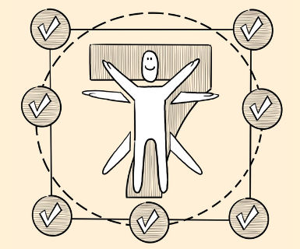
Review of the general capabilities
‘Revisit and improve where necessary, the learning continua for the general capabilities with reference to current research.’
Source: ACARA 2020, Terms of Reference: Review of the Australian Curriculum F−10, p. 4, www.acara.edu.au/docs/default-source/curriculum/ac-review_terms-of-reference_website.pdf?sfvrsn=2.
Notes:
Under the terms of reference for the Review of the Australian Curriculum F−10, ACARA was required to revisit and improve where necessary, the learning continua for the general capabilities with reference to current research.
The review process identified overwhelming stakeholder support for continuing the best-practice process of embedding the general capabilities in learning area content and continuing to develop the general capabilities through the learning area content, but it was also acknowledged that this process can be difficult.
In particular, the review acknowledged that teachers can find it difficult to:
see the connections between content, skills and values, and
know how to teach the general capabilities in authentic ways.
So, the capabilities have been refined to clarify these aspects and support teachers to embed them authentically and effectively.
Sources: ACARA 2020, Terms of Reference: Review of the Australian Curriculum F−10, p. 4, www.acara.edu.au/docs/default-source/curriculum/ac-review_terms-of-reference_website.pdf?sfvrsn=2 ; ACARA 2020, Curriculum Review: Process paper, Version 1.0, p. 3, www.acara.edu.au/docs/default-source/curriculum/curriculum-review-process-paper-31-august-2020.pdf.

Slide 12
The general capabilities review aimed to:
remove repetition of content between the general capabilities and the learning areas
improve the relationship between general capabilities and learning area content
improve the quality of content descriptions and achievement standards
suggest to teachers the most authentic ways to treat general capabilities and cross-curriculum priorities
Source: ACARA 2020, Terms of Reference: Review of the Australian Curriculum F−10, ACARA, pp. 1–2, 4. www.acara.edu.au/docs/default-source/curriculum/ac-review_terms-of-reference_website.pdf?sfvrsn=2.
Notes:
More specifically, in Version 9.0, ACARA has aimed to improve the relationship between the general capabilities and learning area content.
This has included:
removing repetition
improving the quality of content descriptions, and
ensuring that content elaborations provide useful examples of where the general capabilities can offer depth and richness.
These changes aim to assist teachers to more easily identify authentic opportunities where students can practise and develop the necessary knowledge, skills, behaviours and dispositions.

Slide 13
Outline
1. What was the review process for the Australian Curriculum general capabilities?
3. What support is offered by the QCAA?
2. What are the changes in Version 9.0 general capabilities?

Slide 14
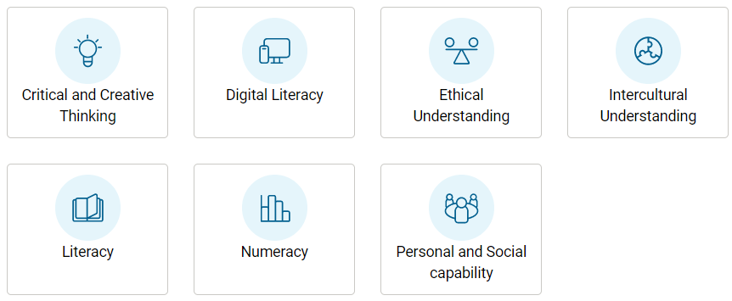
Version 9.0: General capabilities
Seven general capabilities:
Critical and creative thinking
Digital literacy (formerly ICT Capability)
Ethical understanding
Intercultural understanding
Literacy
Numeracy
Personal and social capability
ACARA 2024, v9.australiancurriculum.edu.au/downloads/general-capabilities#accordion-afa194f119-item-6336db4ee7
Notes:
As in Version 8.4, there are seven general capabilities in Version 9.0 of the Australian Curriculum — with the ICT capability now called Digital literacy.

Slide 15
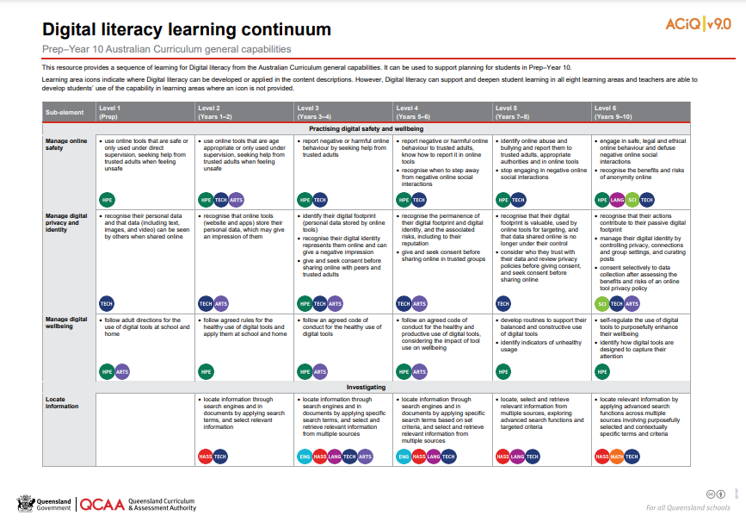
Structure of general capabilities: Learning continua
Developed for five of the seven general capabilities:
Critical and creative thinking
Digital literacy
Personal and social capability
Ethical understanding
Intercultural understanding.
Source: State of Queensland (QCQQ) 2022. Digital literacy learning continuum: www.qcaa.qld.edu.au/downloads/aciqv9/general-resources/ac9_gc_digital_literacy_learning_continuum.pdf
Notes:
The learning continua have been refined for five of the seven general capabilities.
These continua:
describe the knowledge, skills and behaviours that students can reasonably be expected to develop from Foundation (or Prep) to Year 10
map developmental paths in each of the elements and sub-elements across six levels.
The QCAA has developed a suite of learning continua resources, alongside level overviews, which are highlighted towards the end of this presentation. An example of the Digital literacy learning continuum resource is shown. This represents the developmental paths for elements and sub-elements across the six levels of this general capability.
The Literacy and Numeracy general capabilities now use progressions instead of continua. This change will be elaborated on later in the presentation.
The following slides discuss each general capability, beginning with Critical and creative thinking.
Sources: ACARA 2021, Curriculum Review Guidelines Paper Version 1.0, p. 17, www.australiancurriculum.edu.au/media/7118/curriculum-review-guidelines-paper_feb-2021.pdf; State of Queensland (QCAA) 2022, Digital literacy learning continuum, www.qcaa.qld.edu.au/downloads/aciqv9/general-resources/ac9_gc_digital_literacy_learning_continuum.pdf.

Slide 16
Critical and creative thinking: Key changes
Three structural changes were made to the organisation of the continuum.
Sub-element descriptions were refined to improve the development sequence.
Names of the elements and sub-elements were revised.
Source: ACARA 2021, General capabilities: Critical and creative thinking. Consultation — introductory information and learning continua, p. 3, www.australiancurriculum.edu.au/media/7023/gc_critical_and_creative_thinking_consultation_curriculum.pdf.
Notes:
Critical thinking involves students analysing and assessing possibilities against criteria for judgment. To practise the skills of critical thinking, students construct and evaluate arguments and use information, evidence and logic to draw reasoned conclusions and to solve problems.
Creative thinking requires students to generate and apply new ideas and see existing situations in new ways. They identify alternative explanations and possibilities and create new links to generate successful outcomes.
In Version 9.0, ACARA has refined the element and sub-element descriptions and developmental sequence, and made key changes to the continuum.
First, three structural changes were made to the organisation of the continuum:
The sub-elements ‘Identify and clarify information and ideas’ and ‘Organise and process information’ were combined into one sub-element ‘Identify, process and evaluate information’.
‘Reflect on processes’ was removed from the ‘Reflecting on thinking and processes’ element, renamed ‘Interpret concepts and problems’ and placed in the ‘Analysing’ element.
‘Applying logic and reasoning’ and ‘Draw conclusions and design a course of action’ were combined into one sub-element ‘Draw conclusions and provide reasons’.
Second, sub-element descriptions were refined to improve the developmental sequence and more clearly describe the knowledge, skills and behaviours identified within the sub-elements.
Third, names of the elements and sub-elements were revised to simplify language and to use titles that more appropriately reflect the skill described within the element or sub-element.
Source: ACARA 2021, General capabilities: Critical and creative thinking. Consultation — introductory information and learning continua, p. 3, www.australiancurriculum.edu.au/media/7023/gc_critical_and_creative_thinking_consultation_curriculum.pdf.

Slide 17
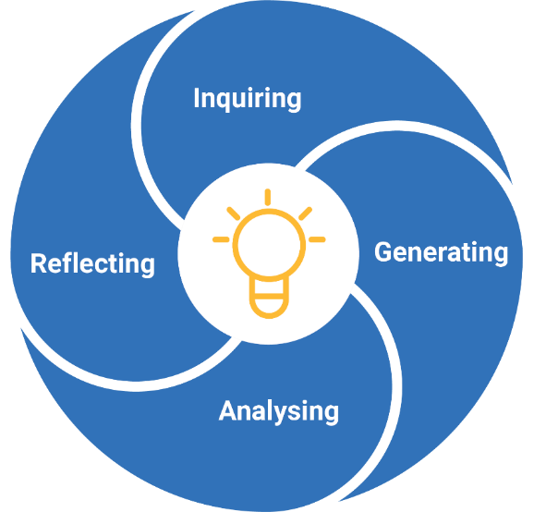
Critical and creative thinking: Organising elements
ACARA 2024, ‘Understand this general capability: Critical and creative thinking’, v9.australiancurriculum.edu.au/curriculum-information/understand-this-general-capability/critical-and-creative-thinking
Notes:
In Version 9.0, the four organising elements of Critical and creative thinking are:
Inquiring, with two sub-elements: ‘develop questions’ and ‘identify, process and evaluate information’
Generating, which is organised into three sub-elements: ‘create possibilities’, ‘consider alternatives’ and ‘put ideas into action’
Analysing, which has three sub-elements which provide students with opportunities to ‘interpret concepts and problems’, ‘draw conclusions and provide reasons’ and ‘evaluate actions and outcomes’, and
Reflecting, which has two sub-elements which support students to ‘think about thinking’ and ‘transfer knowledge’.
Source: ACARA 2024, ‘Understand this general capability: Critical and creative thinking’, v9.australiancurriculum.edu.au/curriculum-information/understand-this-general-capability/critical-and-creative-thinking.

Slide 18
Digital literacy: Key changes
ICT capability was renamed Digital literacy and the description was changed to reflect this.
Structure was revised to better reflect the changed focus.
Elements and sub-elements were renamed to simplify the language and to use titles that better reflect the skill.
Sub-element descriptions were refined.
Source: ACARA 2021, General capabilities: Digital literacy (previously ICT capability). Consultation — introductory information and learning continua, ACARA, p. 3, www.australiancurriculum.edu.au/media/7024/gc_digital_literacy_ict_capability_consultation_curriculum.pdf.
Notes:
The Digital literacy general capability encompasses the knowledge and skills students need to create, manage, communicate and investigate data, information and ideas, and to solve problems. It involves students critically identifying and appropriately selecting and using digital devices or systems, and learning to make the most of the technologies available to them.
In addition to the review process followed for all the general capabilities, the refinement of Digital literacy (formerly ICT) was informed by research into digital intelligence and digital literacy.
As a result, the review provided an opportunity to:
rename the general capability
revise the definition and structure of the capability by renaming, combining or removing elements and sub-elements
rewrite statements to ensure levelness and clarity
refine sub-element descriptions to improve the development sequence across levels one to six, and to more clearly describe the knowledge, skills and behaviours identified within the sub-elements.
Source: ACARA 2021, General capabilities: Digital literacy (previously ICT capability). Consultation — introductory information and learning continua, ACARA, p. 3, https://www.australiancurriculum.edu.au/media/7024/gc_digital_literacy_ict_capability_consultation_curriculum.pdf.

Slide 19
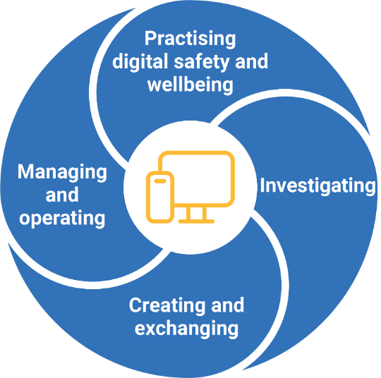
Digital literacy: Organising elements
ACARA 2024, ‘Understand this general capability: Digital Literacy’, v9.australiancurriculum.edu.au/curriculum-information/understand-this-general-capability/digital-literacy
Notes:
In Version 9.0, Digital literacy is divided into four elements, all of which have three sub-elements:
Practising digital safety and wellbeing has sub-elements related to managing online safety, digital privacy and digital wellbeing
Investigating, which involves locating information, acquiring and collating data and interpreting data
Creating and exchanging requires students to ‘plan’, ‘create, communicate and collaborate’ and ‘respect intellectual property’, and
Managing and operating which involves students managing content, protecting content and selecting and using tools.
Source: ACARA 2024, ‘Understand this general capability: Digital Literacy’, v9.australiancurriculum.edu.au/curriculum-information/understand-this-general-capability/digital-literacy.

Slide 20
Ethical understanding: Key changes
Number of elements was reduced from three to two.
Sub-elements were renamed and their descriptions refined to be more reflective of the stages of schooling.
Source: ACARA 2021, General capabilities: Ethical understanding. Consultation — introductory information and learning continua, ACARA, p. 3, www.australiancurriculum.edu.au/media/7083/gc_ethical_understanding_consultation_curriculum.pdf.
Notes:
The Ethical understanding general capability encompasses the knowledge and skills students require to identify ethical concepts, understand different ethical perspectives and apply ethical thinking in response to issues. It is developed through the investigation of a range of questions drawn from various contexts in the curriculum.
As a result of ACARA’s review, the number of elements was reduced from three to two. More specifically:
the first element includes sub-elements related to meta-ethics (ethical and moral concepts) and has been renamed ‘Understanding ethical concepts and perspectives’
the second element includes sub-elements related to normative ethics (theories about how to be ethical) and applied ethics (the application of ethical thinking) and has been renamed ‘Responding to ethical issues’
the third element was removed with its sub-elements combined or renamed to reflect their placement within the new elements.
In addition, several changes were made to sub-elements, and sub-element descriptions were refined to be more reflective of the stages of schooling and the nature of learners at these stages.
Source: ACARA 2021, General capabilities: Ethical understanding. Consultation — introductory information and learning continua, pp. 3, 5, www.australiancurriculum.edu.au/media/7083/gc_ethical_understanding_consultation_curriculum.pdf.

Slide 21
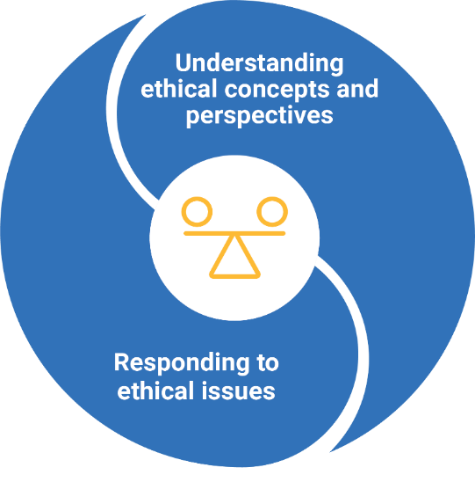
Ethical understanding: Organising elements
ACARA 2024, ‘Understand this general capability: Ethical understanding’, v9.australiancurriculum.edu.au/curriculum-information/understand-this-general-capability/ethical-understanding
Notes:
The Ethical understanding learning continuum is organised into two elements, each of which has three sub-elements.
First, Understanding ethical concepts and perspectives gives students opportunities to ‘explore ethical concepts’, ‘examine values, rights and responsibilities, and ethical norms’, and ‘recognise influences on ethical behaviour and perspectives’.
Second, Responding to ethical issues provides students with an opportunity to ‘explore ethical perspectives and frameworks’, ‘explore ethical issues’ and ‘make and reflect on ethical decisions’.
Source: ACARA 2024, ‘Understand this general capability: Ethical understanding’, v9.australiancurriculum.edu.au/curriculum-information/understand-this-general-capability/ethical-understanding.

Slide 22
Intercultural understanding: Key changes
Element descriptions were changed and refocused.
Sub-element descriptions were changed to refocus their intent.
Names of the elements and sub-elements were revised.
Source: ACARA 2021, General capabilities: Intercultural understanding. Consultation — introductory information and learning continua, p. 3, www.australiancurriculum.edu.au/media/7172/gc_intercultural_understanding_capability_consultation_curriculum.pdf.
Notes:
Intercultural understanding, encompasses the behaviours and dispositions that students need to understand what happens and what to do when cultures intersect. It involves students developing the knowledge and skills to reflect on culture and cultural diversity, engage with cultural and linguistic diversity, and navigate intercultural contexts.
Through the review, three main refinements have been made.
Firstly, the element descriptions were changed and refocussed for consistency with current research, and to make explicit a cycle of self-awareness and agency.
Specifically:
‘Recognising culture and developing respect’ was refocused as ‘Reflecting on culture and cultural diversity’
‘Interacting and empathising with others’ was refocused as ‘Engaging with cultural and linguistic diversity’, and
‘Reflecting on intercultural experiences and taking responsibility’ was refocused as ‘Navigating intercultural contexts’.
Secondly, the sub-element descriptions were changed to:
realign their intent with current research
improve the sequence across levels one to six, and
more clearly describe the knowledge, skills and behaviours.
Finally, the names of the elements and sub-elements were revised to simplify language across the continuum, and to use titles that more appropriately reflect the skills described within the element or sub-element.
Source: ACARA 2021, General capabilities: Intercultural understanding. Consultation — introductory information and learning continua, pp. 3, 5, www.australiancurriculum.edu.au/media/7172/gc_intercultural_understanding_capability_consultation_curriculum.pdf.

Slide 23
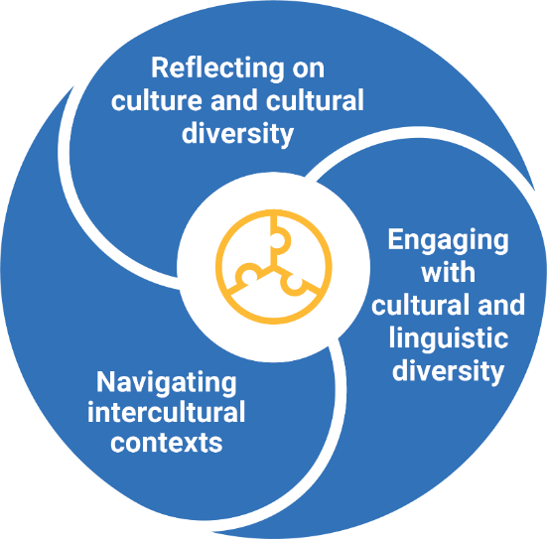
Intercultural understanding: Organising elements
ACARA 2024, ‘Understand this general capability: Intercultural understanding’, v9.australiancurriculum.edu.au/curriculum-information/understand-this-general-capability/intercultural-understanding
Notes:
The learning continuum for Intercultural understanding is organised into three elements, all of which have three sub-elements.
Reflecting on culture and cultural diversity provides students with opportunities to ‘reflect on the relationship between cultures and identities’, ‘examine cultural perspectives and world views’, and ‘explore the influence of cultures on interactions’
Engaging with cultural and linguistic diversity supports students to learn to ‘communicate responsively’, ‘develop multiple perspectives’ and ‘develop empathy’, and
Navigating intercultural contexts supports students to ‘consider responses to intercultural experiences’, ‘respond to biases, stereotypes, prejudices and discrimination’ and ‘adapt in intercultural exchanges’.
Source: ACARA 2024, ‘Understand this general capability: Intercultural understanding’, v9.australiancurriculum.edu.au/curriculum-information/understand-this-general-capability/intercultural-understanding.

Slide 24
Personal and social capability: Key changes
Five structural changes were made to the organisation of the continuum
Sub-element descriptions were refined
Names of the elements and sub-elements in the learning continuum were revised
Descriptions for Level 1a were revised and aligned to the new structure and additional descriptions for each sub-element included.
Source: ACARA 2021, General capabilities: Personal and social capability. Consultation — introductory information and learning continua, pp. 3–4, www.australiancurriculum.edu.au/media/7022/gc_personal_and_social_capability_consultation_curriculum.pdf.
Notes:
The Personal and social capability provides a foundation for students to understand themselves and others, and to navigate their relationships, lives, work and learning. It supports students to develop their ability to regulate their thoughts, behaviours and emotions. Level 1a supports students with disability to access age-equivalent content and participate in learning on the same basis as their peers.
The review identified opportunities to improve the structural flow and improve the relationship of the Personal and social capability with learning area content.
First, five structural changes were made to the organisation of the continuum:
‘Recognise personal qualities and achievements’ and ‘Understand themselves as learners’ sub-elements were combined into one sub-element, ‘Personal awareness’
‘Work independently and show initiative’ was removed from the ‘self-management’ element, and ‘Develop self-discipline and set goals’ was renamed ‘Emotional regulation’.
The ‘Understand relationships’ and ‘Appreciate diverse perspectives’ sub-elements were combined to form the ‘Relational awareness’ sub-element as acknowledgment that appreciating diversity is a key component of relationship building
The sub-element ‘Contribute to civil society’ was renamed ‘Community awareness’ to acknowledge the need for students to develop awareness of, and take responsibility for, their social, physical and natural environments
‘Empathy’ was included as a sub-element to acknowledge the development of the skill to manage relationships and build awareness of others’ feelings, needs and concerns and its contribution to social awareness.
Second, sub-element descriptions were refined to improve the development sequence across levels one to six, and to more clearly describe the knowledge, skills and behaviours identified.
Third, names of the elements and sub-elements in the learning continuum were revised to simplify language across the continuum and to use titles that more appropriately reflect the skill described within the element or sub-element.
And four, the descriptions for Level 1a were revised and aligned to the new structure of the learning continuum, and additional descriptions for each sub-element included, to support teachers in their approaches to planning and programming for students with disability.
Source: ACARA 2021, General capabilities: Personal and social capability. Consultation — introductory information and learning continua, p. 3–4, www.australiancurriculum.edu.au/media/7022/gc_personal_and_social_capability_consultation_curriculum.pdf.

Slide 25
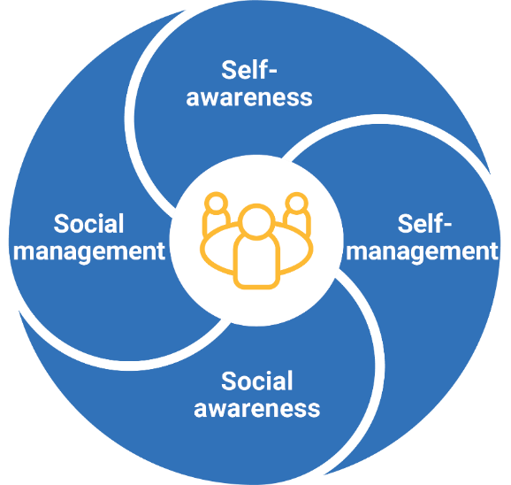
Personal and social capability: Organising elements
ACARA 2024, v9.australiancurriculum.edu.au/curriculum-information/understand-this-general-capability/personal-and-social-capability
Notes:
The personal and social capability learning continuum is organised into four elements.
These are:
Self-awareness, which has the sub-elements ‘personal awareness’, ‘emotional awareness’ and ‘reflective practice’
Self-management, which supports students to develop ‘goal setting’, ‘emotional regulation’ and ‘perseverance and adaptability’
Social awareness, which includes three sub-elements: ‘empathy’; ‘relational awareness’; and ‘community awareness’ and
Social management with five sub-elements: ‘communication’, ‘collaboration’, ‘leadership’, ‘decision-making’ and ‘conflict resolution’.
Source: ACARA 2024, ‘Understand this general capability: Personal and social capability’, v9.australiancurriculum.edu.au/curriculum-information/understand-this-general-capability/personal-and-social-capability.

Slide 26
Activity: Positive outcomes of the change
In a moment …
Consider your response to the following questions:
Why might these changes to the general capabilities matter to me?
Why might they matter to my school community?
Why might they matter to the wider world?
Notes:
Reflection point:
Now that we have explored the key changes and organising elements of the first five general capabilities, consider your response to the following questions:
Why might these changes to general capabilities matter to me?
Why might they matter to my school community?
Why might they matter to the wider world?
If you are viewing this presentation with others, share and discuss your responses to these questions.

Slide 27
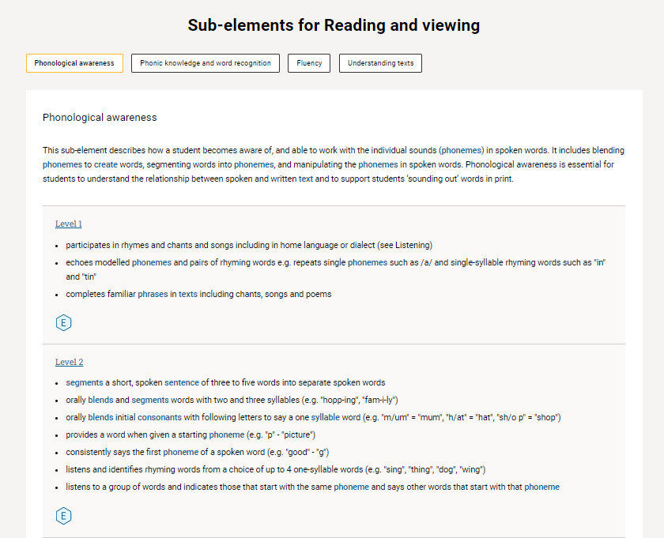
Structure of general capabilities: Progressions
Developed for two of the general capabilities:
Literacy
Numeracy.
Source: ACARA 2024, v9.australiancurriculum.edu.au/f-10-curriculum/general-capabilities/literacy?element=1&sub-element=LRPhA
Notes:
We’ll turn now to the final two general capabilities, Literacy and Numeracy. Instead of learning continua, these two capabilities are structured around progressions.
The progressions describe the learning pathway/s along which students typically progress, regardless of age or year level.
They describe the skills, understandings and capabilities students typically acquire as their proficiency increases in a particular aspect of the curriculum over time.
They support teachers to: ascertain the stage of learning reached; identify any gaps in skills and knowledge; and plan for the next step to progress learning.
Finally, they provide teachers with a conceptual tool that supports them to develop targeted teaching and learning programs for students who are working at, above or below the year level expectation.
This screenshot from the Australian Curriculum website, identifies the sub-elements for Reading and viewing, in particular Phonological awareness. You’ll note the progression of learning through the descriptions of skills, understandings and capabilities students typically acquired at specific stages of development.
Source: ACARA 2022, ‘Literacy’, v9.australiancurriculum.edu.au/f-10-curriculum/general-capabilities/literacy?element=1&sub-element=LRPhA

Slide 28
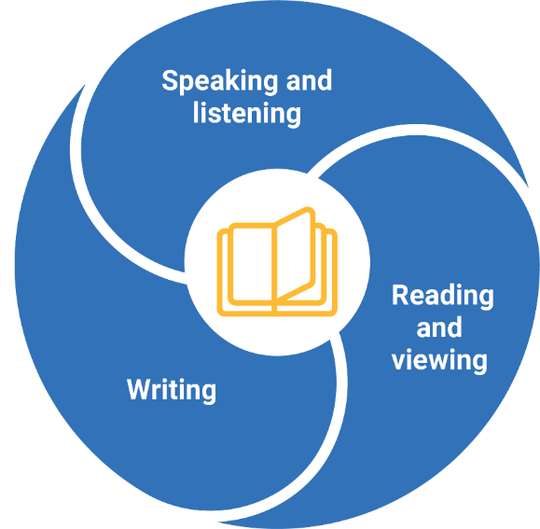
Literacy: Organising elements
ACARA 2024, ‘Understand this general capability: Literacy’, v9.australiancurriculum.edu.au/curriculum-information/understand-this-general-capability/literacy
Notes:
The Australian Curriculum introduction to the Literacy general capability explains that ‘literacy involves students listening to, reading, viewing, speaking, writing and creating oral, print, visual and digital texts, and using and modifying language for different purposes. Literacy enables students to: access, understand, analyse and evaluate information and ideas, express thoughts and emotions; present ideas and opinions; and interact with others’ (p. 3)
As such, the Literacy general capability is organised into three elements.
The first is Speaking and listening, with three sub-elements: Listening; Interacting; and Speaking.
Second is Reading and viewing with four sub-elements: Phonological awareness; Phonic knowledge and word recognition; Fluency; and Understanding texts.
The final element is Writing which has five sub-elements: Creating texts; Grammar; Punctuation; Spelling; and Handwriting and keyboarding.
Version 9.0 of the Literacy learning progression is a refinement of earlier versions of the learning progressions, based on the review of the English learning area content.
Source: ACARA 2024, ‘Understand this general capability: Literacy’, v9.australiancurriculum.edu.au/curriculum-information/understand-this-general-capability/literacy.

Slide 29
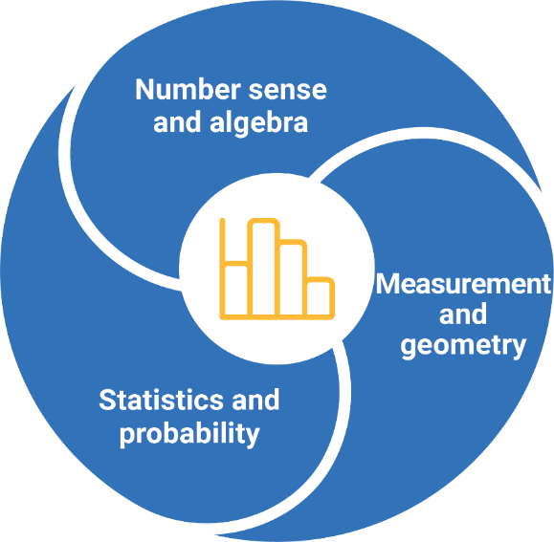
Numeracy: Organising elements
ACARA 2024, ‘Understand this general capability: Numeracy’, v9.australiancurriculum.edu.au/curriculum-information/understand-this-general-capability/numeracy
Notes:
The Australian Curriculum introduction to the Numeracy general capability explains that ‘Numeracy is fundamental to a student’s ability to learn at school and to engage productively in society. It involves the recognition, formulation and interpretation of mathematics, and its application to real-world problems and contexts’ (p. 3).
The Numeracy general capability is organised into three elements.
First is Number sense and algebra. It encompasses eight sub-elements: Number and place value; Counting processes; Additive strategies; Multiplicative strategies; Interpreting fractions; Proportional thinking; Number patterns and algebraic thinking; and Understanding money
The second element is Measurement and geometry with four sub-elements: Understanding units of measurement; Understanding geometric properties; Positioning and locating; and Measuring time.
The final element is Statistics and probability. It has two sub-elements: Understanding chance; and Interpreting and representing data.
Like Literacy, the earlier version of the Numeracy learning progression has been refined based on the review of the Mathematics learning area content in Version 9.0 of the Australian Curriculum.
Source: ACARA 2024, ‘Understand this general capability: Numeracy’, v9.australiancurriculum.edu.au/curriculum-information/understand-this-general-capability/numeracy.

Slide 30
Activity: Positive outcomes of the change
In a moment …
Consider your response to the following question:
What is one opportunity for teaching and learning that arises out of the refresh of the general capabilities?
Notes:
Reflection point:
What is one opportunity for teaching and learning that arises out of the refresh of the general capabilities?
If you are viewing this presentation with others, share and discuss your ideas.

Slide 31
Outline
1. What was the review process for the Australian Curriculum general capabilities?
3. What support is offered by the QCAA?
2. What are the changes in Version 9.0 general capabilities?

Slide 32
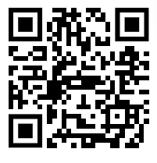
Australian Curriculum in Queensland webpages
Notes:
The QCAA has a range of resources available online at the QCAA website that offer support for both Version 9.0 and Version 8.4 of the Australian Curriculum.
To access Version 9.0 resources, select the Prep–Year 10 tab on the QCAA website, select the Australian Curriculum link, then click on the ‘Australian Curriculum Version 9.0 in Queensland’ (ACiQ) tile: https://www.qcaa.qld.edu.au/p-10/aciq/version-9. From this menu, you can select to view content for the general capabilities, learning areas or cross-curriculum priorities.

Slide 33
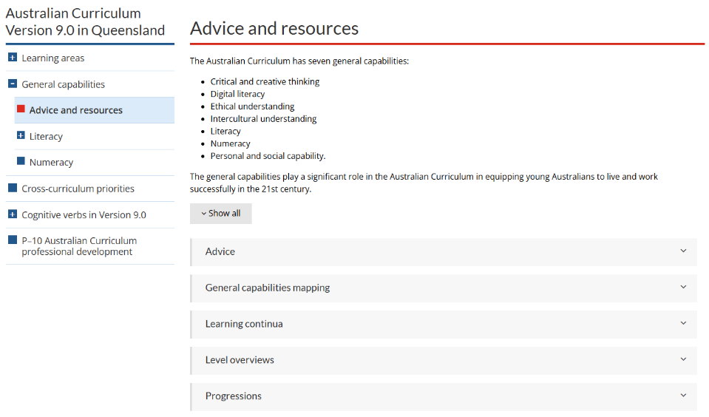
General capabilities ACiQv9.0 advice and resources
Notes:
The General capabilities resources highlighted in the following slides are located in the Advice and resources accordion menu: https://www.qcaa.qld.edu.au/p-10/aciq/version-9/general-capabilities/advice-and-resources

Slide 34
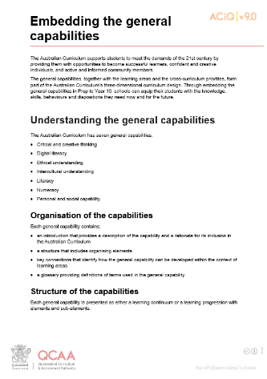
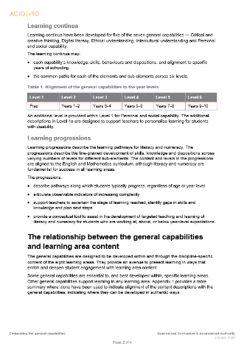
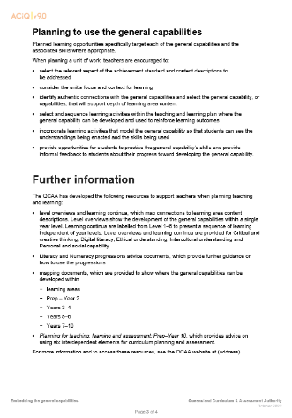
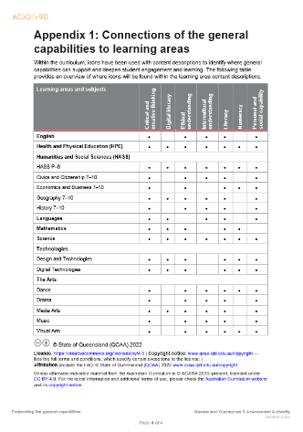
Supporting resources: Embedding the general capabilities
Notes:
One useful resource is ‘Embedding the general capabilities’. This advice provides a summary of the structure and levels of the general capabilities as well as considerations for teaching and learning.
This resource is located in the Advice accordion or can be accessed using the QR code.

Slide 35
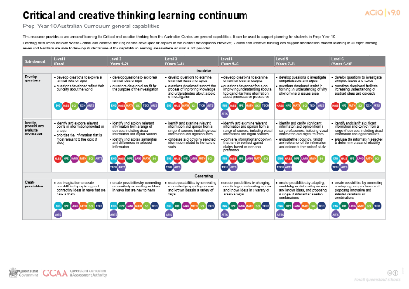
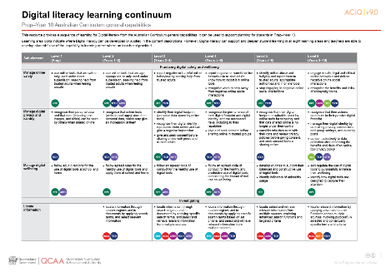
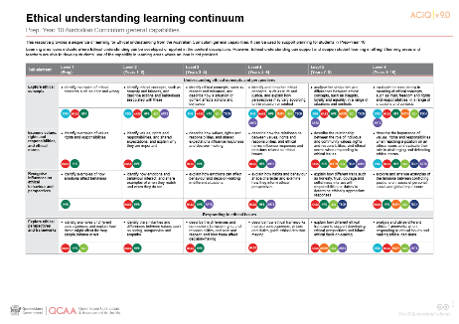
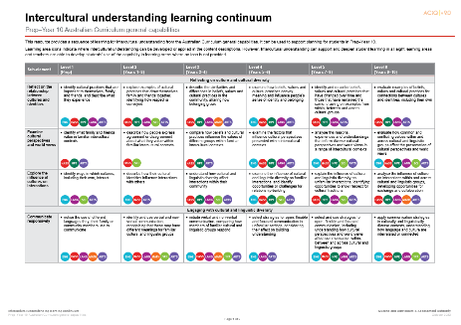
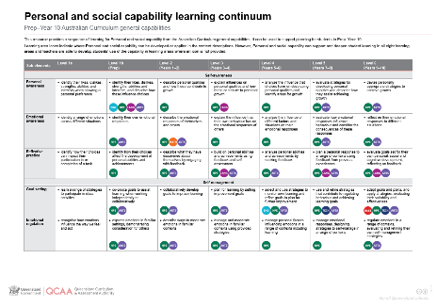
Supporting resources: Learning continua
Notes:
In addition, there are Learning continua for each individual general capability. These are labelled from Level 1 to 6 to present a sequence of learning independent of year levels.
These are located in the Learning continua accordion and can be accessed using the QR code.

Slide 36
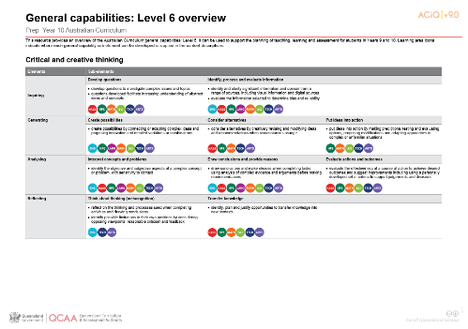
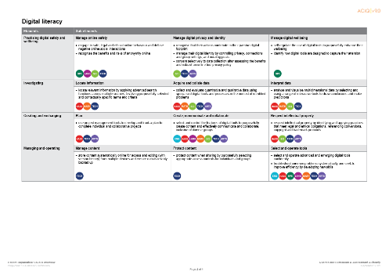
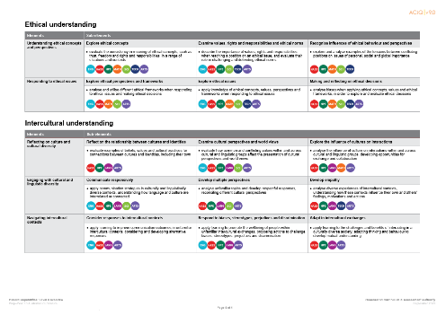
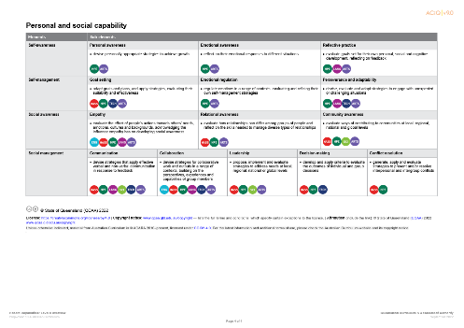
Supporting resources: Level overviews
Notes:
Finally, complementing the learning continua, Level overview resources show the development of all five general capabilities within a single level.
These are located in the Level overviews accordion and can be accessed using the QR code.

Slide 37
Learning goal
Success criteria
To outline the changes to the Australian Curriculum Version 9.0 general capabilities.
You will know you are successful if you can identify the changes to Version 9.0 of the general capabilities.

Slide 38
Contact
K–10 Curriculum and Assessment Branch​ ​
T +61 7 3120 6102
E australiancurriculum@qcaa.qld.edu.au
W www.qcaa.qld.edu.au

Slide 39
References
Australian Curriculum, Assessment and Reporting Authority 2020, Curriculum review Process Paper, Version 1.0, August 2020.
Australian Curriculum, Assessment and Reporting Authority 2021, General capabilities (Version 8.4) www.australiancurriculum.edu.au/f-10-curriculum/general-capabilities/
Australian Curriculum, Assessment and Reporting Authority 2021, General capabilities: Critical and creative thinking. Consultation: Introductory information and learning continua, www.australiancurriculum.edu.au/media/7023/gc_critical_and_creative_thinking_consultation_curriculum.pdf
Australian Curriculum, Assessment and Reporting Authority 2021, General capabilities: Digital literacy (previously ICT capability). Consultation: Introductory information and learning continua, www.australiancurriculum.edu.au/media/7024/gc_digital_literacy_ict_capability_consultation_curriculum.pdf
Australian Curriculum, Assessment and Reporting Authority 2021, General capabilities: Ethical understanding. Consultation: Introductory information and learning continua, www.australiancurriculum.edu.au/media/7083/gc_ethical_understanding_consultation_curriculum.pdf
Australian Curriculum, Assessment and Reporting Authority 2021, General capabilities: Intercultural understanding. Consultation: Introductory information and learning continua, www.australiancurriculum.edu.au/media/7172/gc_intercultural_understanding_capability_consultation_curriculum.pdf
Australian Curriculum, Assessment and Reporting Authority 2021, General capabilities: Personal and social capability. Consultation: Introductory information and learning continua, www.australiancurriculum.edu.au/media/7022/gc_personal_and_social_capability_consultation_curriculum.pdf

Slide 40
References
Australian Curriculum, Assessment and Reporting Authority 2021, ‘Organisation of the general capabilities’, Australian Curriculum Review.
Australian Curriculum, Assessment and Reporting Authority 2020, Terms of reference: Review of the Australian Curriculum F-10. www.acara.edu.au/docs/default-source/curriculum/ac-review_terms-of-reference_website.pdf?sfvrsn=2.
Education Council 2019, The Alice Springs (Mparntwe) Education Declaration, https://www.education.gov.au/alice-springs-mparntwe-education-declaration/resources/alice-springs-mparntwe-education-declaration
QCAA 2019, Embedding the general capabilities, www.qcaa.qld.edu.au/downloads/aciq/general-resources/ac_gc_embedding_general_capabilities.pdf.

Slide 41
Acknowledgments
Third-party copyright material, and QCAA material not covered by the CC BY licence is listed below:
Queensland Government coat of arms, and the QCAA and QSA trademarks may not be reproduced without permission.
Acknowledgment of Country artwork (2023) ‘Growth through Learning’ by Chern’ee, Brooke and Jesse Sutton, Kalkadoon. www.cherneesutton.com.au
The Alice Springs (Mparntwe) Education Declaration 2019 © Education Services Australia, as the legal entity for the Council of Australian Governments Education Council. Licensed under a Creative Commons Attribution, Non-Commercial 4.0 International Licence.
Unless otherwise indicated material from Australian Curriculum is © ACARA 2010–present, licensed under CC BY 4.0. For the latest information and additional terms of use, please check the Australian Curriculum website and its copyright notice.

Slide 42
Acknowledgments
The general capabilities organising elements diagrams, images and icons are 'Excluded Material' used under the terms of the Australian Curriculum and its copyright notice and is not modified. © Australian Curriculum, Assessment and Reporting Authority (ACARA) 2009 to present, unless otherwise indicated. You may view, download, display, print, reproduce (such as by making photocopies) and distribute these Excluded Materials in unaltered form only for your personal, non-commercial educational purposes or for the non-commercial educational purposes of your organisation, provided that you make others aware it can only be used for these purposes and attribute ACARA as the source of the Excluded Material. For the avoidance of doubt, this means that you cannot edit, modify or adapt any of these materials, and you cannot sub-license any of these materials to others. Apart from any uses permitted under the Copyright Act 1968 (Cth), and those explicitly granted above, all other rights are reserved by ACARA. If you want to use such material in a manner that is outside this restrictive licence, you must request permission from ACARA by submitting a request through the online enquiry form (select 'copyright').
Student and staff images have been used with permission.

Slide 43
Copyright notice
© State of Queensland (QCAA) 2024
Licence: https://creativecommons.org/licenses/by/4.0 | Copyright notice: www.qcaa.qld.edu.au/copyright — lists the full terms and conditions, which specify certain exceptions to the licence. | Attribution (include the link): © State of Queensland (QCAA) 2024 www.qcaa.qld.edu.au/copyright.
Other copyright material in this presentation is listed on the previous slide/s.

Slide 44
QCAA social media
Notes:
If you don’t do so already, we recommend you follow QCAA on one or more social media platforms to stay in touch with us, and to find out about upcoming resources and professional learning.

