Slide 1
Familiarisation and planning
240863
Australian Curriculum v9.0: English — Years 7–10
Notes:
This presentation is designed to introduce curriculum leaders and teachers to the Australian Curriculum Version 9.0: English — Years 7‒10.

Slide 2
Acknowledgment of Country
Notes:
Acknowledgment of Country
The QCAA acknowledges the Traditional Owners and Traditional Custodians of the lands on which we meet today.
We pay our respects to their Elders and their descendants, who continue cultural and spiritual connections to Country, and we extend that respect to Aboriginal people and Torres Strait Islander people here today.
We thank them for sharing their cultures and spiritualities and recognise the important contribution of this knowledge to our understanding of this place we call home.

Slide 3
Learning goal
Understand the implications of changes in the Years 7–10 Australian Curriculum from v8.4 to v9.0: English for planning.
Success criteria
You will know you are successful if you:
have more knowledge about the intent and structure of the Years 7–10 Australian Curriculum v9.0: English
can identify actions for planning in your school.

Slide 4
Outline
Introduction to the Australian Curriculum v9.0: English
Understand this learning area
Formulating next steps
Curriculum elements

Slide 5
Outline
Introduction to the Australian Curriculum v9.0: English
Understand this learning area
Formulating next steps
Curriculum elements

Slide 6
The three-dimensional Australian Curriculum
Source: ACARA, www.v9.australiancurriculum.edu.au/help/website-tour
Notes:
In the Australian Curriculum Version 9.0, the three-dimensional interrelated structure has not changed as part of the review. The diagram visually represents these three dimensions.
Source: Script and picture adapted (addition of labels) from video at www.v9.australiancurriculum.edu.au/help/website-tour (time stamp 50 seconds).

Slide 7
English in the three-dimensional Australian Curriculum
Source: ACARA, www.v9.australiancurriculum.edu.au/help/website-tour
Notes:
The Australian Curriculum consists of eight learning areas. English is indicated in blue.
Source: Script and picture adapted (addition of labels) from video at www.v9.australiancurriculum.edu.au/help/website-tour (time stamp 50 seconds).

Slide 8
The three-dimensional Australian Curriculum
Source: ACARA, www.v9.australiancurriculum.edu.au/help/website-tour
Notes:
There are seven general capabilities:
Literacy
Numeracy
Digital literacy
Critical and creative thinking
Personal and social capability
Intercultural understanding, and
Ethical understanding.
As part of the review, the general capabilities have been refined.
The Information, Communications and Technologies (ICT) general capability in v8.4 has been renamed Digital literacy in v9.0 to reflect current understandings in the field.
The Literacy and Numeracy general capabilities are no longer continua. In v9.0 they are progressions representing the fine-grained indicators of the typical trajectory of literacy and numeracy development.
The remaining general capabilities have had refinements to elements, sub-elements and continua.
Source: Script and picture adapted (addition of labels) from video at www.v9.australiancurriculum.edu.au/help/website-tour (time stamp 50 seconds).

Slide 9
The three-dimensional Australian Curriculum
Source: ACARA, www.v9.australiancurriculum.edu.au/help/website-tour
Notes:
There are three cross-curriculum priorities:
Aboriginal and Torres Strait Islander Histories and Cultures
Asia and Australia’s engagement with Asia, and
Sustainability.
Source: Script and picture adapted (addition of labels) from video at www.v9.australiancurriculum.edu.au/help/website-tour (time stamp 50 seconds).

Slide 10
Organisation of English and changes
Version 8.4
Version 9.0
Understand how the learning area works
Rationale
Aims
Key ideas
Structure
Resources (learning area specific)
Understand this learning area
Introduction
Rationale
Aims
Structure
Key considerations
Key connections
Resources
Learning area curriculum
Year level description
Achievement standard
Strands and sub-strands
Content descriptions
Threads (learning area specific)
Content elaborations
Curriculum elements
Level description
Achievement standard
Strands and sub-strands
Content descriptions
Content elaborations
Notes:
This is an overview of the organisation of the Australian Curriculum Version 8.4: English compared to Version 9.0, with the main changes noted.
Source: Image created in house using SmartArt. Adapted from: https://v9.australiancurriculum.edu.au/teacher-resources/understand-this-learning-area/english.

Slide 11
Organisation of English and changes
Version 8.4
Version 9.0
Understand how the learning area works
Rationale
Aims
Key ideas
Structure
Resources (learning area specific)
Understand this learning area
Introduction
Rationale
Aims
Structure
Key considerations
Key connections
Resources
Learning area curriculum
Year level description
Achievement standard
Strands and sub-strands
Content descriptions
Threads (learning area specific)
Content elaborations
Curriculum elements
Level description
Achievement standard
Strands and sub-strands
Content descriptions
Content elaborations
Notes:
The organisation of the Australian Curriculum in Version 8.4 is in two parts:
Understand how the learning area works, which includes the rationale, aims, key ideas, structure and resources.
Learning area curriculum including the year level description, the achievement standard, strands and sub-strands, content descriptions, threads and content elaborations.
Source: Image created in house using SmartArt. Adapted from https://v9.australiancurriculum.edu.au/teacher-resources/understand-this-learning-area/english.

Slide 12
Organisation of English and changes
Version 8.4
Version 9.0
Understand how the learning area works
Rationale
Aims
Key ideas
Structure
Resources (learning area specific)
Understand this learning area
Introduction
Rationale
Aims
Structure
Key considerations
Key connections
Resources
Learning area curriculum
Year level description
Achievement standard
Strands and sub-strands
Content descriptions
Threads (learning area specific)
Content elaborations
Curriculum elements
Level description
Achievement standard
Strands and sub-strands
Content descriptions
Content elaborations
Notes:
The Version 9.0 learning area structure helps teachers organise the teaching and assessment for English.
It is organised into two sections:
Understand this learning area and,
Curriculum elements.
The Understand this learning area section provides detail of the intent of the Australian Curriculum v9.0: English and a snapshot of the structure. In blue are two new sections: key considerations and key connections.
The Curriculum elements section shows the elements associated with English.
Source: Image created in house using SmartArt. Adapted from https://v9.australiancurriculum.edu.au/teacher-resources/understand-this-learning-area/english.

Slide 13
Outline
Introduction to Australian Curriculum v9.0
Understand this learning area
Formulating next steps
Curriculum elements

Slide 14
Organisation of English
Version 9.0
Understand this learning area
Introduction
Rationale
Aims
Structure
Key considerations
Key connections
Resources
Introduction
Rationale
Aims
Curriculum elements
Level description
Achievement standard
Strands and sub-strands
Content descriptions
Content elaborations
Notes:
In English, the introduction in Version 9.0 is one sentence: ‘The Australian Curriculum: English has been developed on the basis that all students will study English in each year of schooling from Foundation to Year 10.’ (ACARA, 2022, https://v9.australiancurriculum.edu.au/teacher-resources/understand-this-learning-area/english).
The rationale and aims capture the intent of teaching English and inform teachers’ planning in a school context.
Source: Image created in house using SmartArt. Adapted from https://v9.australiancurriculum.edu.au/teacher-resources/understand-this-learning-area/english.

Slide 15
Organisation of English
Version 9.0
Understand this learning area
Introduction
Rationale
Aims
Structure
Key considerations
Key connections
Resources
Aims
Structure
Curriculum elements
Level description
Achievement standard
Strands and sub-strands
Content descriptions
Content elaborations
Notes:
Exploring the aims and the structure of English provides a way for teachers to conceptualise the Australian Curriculum English.
Source: Image created in house using SmartArt. Adapted from https://v9.australiancurriculum.edu.au/teacher-resources/understand-this-learning-area/english.

Slide 16
Structure of English: strands and sub-strands
Version 9.0 | (Header row)
Language | Literature | Literacy
Language variation and change | Literature and contexts Literature and context | Texts in context
Language for interacting with others Language for interaction | Engaging with and responding to literature Responding to literature | Interacting with others
Text structure and organisation | Examining literature | Analysing, interpreting and evaluating Interpreting, analysing and evaluating
Language for expressing and developing ideas | Creating literature | Creating texts
Phonics and word knowledge |  | Phonic and word knowledge (P–6) Word knowledge (7–10)
Notes:
In English, the curriculum content is organised through strands and sub-strands. The three strands are:
Language
Literature
Literacy.
When planning, the strands are interrelated where appropriate to support teaching, learning and assessment. Each strand is organised into sub-strands. There have been refinements to the sub-strand structure. In black text are the Version 9.0 names of strands and sub-strands. In grey and with a strikethrough are the names of the Australian Curriculum Version 8.4 sub-strands.
Some changes include:
Language variation and change is no longer a sub-strand and its content has been redistributed.
Phonics and word knowledge has been moved to the Literacy strand. For secondary, the significance is that word knowledge is now explicitly in Years 7 and 8 as a separate sub-strand, whereas this content used to be included in the Language for expressing and developing ideas sub-strand.
In Literature, Responding to literature has been refined to strengthen engagement with literature.
Source: Adapted from https://v9.australiancurriculum.edu.au/teacher-resources/understand-this-learning-area/english.

Slide 17
Structure of English: strands and sub-strands
Version 9.0 | (Header row)
Aim 1 — overarching
Aim 2 | Aim 3 | Aim 4
Language | Literature | Literacy
Language for interacting with others | Literature and contexts | Texts in context
Text structure and organisation | Engaging with and responding to literature | Interacting with others
Language for expressing and developing ideas | Examining literature | Analysing, interpreting and evaluating
 | Creating literature | Creating texts
 |  | Phonic and word knowledge (P–6) Word knowledge (7–10)
Notes:
The four aims in Version 9.0: English are represented in the three strands with Aim 1 as the culminating aim derived from the teaching and learning of all three strands. (ACARA, 2022, https://v9.australiancurriculum.edu.au/teacher-resources/understand-this-learning-area/english).
Source: Adapted from https://v9.australiancurriculum.edu.au/teacher-resources/understand-this-learning-area/english.

Slide 18
Organisation of English
Version 9.0
Understand this learning area
Introduction
Rationale
Aims
Structure
Key considerations
Key connections
Resources
Key considerations
Key connections
Resources
Curriculum elements
Level description
Achievement standard
Strands and sub-strands
Content descriptions
Content elaborations
Notes:
The final section of Understand this learning area includes the key considerations, key connections, and resources that provide further support and advice for teachers when planning for Version 9.0 in English.
Source: Image created in house using SmartArt. Adapted from https://v9.australiancurriculum.edu.au/teacher-resources/understand-this-learning-area/english.

Slide 19
Key considerations
Integrating the strands in planning
Language modes
Texts
Protocols for engaging First Nations Australians
Meeting the needs of diverse learners
The role of English in the Australian Curriculum
Notes:
The key considerations is a new section in v9.0 consistent across all learning areas and includes the refined key ideas from v8.4. It helps teachers to think about teaching and learning specific to English.
English contributes to all other learning areas ‘by establishing and expanding students’ knowledge of the English language and how it is applied in different contexts’ (ACARA, 2022, https://v9.australiancurriculum.edu.au/teacher-resources/understand-this-learning-area/english).
In addition, in English, teachers consider how to integrate the strands, and use a range of modes and texts in planning.
There are two new considerations in all learning areas which are Protocols for engaging First Nations Australians and Meeting the needs of diverse learners.
Source: Image created in house using SmartArt based on https://v9.australiancurriculum.edu.au/teacher-resources/understand-this-learning-area/english.

Slide 20
Key connections
Learning areas
General capabilities
Cross-curriculum priorities
Source: ACARA, www.v9.australiancurriculum.edu.au/help/website-tour
Notes:
The key connections in the curriculum support teachers to integrate English with other learning areas, embed relevant general capabilities and provide possible contexts for learning through the cross-curriculum priorities.
This integration can enrich and deepen student engagement with learning area content.
These connections should only be considered when they provide appropriate and authentic opportunities to strengthen learning area content.

Slide 21
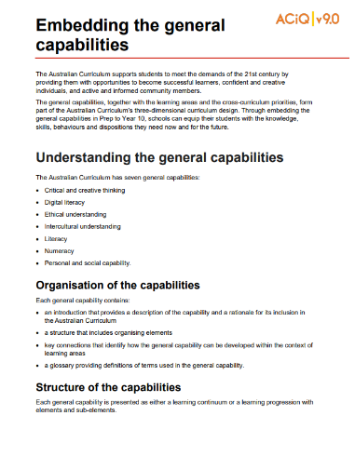
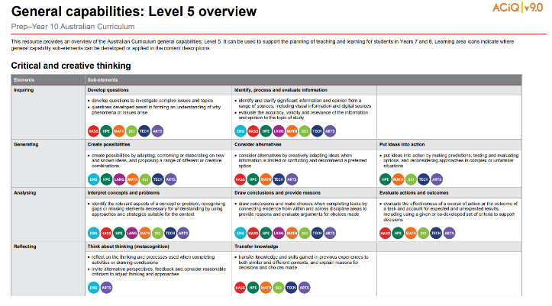
General capabilities advice and resources
www.qcaa.qld.edu.au/p-10/aciq/version-9/cross-curriculum-priorities
Notes:
The QCAA has resources that identify the connections the Australian Curriculum has made between learning areas and the general capabilities.
The general capability level overviews provide an overview of where each general capability can be developed or applied in the content descriptions of the learning areas. For example, the general capability Level 5 and Level 6 align with Years 7–10 learning areas.
The continua resources are available for the general capabilities:
critical and creative thinking
digital literacy
ethical understanding
intercultural understanding and,
personal and social capability.
There are resources available that provide a sequence of learning for the capability from Level 1 to Level 6. This can be helpful for teachers when catering for students with diverse needs.
The QCAA has advice documents to support teachers to use the Literacy and Numeracy progressions. These progressions provide observable indicators of increasing complexity in literacy and numeracy which can help teachers to develop targeted teaching and learning programs for students who are working at, above, and below year-level expectations.
These resources can support teaching teams to interrogate connections between the general capabilities and the learning area content in more detail.

Slide 22
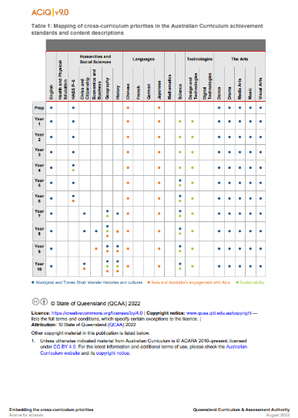
Cross-curriculum priorities advice and resources
www.qcaa.qld.edu.au/p-10/aciq/version-9/cross-curriculum-priorities
Notes:
The QCAA has resources to support schools with understanding how to connect the curriculum with cross-curriculum priorities.
Cross-curriculum priorities are incorporated through learning area content, in ways that are appropriate and authentic. The resources provide an overview of, as well as mapping across learning area and/or subject content descriptions and achievement standards to identify connections to each of the cross-curriculum priorities. ​

Slide 23
Glossary: Developing shared meanings
Terminology | Definition
Language features | Features that support meaning (e.g. clause- and word-level grammar, vocabulary, figurative language, punctuation, images). Choices vary for the purpose, subject matter, audience and mode or medium.
Source: Quoted verbatim and unaltered from ACARA www.v9.australiancurriculum.edu.au/downloads/learning-areas
Notes:
The glossary is useful for developing a shared understanding of terms used in the Australian Curriculum Version 9.0: English.
It provides definitions used in the curriculum, including terms or expressions used in the achievement standard to capture a number of related ideas.
For example, the term ‘language features’ in the achievement standard includes ‘clause- and word-level grammar, vocabulary, figurative language, punctuation, images.’
Source: Quoted verbatim and unaltered from ACARA www.v9.australiancurriculum.edu.au/downloads/learning-areas.

Slide 24
Outline
Introduction to Australian Curriculum v9.0
Understand this learning area
Formulating next steps
Curriculum elements

Slide 25
Organisation of English
Version 9.0
Understand this learning area
Introduction
Rationale
Aims
Structure
Key considerations
Key connections
Resources
Curriculum elements
Level description
Achievement standard
Strands and sub-strands
Content descriptions
Content elaborations
Level description
Achievement standard
Notes:
The English level description in the Curriculum elements section provides a high-level overview of the learning students should experience each year.
In Queensland, the achievement standard represents the C standard (or equivalent).
Source: Image created in house using SmartArt. Adapted from https://v9.australiancurriculum.edu.au/teacher-resources/understand-this-learning-area/english.

Slide 26
Level description: Structure and content
Considerations
Contexts for interaction
Text experiences
Range of literary texts
Characteristics of literary texts (reading/viewing)
Range of purposes for text creation
Notes:
Each level description has a consistent structure.
The information in the year level description provides useful context when reading the achievement standards and content descriptions.

Slide 27
English: Achievement standard structure
Version 8.4 | Version 9.0
Receptive modes (reading, viewing, listening) | Listening, speaking and creating
Productive Mode (writing, speaking, creating) | Reading and viewing
 | Writing and creating
Three paragraphs
Notes:
The organisation of the achievement standard in Version 9.0 has been revised.
The achievement standard now has three paragraphs:
one for listening, speaking and creating
one for reading and viewing, and
one for writing and creating.
Creating appears in the first and third paragraphs of the achievement standard, as creating can be seen as a process for spoken and/or written texts. The inclusion of multimodal texts in both paragraphs in many year levels reflects the changing nature of how individuals communicate.

Slide 28
Year 9 English: Achievement standard structure
By the end of Year 9, students interact with others, and listen to and create spoken and multimodal texts including literary texts. With a range of purposes and for audiences, they discuss and expand on ideas, shaping meaning and providing substantiation. They select and experiment with text structures to organise and develop ideas. They select and experiment with language features including literary devices, and experiment with multimodal features and features of voice.
Modes and texts
Purpose, audience and ideas
Text structure and organisation
Language and multimodal features
Source: Quoted verbatim and unaltered from AC https://v9.australiancurriculum.edu.au/f-10-curriculum/learning-areas/english/year-9?view=quick&detailed-content-descriptions=0&hide-ccp=0&hide-gc=0&side-by-side=1&strands-start-index=0&subjects-start-index=0
Notes:
Each paragraph of the achievement standard follows a consistent internal structure, across all year levels.
This example is the first of three paragraphs of the achievement standard for listening, speaking and creating in Year 9.
It is important for teachers to reflect on the whole paragraph when planning in English. That is, the text created for a mode is done so in consideration of the purpose, audience and ideas, text structure and organisation and language and multimodal features.

Slide 29
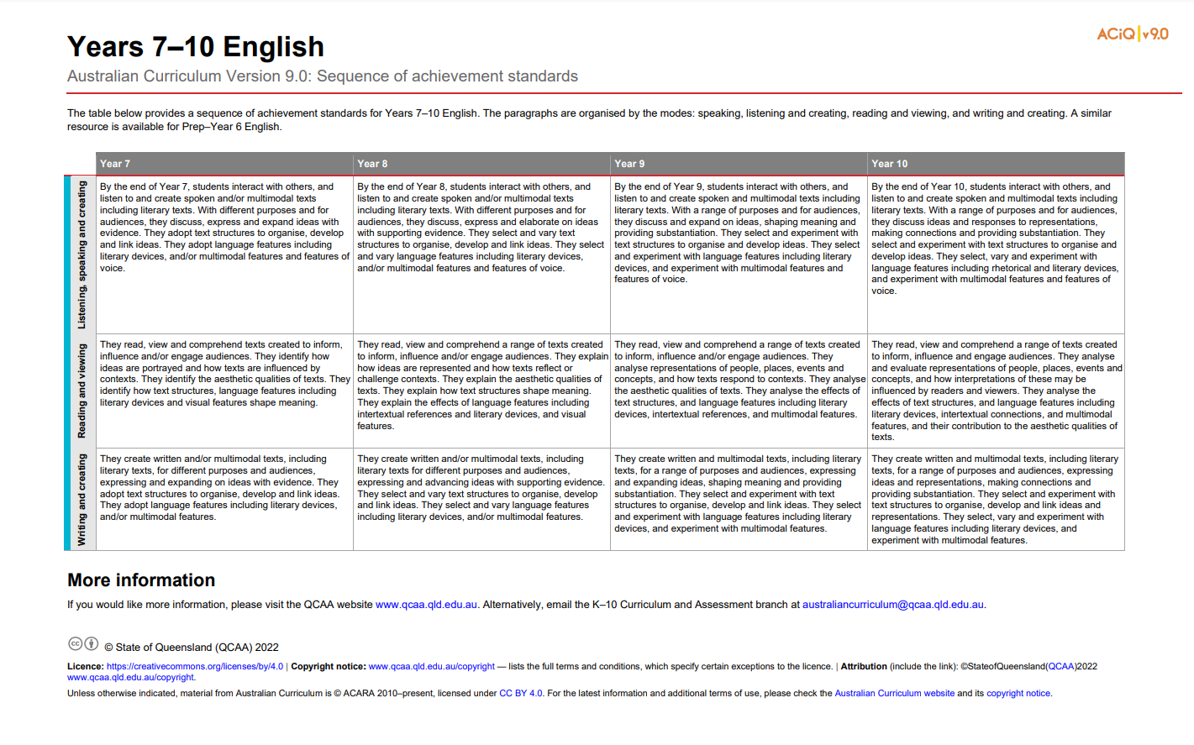
English: Achievement standard structure
www.qcaa.qld.edu.au/downloads/aciqv9/english/curriculum/ac9_english_yr7-10_as_sequence.pdf
Notes:
On the QCAA website, there is a resource illustrating the sequence of achievement standards from Years 7‒10. There is a similar resource for Prep–Year 6.

Slide 30
Organisation of English
Version 9.0
Understand this learning area
Introduction
Rationale
Aims
Structure
Key considerations
Key connections
Resources
Curriculum elements
Level description
Achievement standard
Strands and sub-strands
Content descriptions
Content elaborations
Strands and sub-strands
Content descriptions
Content elaborations
Notes:
The final section of Curriculum elements provides further information regarding the content descriptions in the strands and sub-strands which inform teaching and learning and assessment.
Content descriptions specify the knowledge, understanding and skills that students learn and that teachers are expected to teach. The content elaborations provide optional examples of how to teach the content descriptions.
Source: Image created in house using SmartArt. Adapted from https://v9.australiancurriculum.edu.au/teacher-resources/understand-this-learning-area/english.

Slide 31
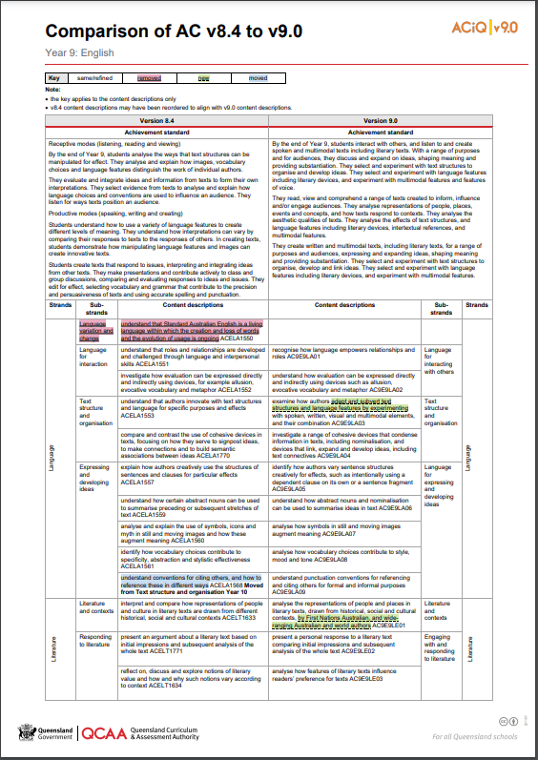
Comparison of AC v8.4 to v9.0 documents
One document for each year level is available on the QCAA website.
www.qcaa.qld.edu.au/downloads/aciqv9/english/curriculum/ac9_english_yr9_comp.pdf
Notes:
The comparison documents show the changes to the content descriptions for English.

Slide 32
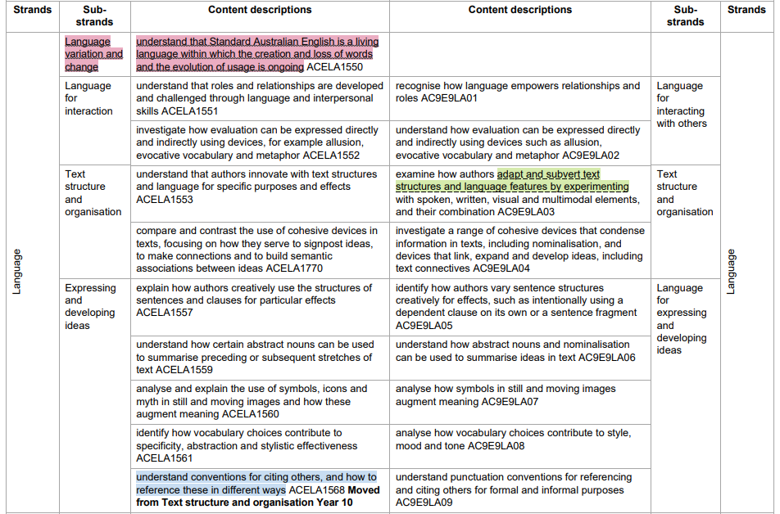
Colour-coded changes between v8.4 and v9.0
Notes:
A key is used to show the changes from Version 8.4 to Version 9.0.
Examples from the Year 9 English curriculum will be used to show the changes.

Slide 33
Same/refined content
Notes:
If something has been refined from Version 8.4, it does not appear in colour.
For example, in Version 8.4 the content description was: 'compare and contrast the use of cohesive devices in texts, focusing on how they serve to signpost ideas, to make connections and to build semantic associations between ideas’.
Whereas, in Version 9.0, the content description has been refined to: 'investigate a range of cohesive devices that condense information in texts, including nominalisation, and devices that link, expand and develop ideas, including text connectives’.

Slide 34
Removed content
Notes:
If a content description or part of a content description has been removed from Version 8.4 and no longer appears in Version 9.0, it has been highlighted in red.
For this example, 'Language variation and change' has been removed.

Slide 35
New content
Notes:
If a new content description has been added to Version 9.0, it has been highlighted in green.
In this instance, 'adapt and subvert text structures and language features by experimenting’ has been added. This addition is also reflected in the achievement standard.

Slide 36
Moved content
Notes:
If a content description has moved year levels from Version 8.4 to Version 9.0, it has been highlighted in blue. There is also a bold note to indicate the year level from which it has moved.
For example, 'understand conventions for citing others, and how to reference these in different ways' has been moved from the sub-strand Text structure and organisation in Year 10, allowing teachers to include citing others and referencing earlier in Year 9.

Slide 37
Outline
Introduction to Australian Curriculum v9.0
Understand this learning area
Formulating next steps
Curriculum elements

Slide 38
Australian Curriculum in Queensland (ACiQ) v9.0 webpages
QCAA website www.qcaa.qld.edu.au/p-10/aciq
Notes:
Resources to support the Australian Curriculum Version 9.0 can be found within the Australian Curriculum in Queensland Version 9.0 webpages.
These webpages only include resources that have been created or updated to align with Version 9.0.
Source: Screenshot is from QCAA website www.qcaa.qld.edu.au/p-10/aciq.

Slide 39
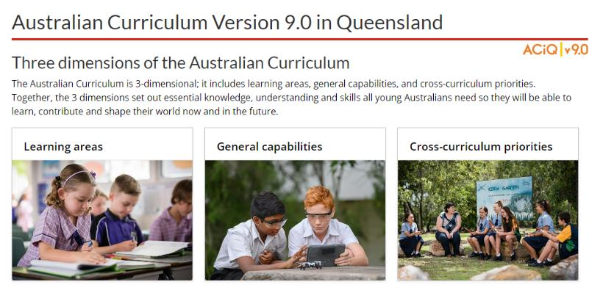
The ACiQ v9.0 webpages
These webpages house advice and resources to support the three dimensions of the Australian Curriculum:
Learning areas
General capabilities
Cross-curriculum priorities.
Notes:
The Version 9.0 webpages support familiarisation with all three dimensions of the curriculum.
Teachers can access advice and resources for their learning area and/or subject, or the general capabilities, and the cross-curriculum priorities.
Source: Screenshot is from QCAA website www.qcaa.qld.edu.au/p-10/aciq/version-9.

Slide 40
Examples of QCAA resources for English
Comparison of AC v8.4 to v9.0 (P–10)
Sequence of achievement standards
Sequence of content descriptions
Achievement standard aligned to content descriptions (P–10)
Prepopulated curriculum and assessment plans
Assessment techniques and conditions (P–10)
Standards elaborations
Standards elaborations: glossary of qualifiers
QCAA P–10 Planning app
Notes:
On screen is a snapshot of some of the English resources. These resources have been hyperlinked in the slide.

Slide 41
Learning goal
Understand the implications of changes in the Years 7–10 Australian Curriculum from v8.4 to v9.0: English for planning.
Success criteria
You will know you are successful if you:
have more knowledge about the intent and structure of the Years 7–10 Australian Curriculum v9.0: English
can identify actions for planning in your school.

Slide 42
Contact
K–10 Curriculum and Assessment Branch​ ​
T +61 7 3120 6102
E australiancurriculum@qcaa.qld.edu.au
W www.qcaa.qld.edu.au
Notes:
If you have any queries regarding Australian Curriculum v9.0: English, please contact the K-10 Curriculum and Assessment Branch.
​

Slide 43
References
Australian Curriculum, Assessment and reporting Authority 2013, The Shape of the Australian Curriculum Version 4.0, www.docs.acara.edu.au/resources/The_Shape_of_the_Australian_Curriculum_v4.pdf.

Slide 44
Acknowledgments
Third-party copyright material, and QCAA material not covered by the CC BY licence is listed below:
Queensland Government coat of arms, and the QCAA and QSA trademarks may not be reproduced without permission.
Unless otherwise indicated, material from Australian Curriculum is © ACARA 2010–present, licensed CC BY 4.0. For the latest information and additional terms of use, see the Australian Curriculum website and its copyright notice.
Acknowledgment of Country artwork (2023) ‘Growth through Learning’ by Chern’ee, Brooke and Jesse Sutton, Kalkadoon. www.cherneesutton.com.au
Student and staff images have been used with permission.
The three-dimensional curriculum diagram and glossary are 'Excluded Material' used under the terms of the Australian Curriculum and its copyright notice and not modified. © Australian Curriculum, Assessment and Reporting Authority (ACARA) 2009 to present, unless otherwise indicated. You may view, download, display, print, reproduce (such as by making photocopies) and distribute these Excluded Materials in unaltered form only for your personal, non-commercial educational purposes or for the non-commercial educational purposes of your organisation, provided that you make others aware it can only be used for these purposes and attribute ACARA as the source of the Excluded Material. For the avoidance of doubt, this means that you cannot edit, modify or adapt any of these materials, and you cannot sub-licence any of these materials to others. Apart from any uses permitted under the Copyright Act 1968 (Cth), and those explicitly granted above, all other rights are reserved by ACARA.

Slide 45
Copyright notice
© State of Queensland (QCAA) 2024
Licence: https://creativecommons.org/licenses/by/4.0 | Copyright notice: www.qcaa.qld.edu.au/copyright — lists the full terms and conditions, which specify certain exceptions to the licence. | Attribution: © State of Queensland (QCAA) 2024 www.qcaa.qld.edu.au/copyright.
Other copyright material in this presentation is listed on the previous slide/s.

Slide 46
QCAA social media
Notes:
If you don’t do so already, we recommend you follow QCAA on one or more social media platforms to stay in touch with us, and to find out about upcoming resources and professional learning.

