Slide 1
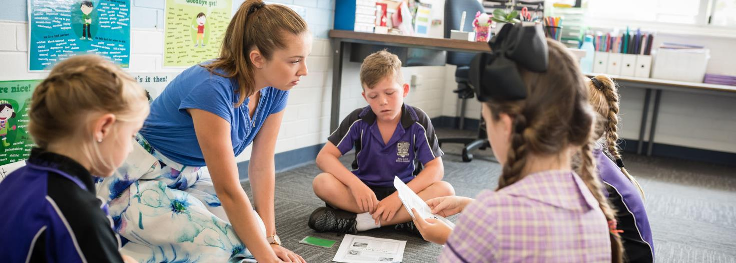
Years 3–6: Planning for and assessing reading
Australian Curriculum v9.0: English
Notes:
This resource reproduces the key slides from the webinar delivered in 2024.
For more information, please email australiancurriculum@qcaa.qld.edu.au.
Source: Image: 171030QCAA_BBSS_049_Webshot.jpg

Slide 2
Acknowledgment of Country

Slide 3
Learning goal
Success criteria
To understand how reading is represented in the Australian Curriculum v9.0: English and consider ways to plan for and assess reading in Years 3–6.
You will know you are successful if you are more familiar with planning for and assessing reading in Years 3–6, using the Australian Curriculum v9.0: English.

Slide 4
Outline
Planning for reading in Years 3–6 English
Assessing reading in Years 3–6 English

Slide 5
Australian Curriculum v9.0: English
Understand this learning area
Introduction
Rationale
Aims
Structure
Key considerations
Key connections
Resources including glossary
Version 9.0
Curriculum elements
Level description by year
Achievement standard
Strands and sub-strands
Content descriptions
Content elaborations
Notes:
The Australian Curriculum v9.0: English is organised into two parts:
Understand this learning area, which includes the introduction, aims, structure, key considerations, key connections and resources, e.g. the English glossary
and
Curriculum elements, which includes level descriptions (by year), achievement standard, strands and sub-strands, content descriptions.
Source: Image created in house using SmartArt. Adapted from English ‘About the learning area’. For example: https://v9.australiancurriculum.edu.au/teacher-resources/understand-this-learning-area/english

Slide 6
The English curriculum aims to ensure that students:
1. Learn to purposefully and proficiently read, view, listen to, speak, write, create and reflect on increasingly complex texts across a growing range of contexts.
2. Understand how Standard Australian English works in its spoken and written forms, and in combination with non-linguistic forms of communication, to create meaning.
3. Develop interest and skills in examining the aesthetic aspects of texts and develop an informed appreciation of literature.
4. Appreciate, enjoy, analyse, evaluate, adapt and use the richness and power of the English language in all its variations to evoke feelings, form ideas and facilitate interaction with others.
Source: Quoted verbatim and unaltered from the AC: https://v9.australiancurriculum.edu.au/teacher-resources/understand-this-learning-area/english
Notes:
The English curriculum has four aims. The first is an overarching aim.
These aims outline knowledge, skills and dispositions that we want all students to develop in English.
The development of student reading represented in the Australian Curriculum V9.0: English reflects the evidence-base at the time the curriculum was reviewed.
The specific elements of the aims that are important for reading are highlighted in blue.
Through the teaching of English, we want students to be able to
read increasingly complex texts purposefully and proficiently
use Standard Australian English to create meaning, but also appreciate the richness and power of English in all its variations
develop an informed appreciation of literary texts, e.g. picture books, fictional narratives, poetry, rhymes, animations and non-fiction literature.
Source: Adapted from: https://v9.australiancurriculum.edu.au/teacher-resources/understand-this-learning-area/english

Slide 7
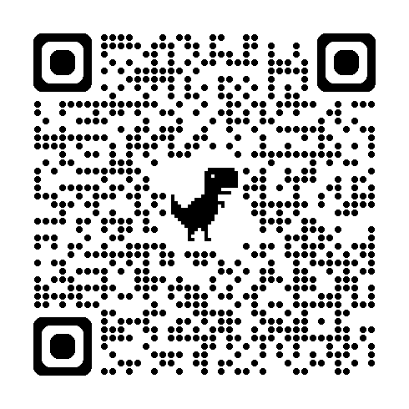
Definition of ‘read’: English glossary
To decode and process words, symbols or actions to derive or construct meaning. It includes interpreting, critically analysing and reflecting on the meaning of written, visual, print and non-print texts.
Source: Quoted verbatim and unaltered from the AC: https://v9.australiancurriculum.edu.au/downloads/learning-areas#accordion-b71b085f07-item-49001e70bc
Notes:
The Australian Curriculum English glossary defines the term read as ‘To decode and process words, symbols or actions to derive or construct meaning. It includes interpreting, critically analysing and reflecting on the meaning of written, visual, print and non-print texts.’
The glossary defines the word decode as ‘A process of efficient word recognition in which readers use knowledge of the relationship between letters and sounds to work out how to say and read written words.’
The purpose of decoding, in conjunction with the processing of words, symbols and actions, is to ‘derive or construct meaning’.
Therefore, while students consolidate prior learning of many constrained skills (especially in Years 3 and 4) and continue to read with increasing automaticity, they simultaneously build their comprehension of written, visual, print and non-print texts.
By Years 5 and 6, the focus of reading is on supporting students to derive and construct meaning from the texts they read as the achievement standard does not require explicit assessment of decoding skills in these later primary years.
It is recognised that some students will continue to need support to decode. The Australian Curriculum v9.0: English is recursive and cumulative so where needed teachers will teach the appropriate content descriptions from earlier years to strengthen decoding.

Slide 8
Strands and sub-strands: Reading and viewing
Version 9.0 | (Header row)
Language | Literature | Literacy
Language for interacting with others | Literature and contexts | Texts in context
Text structure and organisation | Engaging with and responding to literature | Interacting with others
Language for expressing and developing ideas | Examining literature | Analysing, interpreting and evaluating
 | Creating literature | Creating texts
 |  | Phonic and word knowledge (P–6) Word knowledge (7–10)
Notes:
Content descriptions specifically related to reading can be found in two sub-strands in the Literacy strand: Analysing, interpreting and evaluating texts and Phonic and word knowledge.
Building on learning in Prep to Year 2, detail in the content descriptions in these two strands continues to develop understanding and skills as students engage with increasingly complex texts, and texts from across learning areas.
Content descriptions from the sub-strands can be planned for and taught explicitly. Teachers may identify some students who may require specific, continuing support in reading and, in particular, in decoding.

Slide 9
Level description: Year 3
Recursive and cumulative
Text experiences (reading, viewing & listening)
Range of text purposes (writing, speaking & creating)
Language and other features
Notes:
The level description provides information specific to a particular year level, e.g. Year 3.
You may use the level descriptions to better understand the complexity and depth of content about reading found in the content descriptions in the strands and sub-strands, e.g. the level description provides information about:
the English curriculum being recursive and cumulative (light orange)
text experiences (green)
language and other features (blue)
the range of text purposes related to the texts students may create (purple).

Slide 10
Years 3–6 level descriptions
Year 3 | Year 4 | Year 5 | Year 6
Students engage with a variety of texts for enjoyment. | (Body row) |  | 14 pt
Notes:
There are common references across the level descriptions, e.g. across Years 3–6, the English curriculum states that ‘students engage with a variety of texts for enjoyment’.
Engaging with texts for enjoyment is extended when students can read fluently and accurately, with automaticity, to support comprehending to derive meaning.

Slide 11
Texts read, viewed and listened to may include …
Year 3 | Year 4 | Year 5 | Year 6
oral texts, picture books, various types of print and digital texts, chapter books, rhyming verse, poetry, non-fiction, film, multimodal texts, dramatic performances … | oral texts, picture books, various types of print and digital texts, short novels of different genres, rhyming verse, poetry, non-fiction, film, multimodal texts, dramatic performances … | film and digital texts, novels, poetry, non-fiction and dramatic performances. | film and digital texts, novels, poetry, non-fiction and dramatic performances.
Source: https://v9.australiancurriculum.edu.au/f-10-curriculum/learning-areas/english/year-3_year-4_year-5_year-6?view=quick&detailed-content-descriptions=0&hide-ccp=0&hide-gc=0&side-by-side=1&strands-start-index=0&subjects-start-index=1
Notes:
Additional information is provided across the Years 3–6 level descriptions about the range of texts that students may read, view and listen to.
The development from Years 3–6 is highlighted in blue. Students begin with chapter books, moving on to short novels of different genres in Year 4, and then reading novels in Years 5 and 6.
As a result, when choosing texts, consider the range and balance, as well as the development across the years.

Slide 12
Authors and illustrators
Texts are drawn from the works of a wide range of authors and illustrators.
They may include First Nations and wide-ranging Australian and world authors and illustrators.
Notes:
The range of texts will also be selected based on the variety of authors and illustrators with whom students might engage. They may include First Nations and wide-ranging Australian and world authors and illustrators.
Image of globe: geralt at Pixabay, https://pixabay.com/illustrations/globe-continents-latitude-earth-868846/

Slide 13
Development of features in texts
Year 3
Year 4
Year 5
Year 6
Events
(fiction)
Content
(non-fiction)
Language features
Vocabulary
Notes:
The level descriptions also provide advice about the features and qualities of texts that are typically appropriate at specific year levels.
Across Years 3–6, you will find information about the types of events and age-appropriate content, as well as typical language features and vocabulary evident in texts.
To illustrate this, we will explore events across Years 3–6.

Slide 14
Progression of events in literary texts
Year 3 | Year 4 | Year 5 | Year 6
events that extend over several pages, unusual happenings within a framework of familiar experiences and may include images that extend meaning. | sequences of events that develop over chapters and unusual happenings within a framework of familiar experiences. | complex sequences of events, elaborated events including flashbacks and shifts in time, and a range of characters. | elaborated events including flashbacks and shifts in time, and a range of less predictable characters.
Source: https://v9.australiancurriculum.edu.au/f-10-curriculum/learning-areas/english/year-3_year-4_year-5_year-6?view=quick&detailed-content-descriptions=0&hide-ccp=0&hide-gc=0&side-by-side=1&strands-start-index=0&subjects-start-index=0
Notes:
In Year 3, literary texts with which students engage will typically ‘describe events that extend over several pages, unusual happenings within a framework of familiar experiences and may include images that extend meaning.’
By Year 6, texts include, ‘elaborated events including flashbacks and shifts in time, and a range of less predictable characters.’
Source: https://v9.australiancurriculum.edu.au/f-10-curriculum/learning-areas/english/year-3_year-4_year-5_year-6?view=quick&detailed-content-descriptions=0&hide-ccp=0&hide-gc=0&side-by-side=1&strands-start-index=0&subjects-start-index=0

Slide 15
Year 3 English
Language
AC9E3LA02: understand how the language of … emotion … can be varied to be more or less forceful.
Literacy
AC9E3LY05: use comprehension strategies … to build literal and inferred meaning …
Chapter book
Literature
AC9E3LE03: discuss how an author uses language … to portray characters … in texts …
Notes:
Taking into account the advice in the level description, students in Year 3 may read a chapter book describing unusual happenings within the framework of a familiar experience, e.g. a graphic novel with chapters about alligators that solve crimes.
The texts may contain images and language features (e.g. some unfamiliar vocabulary), varied sentence structure, and a variety of punctuation.
To support students to read the text independently, teachers may plan a unit using the content descriptions from all three strands.
The teacher may use one example from each strand (as illustrated) to focus explicitly on how the author has used language to portray characters.
The language focus could be on the use of the language of emotion and how it can be varied to be more or less forceful, e.g. why a character in a graphic novel is described as a villain rather than just a bad person.
With this knowledge, students may be better prepared to monitor meaning and reflect critically to build both literal and inferred meaning as they read.
Source: book cover by cheifyc at Pixabay, https://pixabay.com/vectors/book-book-cover-cover-blank-438935/

Slide 16
Year 6 English
Language
AC9E6LA05: understand how embedded clauses can expand the variety of complex sentences ...
Literacy
AC9E6LY03: analyse how text structures and language features work together to … engage … audiences.
Novel
Literature
AC9E6LE03: identify and explain characteristics that define an author’s individual style.
Notes:
The same interrelated nature of the three English strands is illustrated here.
In this Year 6 example, students may independently read a novel with elaborated events based around an ethical dilemma for a character that includes flashbacks and shifts in time.
These more complex texts allow students to engage with the more complex content descriptions in the English Language, Literature and Literacy strands.
Source: https://pixabay.com/vectors/notepad-book-cover-library-orange-155977/

Slide 17
Today’s outline
Planning for reading in Years 3–6 English
Assessing reading in Years 3–6 English

Slide 18
Achievement standards: Compared
Year 3
By the end of Year 3, students interact with others, and listen to and create spoken and/or multimodal texts including stories. They relate ideas; express opinion, preferences and appreciation of texts; and include relevant details from learnt topics, topics of interest or texts. They group, logically sequence and link ideas. They use language features including topic-specific vocabulary, and/or visual features and features of voice.
They read, view and comprehend texts, recognising their purpose and audience. They identify literal meaning and explain inferred meaning. They describe how stories are developed through characters and/or events. They describe how texts are structured and presented. They describe the language features of texts including topic-specific vocabulary and literary devices, and how visual features extend meaning. They read fluently, using phonic, morphemic and grammatical knowledge to read multisyllabic words with more complex letter patterns.
They create written and/or multimodal texts including stories to inform, narrate, explain or argue for audiences, relating ideas including relevant details from learnt topics, topics of interest or texts. They use text structures including paragraphs, and language features including compound sentences, topic-specific vocabulary and literary devices, and/or visual features. They write texts using letters that are accurately formed and consistent in size. They spell multisyllabic words using phonic and morphemic knowledge, and high-frequency words.
Year 4
By the end of Year 4, students interact with others, and listen to and create spoken and/or multimodal texts including stories. They share and extend ideas, opinions and information with audiences, using relevant details from learnt topics, topics of interest or texts. They use text structures to organise and link ideas. They use language features including subjective and objective language, topic-specific vocabulary and literary devices, and/or visual features and features of voice.
They read, view and comprehend texts created to inform, influence and/or engage audiences. They describe how ideas are developed including through characters and events, and how texts reflect contexts. They describe the characteristic features of different text structures. They describe how language features including literary devices, and visual features shape meaning. They read fluently and accurately, integrating phonic, morphemic, grammatical and punctuation knowledge.
They create written and/or multimodal texts including stories for purposes and audiences, where they develop ideas using details from learnt topics, topics of interest or texts. They use paragraphs to organise and link ideas. They use language features including complex sentences, topic-specific vocabulary and literary devices, and/or visual features. They write texts using clearly formed letters with developing fluency. They spell words including multisyllabic and multimorphemic words with irregular spelling patterns, using phonic, morphemic and grammatical knowledge.
Notes:
The achievement standards indicate what students should know and do by the end of the respective year levels.
The reading and viewing paragraphs of the Year 3 and Year 4 Australian Curriculum v9.0: English achievement standards are highlighted in blue.
The reading and viewing paragraph is always the second of the three achievement standard paragraphs.

Slide 19
Achievement standards: Compared
Year 3
They read, view and comprehend texts, recognising their purpose and audience. They identify literal meaning and explain inferred meaning. They describe how stories are developed through characters and/or events. They describe how texts are structured and presented. They describe the language features of texts including topic-specific vocabulary and literary devices, and how visual features extend meaning. They read fluently, using phonic, morphemic and grammatical knowledge to read multisyllabic words with more complex letter patterns.
Year 4
They read, view and comprehend texts created to inform, influence and/or engage audiences. They describe how ideas are developed including through characters and events, and how texts reflect contexts. They describe the characteristic features of different text structures. They describe how language features including literary devices, and visual features shape meaning. They read fluently and accurately, integrating phonic, morphemic, grammatical and punctuation knowledge.
Notes:
The first section of the paragraph (highlighted in blue) outlines the knowledge and skills students are expected to demonstrate when reading and viewing to make meaning or comprehend.

Slide 20
Achievement standards: Compared
Year 3
They read, view and comprehend texts, recognising their purpose and audience. They identify literal meaning and explain inferred meaning. They describe how stories are developed through characters and/or events. They describe how texts are structured and presented. They describe the language features of texts including topic-specific vocabulary and literary devices, and how visual features extend meaning. They read fluently, using phonic, morphemic and grammatical knowledge to read multisyllabic words with more complex letter patterns.
Year 4
They read, view and comprehend texts created to inform, influence and/or engage audiences. They describe how ideas are developed including through characters and events, and how texts reflect contexts. They describe the characteristic features of different text structures. They describe how language features including literary devices, and visual features shape meaning. They read fluently and accurately, integrating phonic, morphemic, grammatical and punctuation knowledge.
Notes:
Students continue to demonstrate phonic and word knowledge (light orange).
This is supported by content descriptions in the Phonic and word knowledge sub-strand of the Literacy strand.
Notice that by the end of Year 4, students should be able to ‘read fluently and accurately, integrating phonic, morphemic, grammatical and punctuation knowledge.’

Slide 21
Achievement standards: Compared
Year 5
They read, view and comprehend texts created to inform, influence and/or engage audiences. They explain how ideas are developed including through characters, settings and/or events, and how texts reflect contexts. They explain how characteristic text structures support the purpose of texts. They explain how language features including literary devices, and visual features contribute to the effect and meaning of a text.
Year 6
They read, view and comprehend different texts created to inform, influence and/or engage audiences. They identify similarities and differences in how ideas are presented and developed including through characters, settings and/or events, and how texts reflect contexts. They identify how texts have similar and different text structures to reflect purpose. They explain how language features including literary devices, and visual features influence audiences.
Notes:
In Years 5–6, there are no requirements in the achievement standard to explicitly assess and report on students’ developing phonic and word knowledge to read fluently and accurately.
However, fluency in phonic and word knowledge is required to make meaning or comprehend. The phonic and word knowledge content descriptions still appear in the Literacy strand, with an emphasis on using this knowledge to read and spell.
As English is recursive, teachers may find that some students in Years 5–6 require on-going monitoring and support with their phonic and word knowledge in order to decode with sufficient automaticity to read and comprehend.

Slide 22
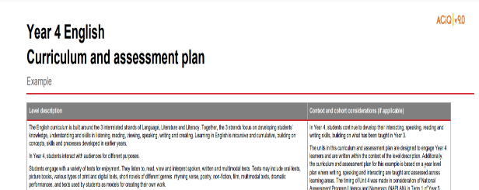
Year 4 Unit 1: Example assessment
Term 1
Beyond the pages
Notes:
To illustrate assessing reading in Years 3–4, we will refer to the Year 4 example curriculum and assessment plans on the QCAA website.
Unit 1 culminates in a written review and an observed demonstration of students’ phonic and word knowledge.
Assessment tasks 1 and 2 assess different aspects of the definition of reading, as well as how students demonstrate aspects of the Year 4 achievement standard for reading and viewing.

Slide 23
Alignment: Assessment 1
Achievement standard:
Written review (extended response):
They read, view and comprehend texts created to inform, influence and/or engage audiences. They describe how ideas are developed including through characters and events, and how texts reflect contexts. They describe the characteristic features of different text structures. They describe how language features including literary devices, and visual features shape meaning. They read fluently and accurately, integrating phonic, morphemic, grammatical and punctuation knowledge.
Students select and read an illustrated story of their choice, e.g. picture book or graphic novel. For an audience of peers, they write a review to offer their opinion about aspects of the book, e.g. development of ideas through characters and events, characteristics of narrative structure, use of language and/or visual features.
Notes:
Assessment task 1 (a written review) focuses on students’ comprehension (making meaning), as they offer opinions about aspects of the text, including:
the development of ideas through characters and events
characteristics of narrative structure
use of language and/or visual features.
A written review will also provide students with the opportunity to demonstrate aspects of the achievement standard for writing and creating. There is more information about this aspect in the full curriculum and assessment plan on the QCAA website.

Slide 24
Alignment: Assessment 2
Achievement standard:
Observed demonstration:
They read, view and comprehend texts created to inform, influence and/or engage audiences. They describe how ideas are developed including through characters and events, and how texts reflect contexts. They describe the characteristic features of different text structures. They describe how language features including literary devices, and visual features shape meaning. They read fluently and accurately, integrating phonic, morphemic, grammatical and punctuation knowledge.
Students read a short passage from a teacher-selected text to demonstrate they can read fluently and accurately, integrating phonic, morphemic, grammatical and punctuation knowledge. This task complements other, on-going formative assessment of students' fluency and accuracy.
Notes:
Assessment 2 (reading) provides students with an opportunity to demonstrate the use of knowledge to read fluently and accurately.
Students may demonstrate this by reading a short passage from a teacher-selected text in Unit 1.
This summative assessment opportunity complements other, on-going formative assessment to support teaching and learning.

Slide 25
Year 6 Unit 3: Example of assessment
Term 3
Tales and tunes
Notes:
To illustrate assessing reading in Years 5–6, we will refer to the Year 6 example curriculum and assessment plan on the QCAA website.
In the first part of Unit 3 Tales and tunes, students read stories and song lyrics and then interact in small groups to discuss the relationship between stories and lyrics.
In the second part of the unit, students use what they have learnt in Part A to create a persuasive speech.
Each part has its own assessment with the Part B assessment building on Part A.

Slide 26
Unit 3 Tales and tunes assessment
Interacting task
Students interact with others in a fishbowl discussion, explaining and elaborating on an appropriate song relevant to the ideas, setting, characters and/or events in selected chapters
Persuasive spoken task
Students create and deliver a pitch in which they persuade a director to use a particular song for a trailer for a film version of the novel. Students use comprehension strategies (e.g. prior knowledge) to connect and compare content from the class discussion in Part A.
Notes:
In Part A, students draw on content from the Literature strand and interact with others to explain and elaborate on a song relevant to the ideas, setting, characters and/or events in selected chapters in one or more stories studied.
The interaction can occur as part of planned, small group discussions in class.
Through this task, students develop the understanding and ideas they need for the assessment task in Part B.

Slide 27
Unit 3 Tales and tunes assessment
Interacting task
Students interact with others in a fishbowl discussion, explaining and elaborating on an appropriate song relevant to the ideas, setting, characters and/or events in selected chapters
Persuasive spoken task
Students create and deliver a pitch in which they persuade a director to use a particular song for a trailer for a film version of the novel. Students use comprehension strategies (e.g. prior knowledge) to connect and compare content from the class discussion in Part A.
Notes:
In the Part B assessment task, students create and deliver a pitch to persuade a director to use a particular song as part of a trailer for a film version of the novel.
In creating the pitch, students will use comprehension strategies to connect and compare content from the earlier class discussions (Part A), i.e. content drawn from the Literacy strand.
In this task, rather than simply repeating what they have already learnt, students have the opportunity to develop their understanding and correct any previous misunderstandings.
Years 5–6 teachers may need to continue monitoring and supporting selected students’ development of accuracy and fluency in reading.

Slide 28
Further support in teaching reading
How else may we support our Years 3–6 students in the development of their reading skills?

Slide 29
Literacy general capability
Source: AC image from Summary overview (video) https://v9.australiancurriculum.edu.au/help/website-tour
Notes:
The Literacy general capability is a key connection in English and complements the teaching of reading by providing fine-grained description of the indicators of literacy development.
Script and picture adapted (addition of labels) from video at https://v9.australiancurriculum.edu.au/help/website-tour (time stamp: 50 seconds)

Slide 30
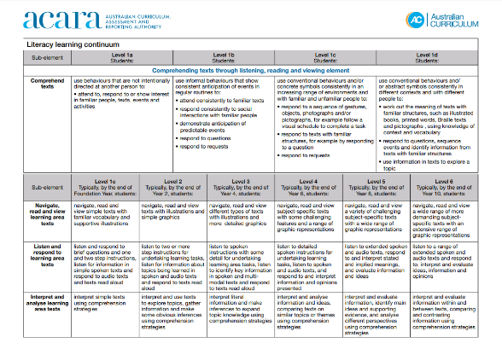
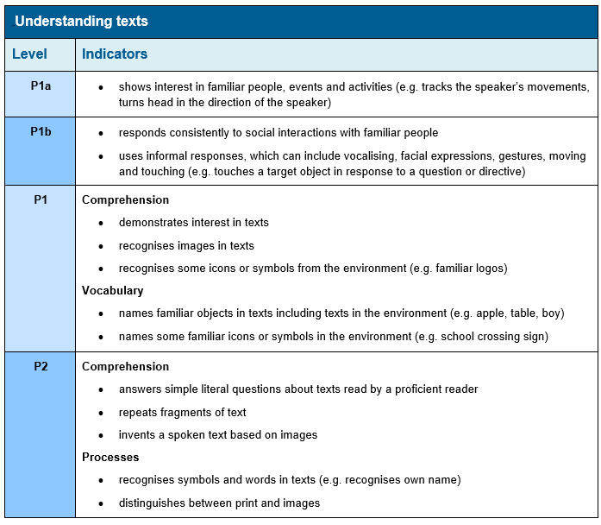
Literacy general capability: Change
v8.4:continua
v9.0: progressions
Source: Reproduced in unaltered form from https://www.australiancurriculum.edu.au/media/3596/general-capabilities-literacy-learning-continuum.pdf and https://v9.australiancurriculum.edu.au/downloads/general-capabilities#accordion-afa194f119-item-6336db4ee7
Notes:
A significant change from v8.4 to v9.0 is that the continua in v8.4 have been replaced by progressions.
These progressions are connected to the related content descriptions in the Australian Curriculum V9.0: English and can be used to assist teachers in responding to students’ particular literacy needs.
Progressions are provided for the elements of speaking and listening, reading and viewing, writing.
Source v8.4 Literacy continuum: https://www.australiancurriculum.edu.au/media/3596/general-capabilities-literacy-learning-continuum.pdf
Source v9.0 Literacy general capability: https://v9.australiancurriculum.edu.au/downloads/general-capabilities#accordion-afa194f119-item-6336db4ee7

Slide 31
QCAA resources: Literacy general capability v9.0
Notes:
To find out more about the Literacy general capability and how it may be used to support reading and other elements of literacy, you can access these QCAA resources on our website.

Slide 32
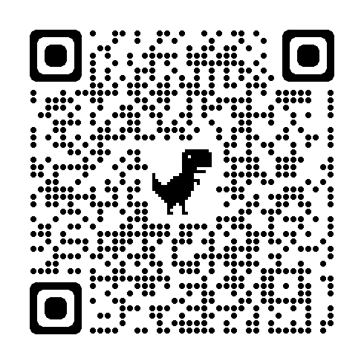
QCAA reading and viewing resources
Notes:
Reading and viewing resources are available from the QCAA website, supporting the Understanding texts sub-element.
Resources include factsheets, accompanied by templates, which cover a range of strategies you can use in the classroom.

Slide 33
Learning goal
Success criteria
To understand how reading is represented in the Australian Curriculum v9.0: English and consider ways to plan for and assess reading in Years 3–6.
You will know you are successful if you are more familiar with planning for and assessing reading in Years 3–6, using the Australian Curriculum v9.0: English.

Slide 34
Acknowledgments
Third-party copyright material, and QCAA material not covered by the CC BY licence is listed below:
Queensland Government coat of arms, and the QCAA and QSA trademarks may not be reproduced without permission.
Acknowledgment of Country artwork (2023) ‘Growth through Learning’ by Chern’ee, Brooke and Jesse Sutton, Kalkadoon. www.cherneesutton.com.au
Student and staff images have been used with permission
Unless otherwise indicated, material from Australian Curriculum is © ACARA 2010–present, licensed CC BY 4.0. For the latest information and additional terms of use, see the Australian Curriculum website and its copyright notice.
The ACARA three-dimension cube and the glossary are 'Excluded Material’, extracts from ‘Understanding this learning area’, definitions from the ACARA glossary and images from the Literacy general capability are used under the terms of the Australian Curriculum and its copyright notice and are not modified. © Australian Curriculum, Assessment and Reporting Authority (ACARA) 2009 to present, unless otherwise indicated. You may view, download, display, print, reproduce (such as by making photocopies) and distribute these Excluded Materials in unaltered form only for your personal, non-commercial educational purposes or for the non-commercial educational purposes of your organisation, provided that you make others aware it can only be used for these purposes and attribute ACARA as the source of the Excluded Material. For the avoidance of doubt, this means that you cannot edit, modify or adapt any of these materials, and you cannot sub-licence any of these materials to others. Apart from any uses permitted under the Copyright Act 1968 (Cth), and those explicitly granted above, all other rights are reserved by ACARA. If you want to use such material in a manner that is outside this restrictive licence, you must request permission from ACARA by emailing (copyright@acara.edu.au).

Slide 35
Acknowledgments
Further third-party copyright material, and QCAA material not covered by the CC BY licence is listed below:
Image of world map: from Gerd Altmann (geralt) at Pixabay, https://pixabay.com/illustrations/globe-continents-latitude-earth-868846/. Used under terms of Pixabay license.
Image of blue book cover: from Chuck Herrera (cheifyc) on Pixabay, https://pixabay.com/vectors/book-book-cover-cover-blank-438935/. Used under terms of Pixabay license.
Image of orange book cover: from OpenClipart-Vectors at Pixabay, https://pixabay.com/vectors/notepad-book-cover-library-orange-155977/ Used under terms of Pixabay license.

Slide 36
Copyright notice
© State of Queensland (QCAA) 2025
Licence: https://creativecommons.org/licenses/by/4.0 | Copyright notice: www.qcaa.qld.edu.au/copyright — lists the full terms and conditions, which specify certain exceptions to the licence. | Attribution (include the link): © State of Queensland (QCAA) 2025 www.qcaa.qld.edu.au/copyright.
Other copyright material in this presentation is listed on the previous slide/s.

Slide 37
QCAA social media

